Slide 1
competent cells formation and transformation of competent cells with DNA.
2nd lab
BCH 462 [practical]

Slide 2
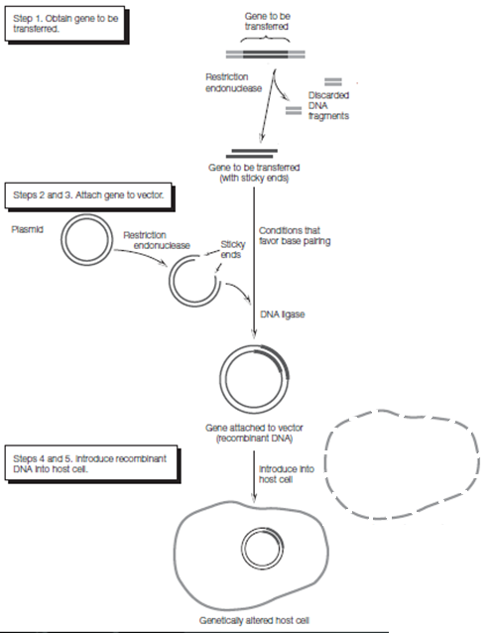

Slide 3
Overall Transformation Process
The plasmid vector must be cut with restriction endonuclease.
DNA ligase joins the DNA fragment and vector.
Host cell is made competent to take up the plasmid.
Transformed cells are grown on selection media.

Slide 4
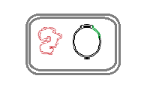
DNA cloning “cell based”
is a method of rapid isolation and amplification of DNA fragmaents
1
DNA fragment
cloning vector
Recombinant DNA
2
Recombinant DNA
the host
Transformed bacteria
3
Notes:
Cloning involves constriction of hybrid DNA molecules that are able to
self-replicate in a host cell , this is accomplished by :
1.Insertion of DNA fragments in to a cloning vector ”e.g. plasmid”.
2.Introducing a vector in to bacterial cells ” the host”.
3.Amplifying the vector DNA using bacterial DNA replication machinery.

Slide 5
Vector
Cloning Vector
Molecule of DNA to which the fragment of DNA to be cloned is joined .
Three features of all cloning vectors
* They must be capable of independent replication within the bacterial host cells
* They must contain at least one specific nucleotide sequence
recognized by restriction endonuclease
* They must contain at least selectable markers for drug
Resistance

Slide 6
Origin of replication
Anti-bacterial resistance gene.
e.g: ampicillin resistance gene.
Generally plasmid vectors should contain three important parts.

Slide 7
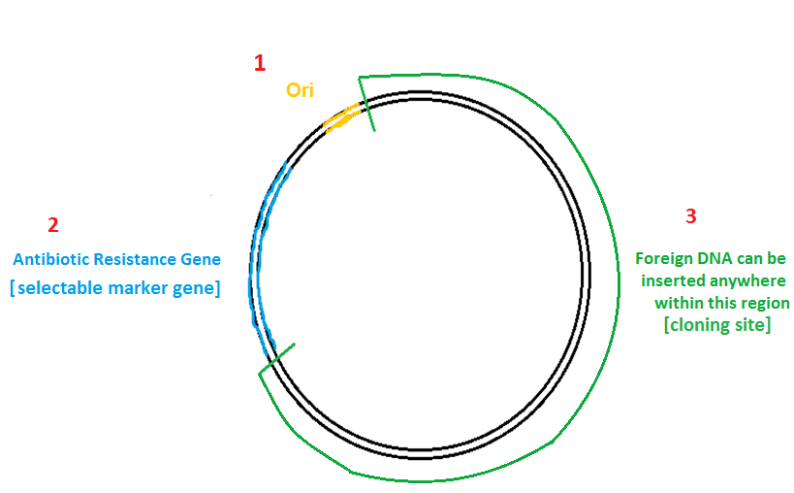
At least one
R.E recognition sites
EcoR1
Bam H1
e.g: ampicillin resistance gene
Hind III
Generally plasmid vectors should contain three important parts.

Slide 8
Cloning Vector Types
Plasmid: an extra chromosomal circular DNA molecule that autonomously replicates inside the bacterial cell; cloning limit: 100 to 10,000 base pairs or 0.1-10 kilobases (kb).
Phage: derivatives of bacteriophage lambda; linear DNA molecules, whose region can be replaced with foreign DNA without disrupting its life cycle; cloning limit: 8-20 kb.
Cosmids: an extra chromosomal circular DNA molecule that combines features of plasmids and phage; cloning limit - 35-50 kb.
Bacterial Artificial Chromosomes (BAC): based on bacterial
mini-F plasmids. cloning limit: 75-300 kb
Yeast Artificial Chromosomes (YAC): an artificial chromosome that contains telomeres, origin of replication, a yeast centromere, and a selectable marker for identification in yeast cells; cloning limit: 100-1000 kb

Slide 9
Competent
-It is the ability to undergo transformation which means the
ability of a cell to take the DNA from the environment.
Natural competence: a genetically specified ability of bacteria that is occur under natural condition.
Artificial competence: when cells in laboratory cultures are treated to be permeable to DNA

Slide 10
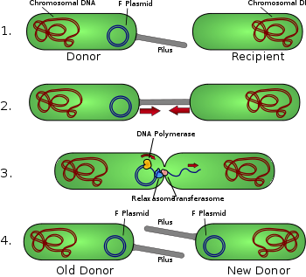
Bacteria can acquire new genetic information by:
1.During conjugation → direct contact.
Conjugation: DNA is transferred directly from one organism to another and it requires direct cell-cell contact.

Slide 11
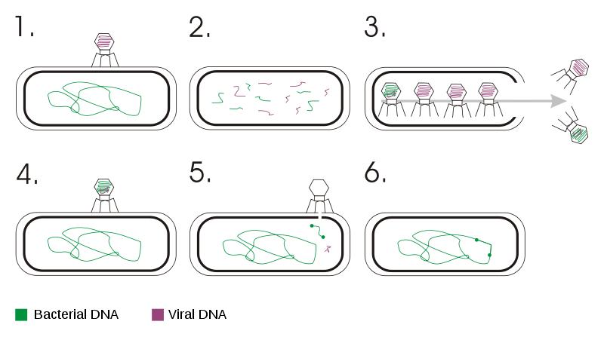
2.Transduction → bacteriophages
Transduction: is the process by which DNA is transferred from one bacterium to another by a virus[bacteriophges].

Slide 12
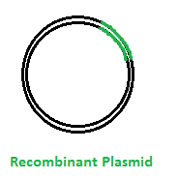
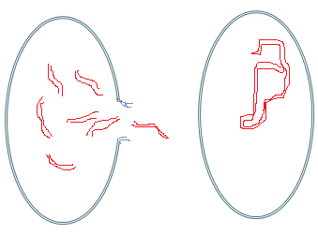
Introducing
Bacterial cell
Chromosomal
DNA
Transformed bacteria
3.Transformation→ DNA, plasmid DNA
Transformation: acquisition of extracellular DNA from the environment.

Slide 13
Competent Cells Formation
Either by:
Electroporation (Electropermeabilization).(high efficiency )
Chemical transformation.
Microwave radiation.

Slide 15
Repeat X more times

Slide 16
Principle of chemical transformation
Since DNA is a very hydrophilic molecule, it won't normally pass through a bacterial cell's membrane.
In order to make bacteria take in the plasmid, this is done by creating small holes in the bacterial cells by suspending them in a solution with a high concentration
of calcium.

Slide 17
Chemically Formed Competent Cells

Slide 18
Chemically Formed Competent Cells Cont.

Slide 19
Chemically Formed Competent Cells Cont.

Slide 20
Chemically Formed Competent Cells Cont.

Slide 21
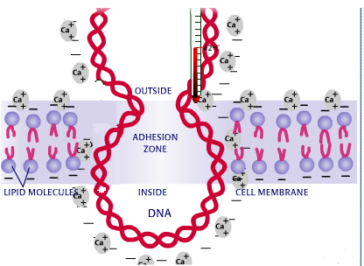
Chemically Formed Competent Cells Cont.

Slide 22
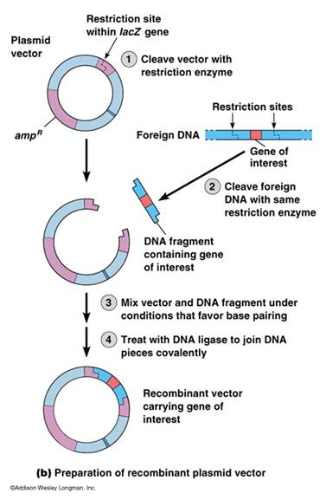
Transformation Cont.
Restriction enzymes are endonucleases.
Each RE recognizes a very specific
nucleotide sequences called recognition
sequence.
DNA ligase joins the sticky ends of
DNA fragments.

Slide 23
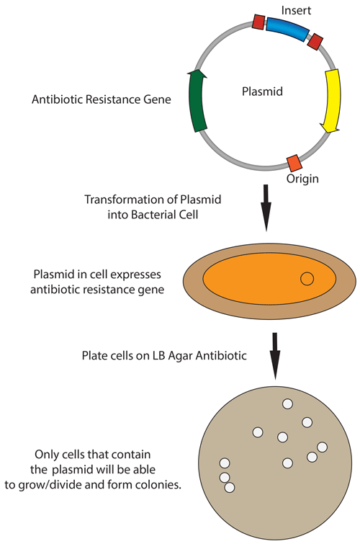
Plasmid Transformation
Transformation Efficiency= Total number of colonies on LB/Amp plate
Amount of DNA plated (µg/ml)

Slide 24
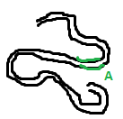
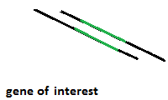
Using same R.E used
For cutting gene A
Using R.E
Animal DNA
“gene A”
“gene A”
DNA cloning using plasmid
1
Ligation
[using ligase enzymes]
2
Bacterial cell
Introducing
3
cloning
Chromosomal
DNA
Culture plate
[media containing appropriate antibiotic ]
Amplified Recombinant plasmid
Transformed bacteria

Slide 25
Animation:
http://www.dnai.org/b/index.html
Principle of chemical transformation :
http://www.dnalc.org/resources/animations/transformation2.html
Mechanism of Recombination:
http://www.dnalc.org/resources/3d/20-mechanism-of-recombination.html

