Slide 1
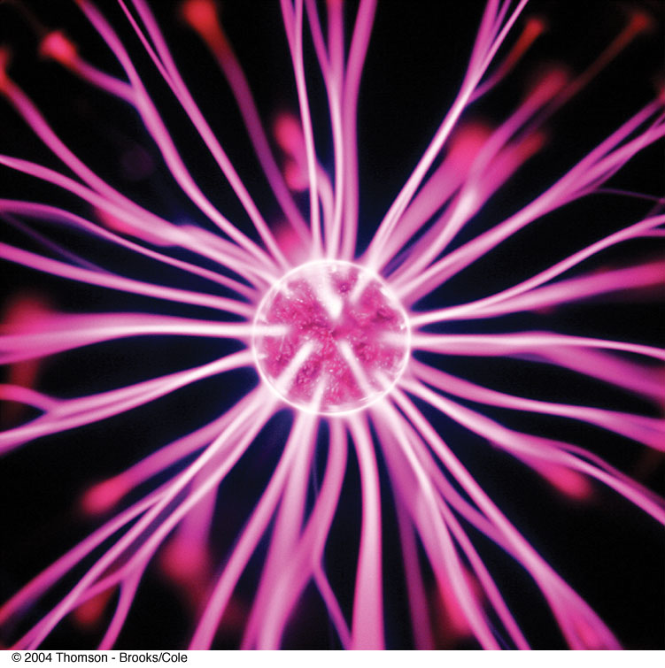
Chapter 24: Gauss’s Law
قانون جاوس
1- Electric Flux
2- Gauss’s Law
3-Application of Gauss’s law
4- Conductors in Electrostatic Equilibrium
Fig 24-CO, p.737
Notes:
Fig 24-CO, p.737 In a table-top plasma ball, the colorful lines emanating from the sphere give evidence of strong electric fields. Using Gauss’s law, we show in this chapter that the electric field surrounding a charged sphere is identical to that of a point charge. (Getty Images)

Slide 2
24-1 Electric Fluxd
Electric flux (Φ) is the number of electric
field lines penetrating a surface of area A.
+
+

Slide 3
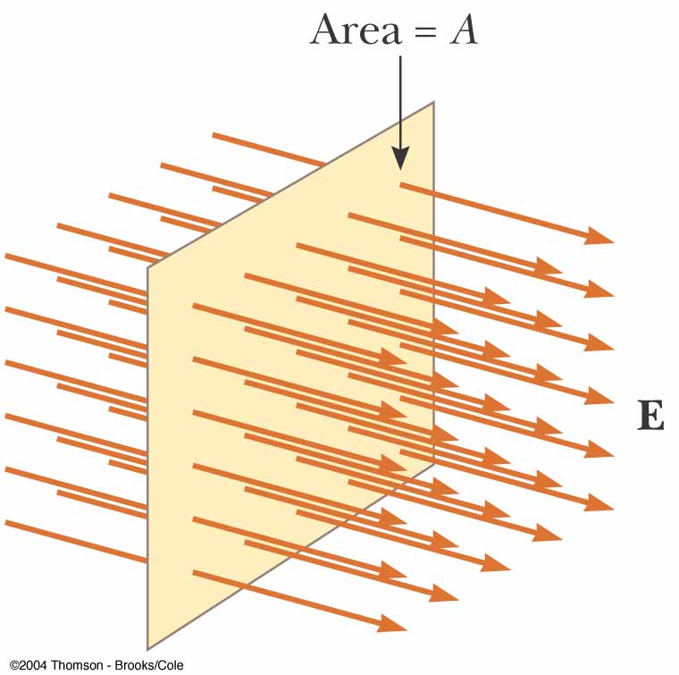
When the uniform electric field penetrating a plane of area A perpendicular to the field E.
Fig 24-1, p.740
Notes:
Figure 24.1 Field lines representing a uniform electric field penetrating a plane of area A perpendicular to the field. The electric flux φE hrough this area is equal to EA.

Slide 4
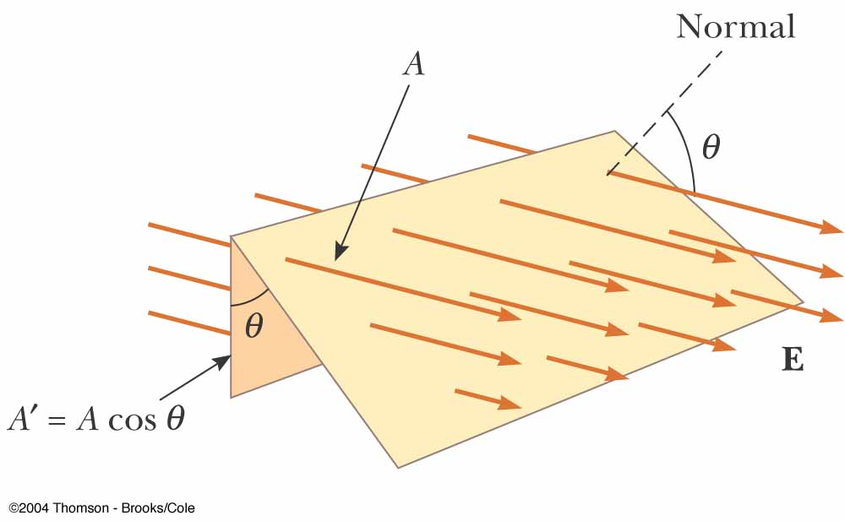

When the uniform electric field penetrating a plane of area A that is at an angle(Θ) to the field E.
$θ$ =0
The flux is maximum
$θ$ =90⁰
the flux is zero
Fig 24-2, p.741
Notes:
Figure 24.2 Field lines representing a uniform electric field penetrating an area A’ that is at an angle θ to the field. Because the number of lines that go through the area A is the same as the number that go through A, the flux through A is equal to the flux through A and is given by φE= EAcos θ.

Slide 5
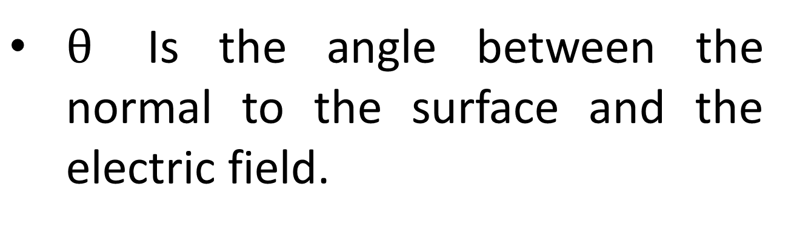
$θ$Is the angle between the normal to the surface and the electric field.

Slide 6

If the electric field vary over a large surface (not uniform)
Divide the surface into a large number of small elements, each of area . The electric flux through this element is
$$∆ A$$

Slide 7
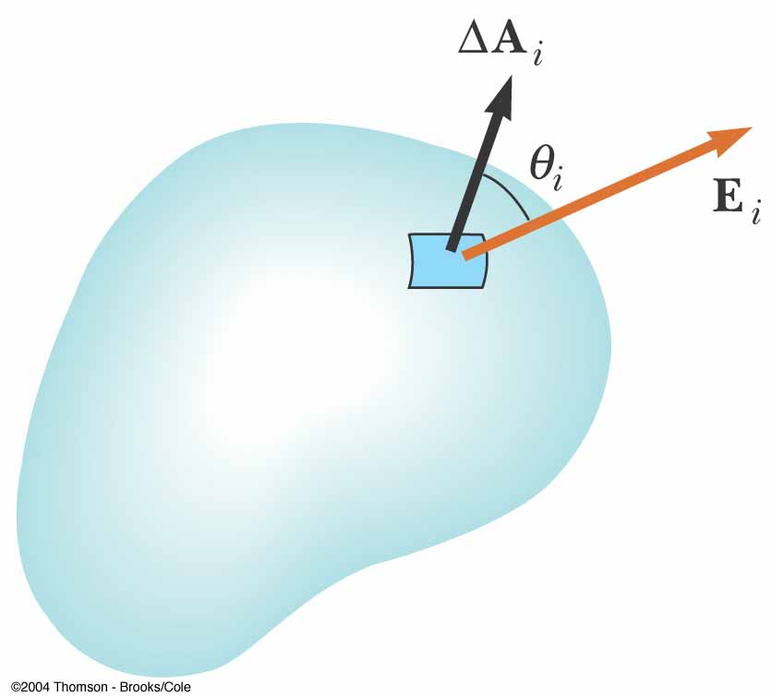
Fig 24-3, p.741
Notes:
Figure 24.3 A small element of surface area Ai. The electric field makes an angle θ_{i} with he vector ΔA_{i}, defined as being normal to the surface element, and the flux through the element is equal to E_{i} ΔAi cos θ_{i} .

Slide 8
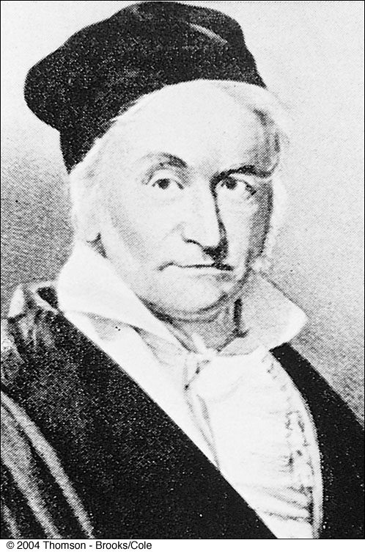
p.742
Notes:
Karl Friedrich Gauss German mathematician and astronomer (1777–1855)
Gauss received a doctoral degree in mathematics from the University of Helmstedt in 1799. In addition to his work in electromagnetism, he made contributions to mathematics and science in number theory, statistics, non-Euclidean geometry, and cometary orbital mechanics. He
was a founder of the German Magnetic Union, which studies the Earth’s magnetic field on a continual basis.

Slide 9
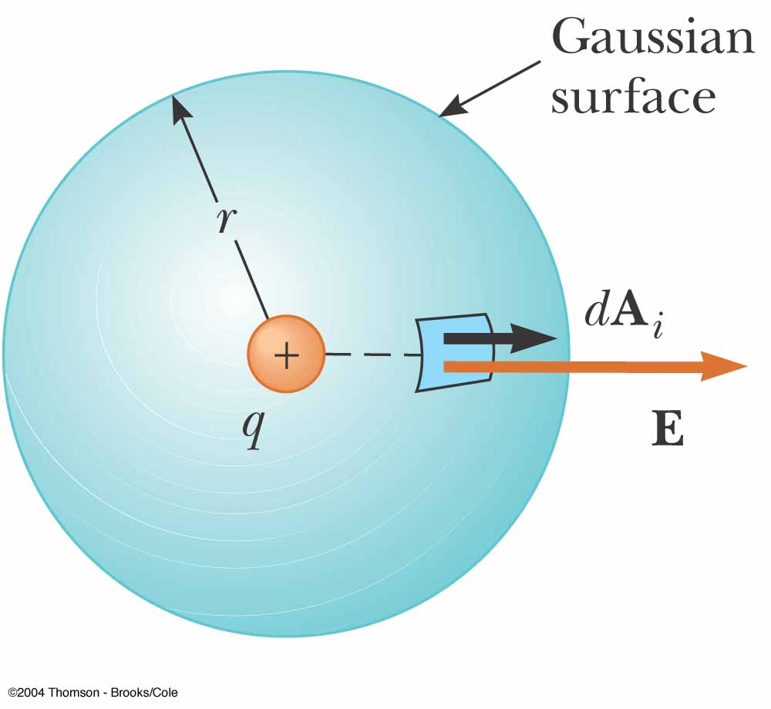
We are often evaluate the flux through a closed surface that divides space into an inside and an outside region.
A spherical Gaussian surface of radius r surrounding a positive point charge q.
The normal to the surface always point outward .
Fig 24-4, p.742
Notes:
Active Figure 24.4 A closed surface in an electric field. The area vectors ΔA_{i} are, by convention,normal to the surface and point outward. The flux through an area element can be positive (element 1), zero (element 2), or negative (element 3).

Slide 10
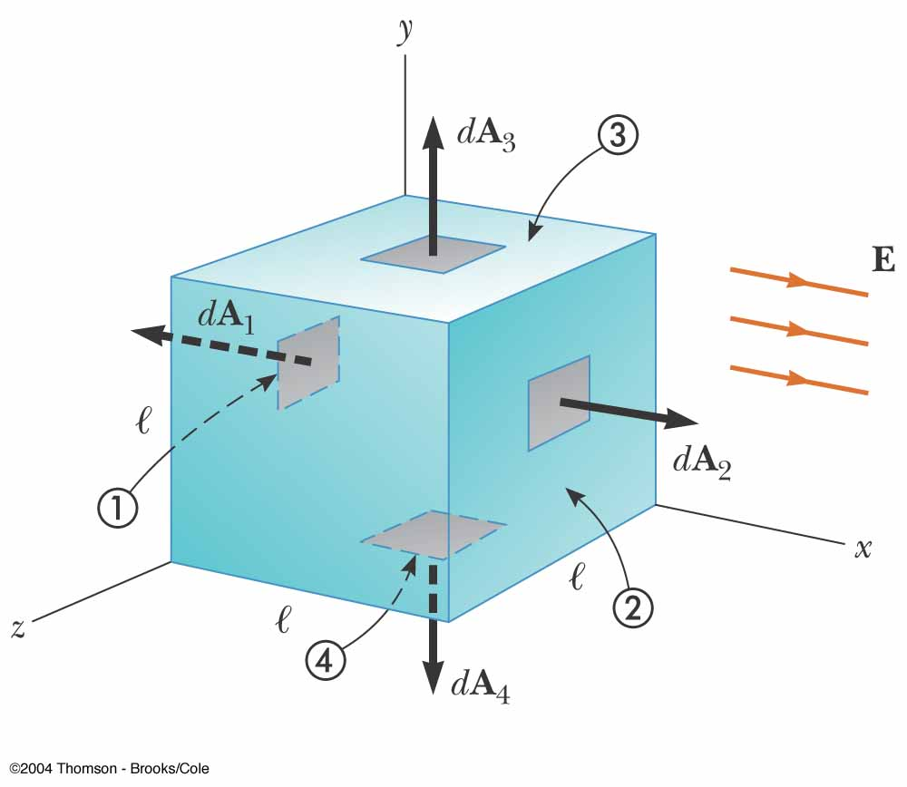
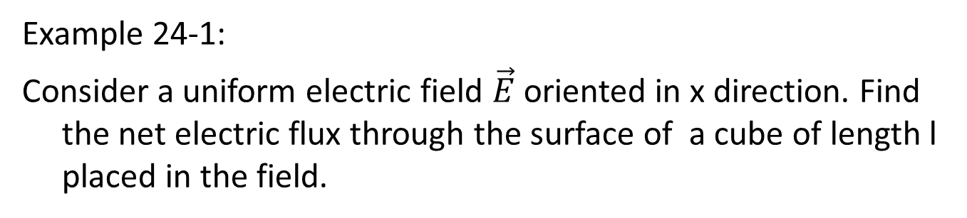
Example 24-1:
Consider a uniform electric field $\vec{E}$oriented in x direction. Find the net electric flux through the surface of a cube of length l placed in the field.
Fig 24-5, p.743
Notes:
Figure 24.5 (Example 24.2) A closed surface in the shape of a cube in a uniform electric field oriented parallel to the x axis. Side 4 is the bottom of the cube, and side 1 is opposite side 2.

Slide 11
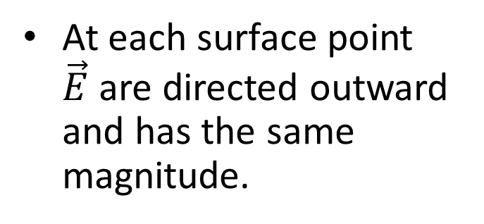
24.2 Gauss’s Law
At each surface point $\vec{E}$are directed outward and has the same magnitude.
q_{in} , is the net charge inside the surface
Fig 24-6, p.743
Notes:
and from Equation 24.4 we find that the net flux through the gaussian surface is
E EdA E dA E dA
Figure 24.6 A spherical gaussian surface of radius r surrounding a point charge q. When the charge is at the center of the sphere, the electric field is everywhere normal to the surface and constant in magnitude.

Slide 12
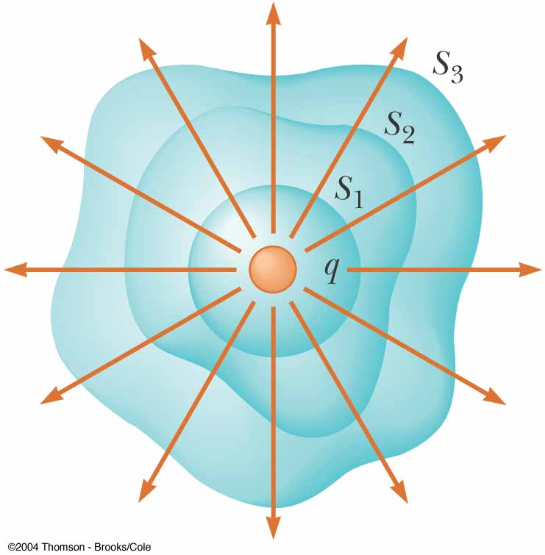
The net electric flux is the same through all surfaces.
Fig 24-7, p.744
Notes:
Figure 24.7 Closed surfaces of various shapes surrounding a charge q. The net electric flux is the same through all surfaces.

Slide 13
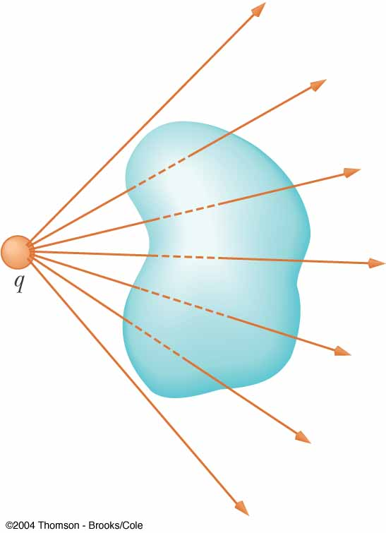
The flux is through the surface is zero if the charge located outside a closed surface.
Fig 24-8, p.744
Notes:
Figure 24.8 A point charge located outside a closed surface. The number of lines entering the surface equals the number leaving the surface.

Slide 14
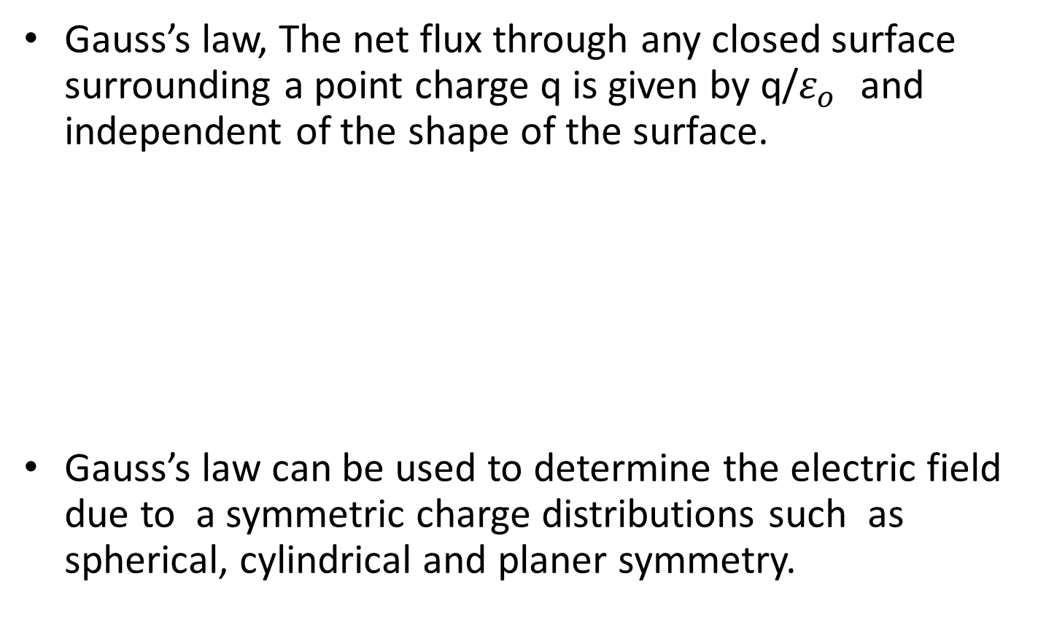
Gauss’s law, The net flux through any closed surface surrounding a point charge q is given by q/$ε_{ο}$ and independent of the shape of the surface.
Gauss’s law can be used to determine the electric field due to a symmetric charge distributions such as spherical, cylindrical and planer symmetry.

Slide 15
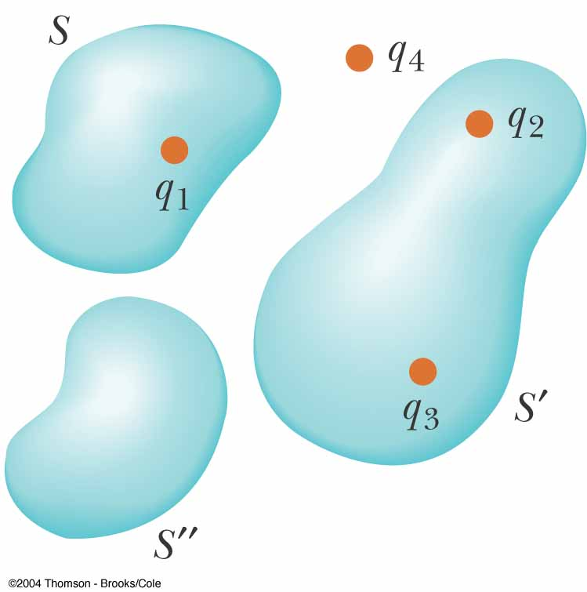
Describe the electric flux through these surfaces?
Fig 24-9, p.744
Notes:
Active Figure 24.9 The net electric flux through any closed surface depends only on the charge inside that surface. The net flux through surface S is q1 /0 , the net flux through surface Sis (q 2 + q3)/e 0 , and the net flux through surface S is zero. Charge q4 does not contribute to the flux through any surface because it is outside all surfaces.

Slide 16
Active Figure 24.9 The net electric flux through any closed surface depends only on the charge inside that surface. The net flux through surface S is q1/ , the net flux through surface Sis (q 2 + q3)/ , and the net flux through surface S is zero. Charge q4 does not contribute to the flux through any surface because it is outside all surfaces.

Slide 17

24-3 application of Gauss’s law
1-
Fig 24-0, p.746

Slide 18

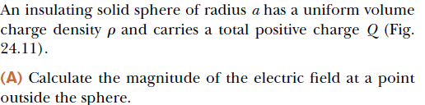

2- A spherically symmetric charge distribution
Example 24.5:

Slide 19
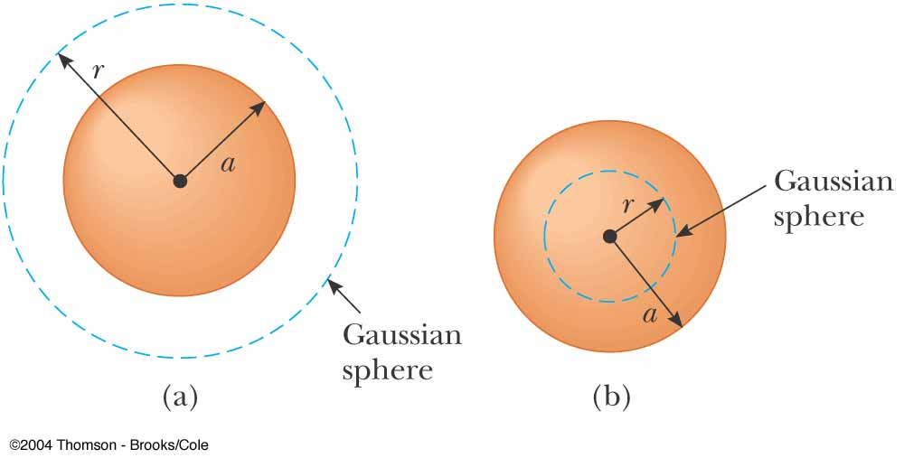
Notes:
Figure 24.10 (Example 24.4) The point charge q is at the center of the spherical gaussian surface, and E is parallel to d A at every point on the surface.

Slide 20
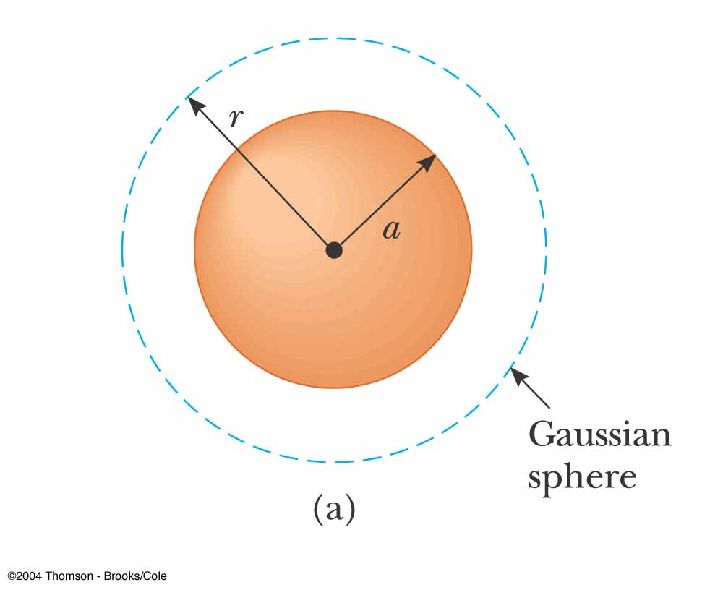
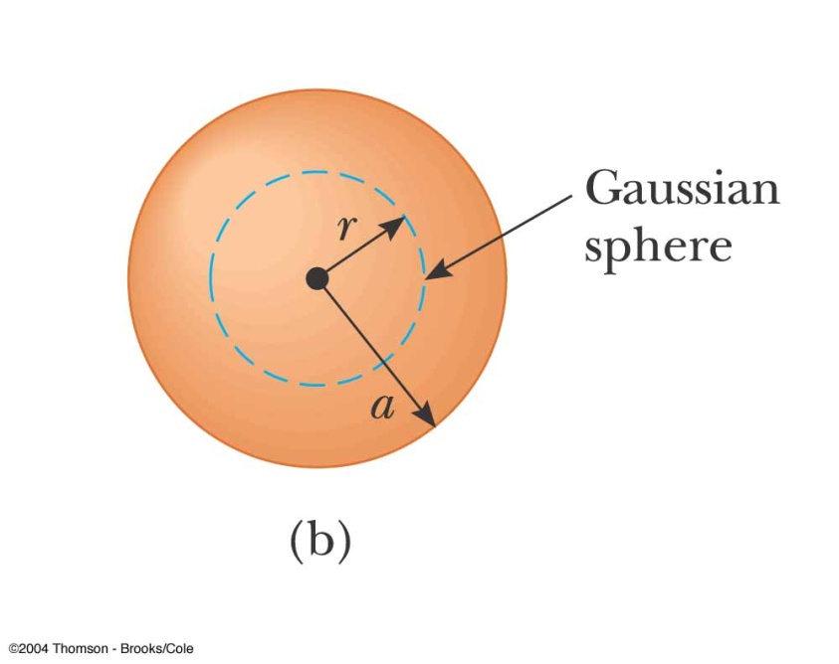
The charge q , the volume charge density is
Fig 24-11, p.747
Notes:
Figure 24.11 (Example 24.5) A uniformly charged insulating sphere of radius a and total charge Q. (a) For points outside the sphere, a large spherical gaussian surface is drawn concentric with the sphere. In diagrams such as this, the dotted line represents the intersection of the gaussian surface with the plane of the page. (b) For points inside the sphere, a spherical gaussian surface smaller than the sphere is drawn.

Slide 21
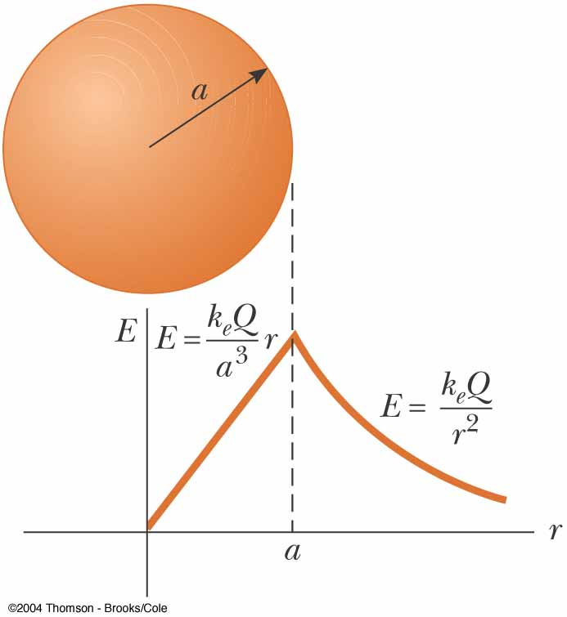
Fig 24-12, p.747
Notes:
Figure 24.12 (Example 24.5) A plot of E versus r for a uniformly charged insulating phere. The electric field inside the sphere (r< a) varies linearly with r. The field outside the sphere (r> a) is the same as that of a point charge Q located at r 0.

Slide 22

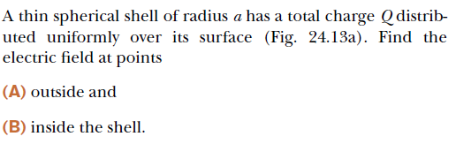
3- A uniformly charged spherical shell

Slide 23
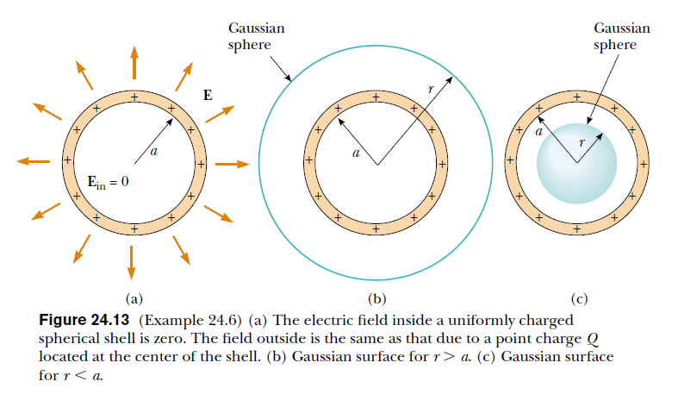

Slide 24
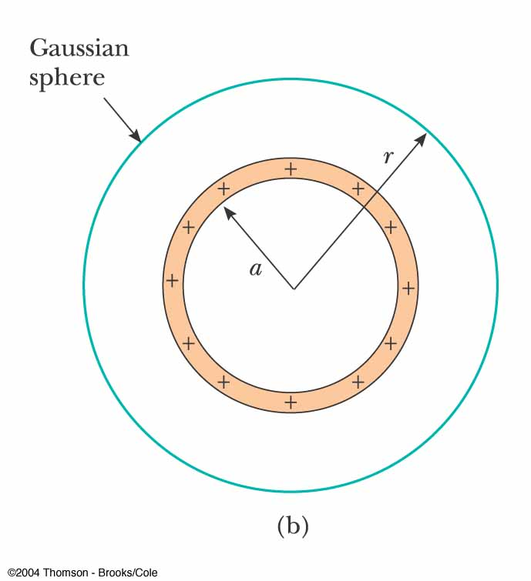
The field outside is the same as that due to a point charge Q located at the center of the shell
Fig 24-13b, p.748
Notes:
Figure 24.13 (Example 24.6) (b) Gaussian surface for r> a.

Slide 25
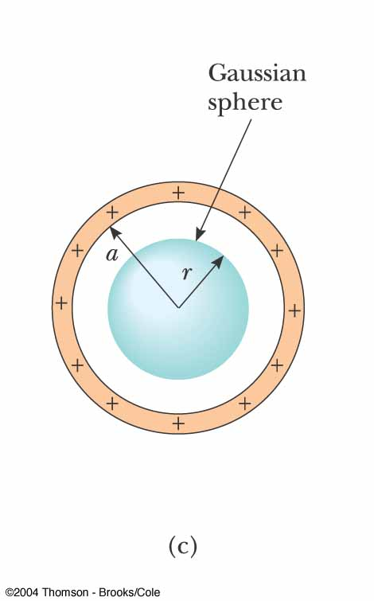
Fig 24-13c, p.748
Notes:
Figure 24.13 (Example 24.6) (c) Gaussian surface for r< a.

Slide 26


4- A cylindrically symmetric charge distribution

Slide 27
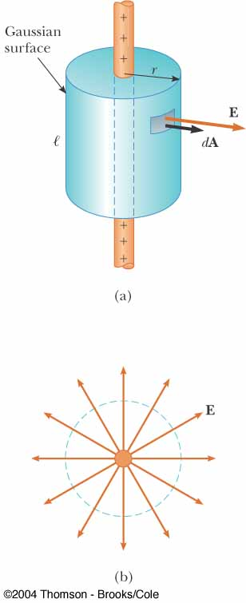
An end view shows that the electric field at the cylindrical surface is constant in magnitude and perpendicular to the surface
Fig 24-14, p.749
Notes:
Figure 24.14 (Example 24.7) (a) An infinite line of charge surrounded by a cylindrical gaussian surface concentric with the line. (b) An end view shows that the electric field at the cylindrical surface is constant in magnitude and perpendicular to the surface.

Slide 28
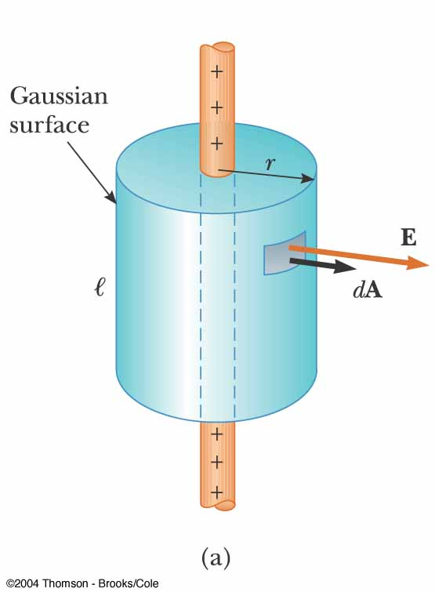
Fig 24-14a, p.749
Notes:
Figure 24.14 (Example 24.7) (a) An infinite line of charge surrounded by a cylindrical gaussian surface concentric with the line.

Slide 29
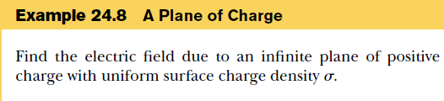
5- A plane of charge

Slide 30
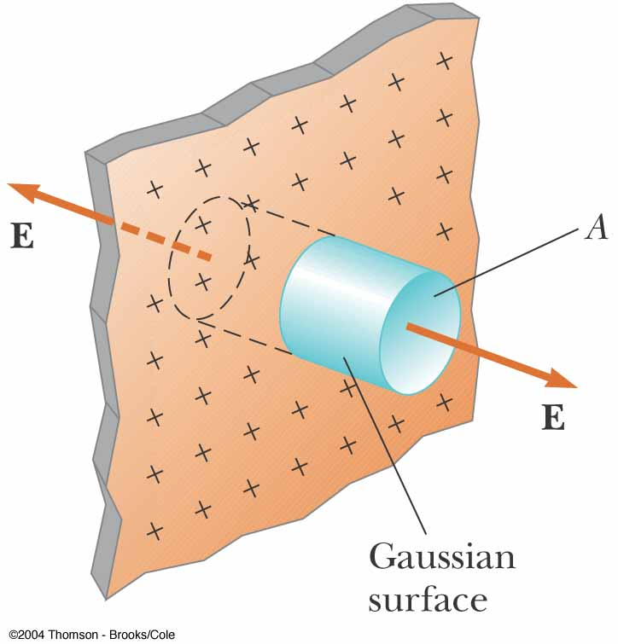
Fig 24-15, p.749
Notes:
Figure 24.15 (Example 24.8) A cylindrical gaussian surface penetrating an infinite plane of charge. The flux is Ea through each end of the gaussian surface and zero through its curved surface.

Slide 31
A good electrical conductor contains charges (electrons) that are not bound to any atom and therefore are free to move about within the material.
When there is no net motion of charge within a conductor, the conductor is in electrostatic equilibrium that has the following properties:.
1. The electric field is zero everywhere inside the conductor.
2. If an isolated conductor carries a charge, the charge resides on its surface.
3. The electric field just outside a charged conductor is perpendicular to the surface of the conductor and has a magnitude σ/ε₀ , where is the surface charge density at that point.
4. On an irregularly shaped conductor, the surface charge density is greatest at locations where the radius of curvature of the surface is smallest.

Slide 32
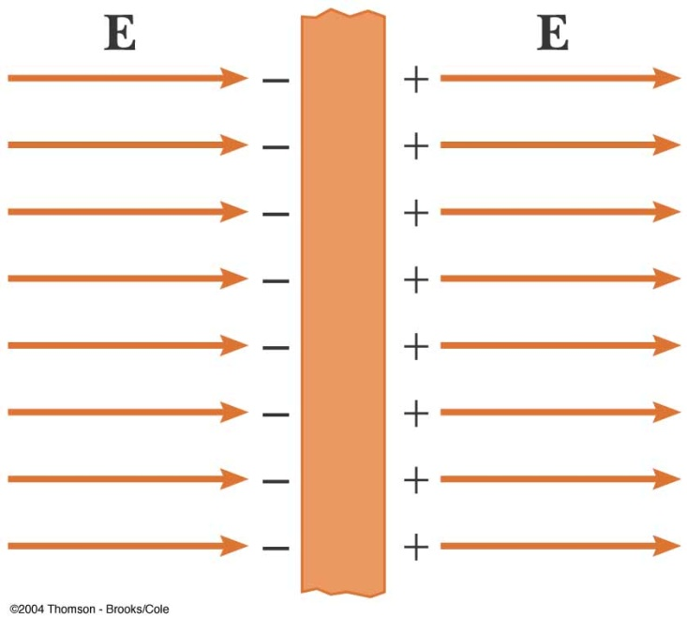
1. The electric field is zero everywhere inside the conductor.
A conducting slab in an external electric field E. The charges induced on the two surfaces of the slab produce an electric field (E’) that opposes the external field (E), giving a resultant field of zero inside the slab.
The time it takes a good conductor to reach equilibrium is of the order of e-16 s, which for most purposes can be considered instantaneous.
We can argue that the electric field inside the conductor must be zero under the assumption that we have electrostatic equilibrium. If the field were not zero, free charges in the conductor would accelerate under the action of the field. This motion of electrons, however, would mean that the conductor is not in electrostatic equilibrium. Thus, the existence of electrostatic equilibrium is consistent only with a zero field in the conductor.

Slide 33
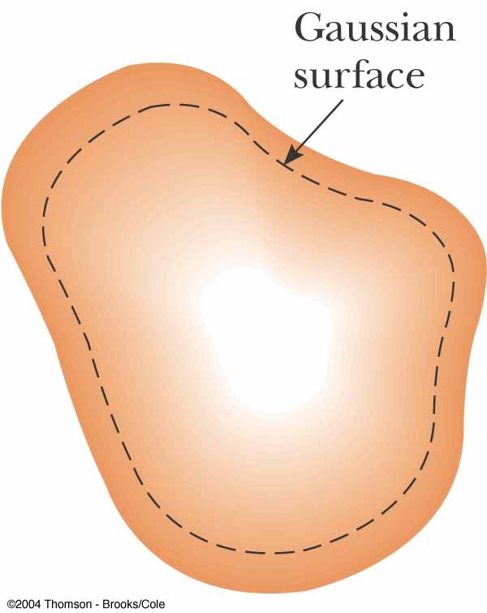
2. If an isolated conductor carries a charge, the charge resides on its surface.
We can use Gauss’s law to verify the second property of a conductor in electrostatic equilibrium.
Q=0
E = 0
# The electric field everywhere inside the conductor is zero when it is in electrostatic equilibrium. Therefore, the electric field must be zero at every point on the gaussian surface.
# Thus, the net flux through this gaussian surface is zero. From this result and Gauss’s law, we conclude that the net charge inside the gaussian surface is zero.
# Because there can be no net charge inside the gaussian surface (which is arbitrarily close to the conductor’s surface), any net charge on the conductor
must reside on its surface.

Slide 34
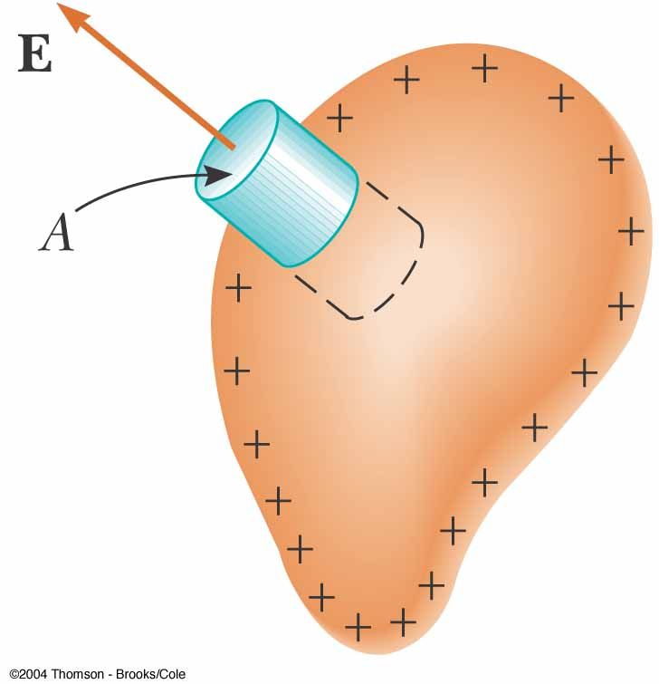
3. The electric field just outside a charged conductor is perpendicular to the surface of the conductor and has a magnitude σ/ε0 , where is the surface charge density at that point.
A gaussian surface in the shape of a small cylinder is used to calculate the electric field
just outside a charged conductor. The flux through the gaussian surface is E_{n}A. Remember that E is zero inside the conductor.

Slide 35


Slide 37
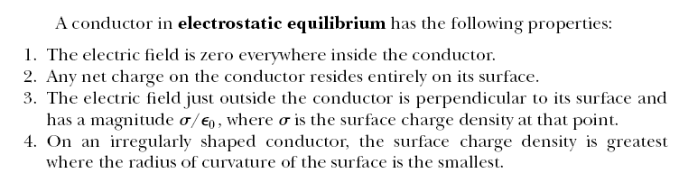

Slide 38
Section 24.1 Electric Flux
Problem 1: A spherical shell is placed in a uniform electric field. Find the total electric flux through the shell.

Slide 39
Answer: The uniform field enters the shell on one side and exits on the other so the total flux is zero

Slide 40
Section 24.2 Gauss’s Law
Q15: The following charges are located inside a submarine: 5, -9, 27 and -84 µC
(a) Calculate the net electric flux through the submarine.
(b) Is the number of electric field lines leaving the submarine greater than, equal to, or less than the number entering it?

Slide 42
Q11: (a) A point charge q is located a distance d from an infinite plane. Determine the electric flux through the plane due to the point charge.
(b) A point charge q is located a very small distance from the center of a very
large square on the line perpendicular to the square and going through its center. Determine the approximate electric flux through the square due to the point
charge.
(c) Explain why the answers to parts (a) and (b) are identical.

Slide 43
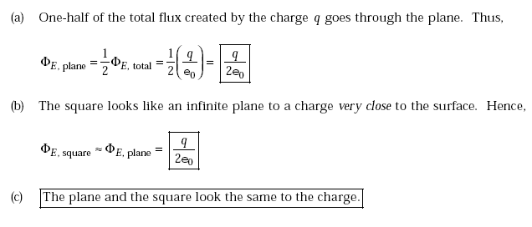

Slide 44
Q37: A large flat sheet of charge has a charge per unit area of 9.00 uC/m². Find the electric field just above the surface of the sheet, measured from its midpoint.

Slide 46
Q41: A thin conducting plate 50.0 cm on a side lies in the xy plane. If a total charge of 4.00 x 10⁻⁸ C is placed on the plate, find (a) the charge density on the plate,
(b) the electric field just above the plate, and (c) the electric field just below the plate.

Slide 48
Homework (1):
Q4, Q5, Q14, Q24, Q31,Q39

