Slide 1
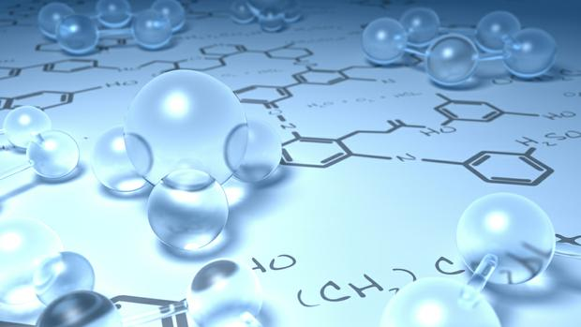
By
Dr. Mohamed El-Newehy
Chemistry Department, College of Science, King Saud University
http://fac.ksu.edu.sa/melnewehy

Slide 2
Hydrocarbons

Slide 3
- Hydrocarbons are Organic Compounds, which contain only the two elements carbon and hydrogen.
Hydrocarbons
Aliphatic Hydrocarbons
Aromatic Hydrocarbons
Benzene-like in its properties
Saturated
Unsaturated
Alkanes
◆
Alkenes
Contain carbon-carbon single bond.
Contain carbon-carbon double bond.
❖
Alkynes
Contain carbon-carbon triple bond.

Slide 4
Saturated Hydrocarbons
Alkanes

Slide 5
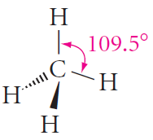
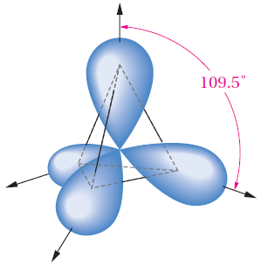
The Structure of Alkanes
- General formula is C_{n}H_{2n+2}
- The simplest alkane is methane.
- Its tetrahedral three-dimensional structure.
- Additional alkanes are constructed by lengthening the carbon chain and adding an appropriate number of hydrogens to complete the carbon valences.

Slide 6
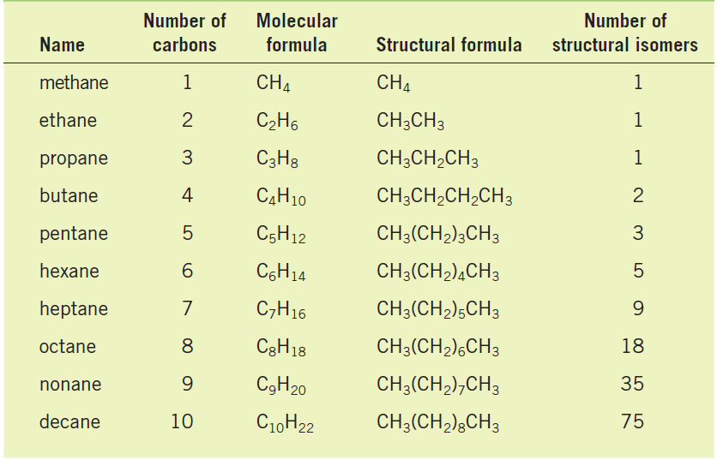
The Structure of Alkanes
Names and Molecular Formulas of the First Ten Alkanes

Slide 7
The Structure of Alkanes
Structure Isomerism
- Isomers are different compounds with identical molecular formulas.
- The phenomenon is called isomerism.
- Structural or constitutional isomers are isomers which differ in the sequence of atoms bonded to each other.
- Examples:
Butanes, C₄H₁₀
Pentanes, C₅H₁₂

Slide 8
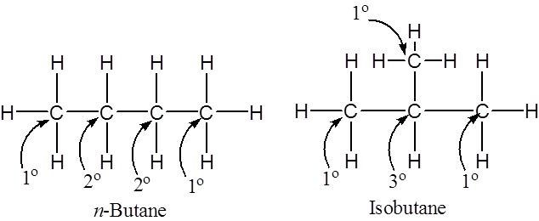
Classes of Carbons and Hydrogen
- A primary (1°) carbon is one that is bonded to only one other carbon.
- A secondary (2°) carbon is one that is bonded to two other carbons.
- A tertiary (3°) carbon is one that is bonded to three other carbons.
- Hydrogens are also referred to as 1°, 2°, or 3° according to the type of carbon they are bonded to.

Slide 9
Nomenclature of Alkanes
Alkyl Group
- An alkyl group is formed by loss of a hydrogen atom from the corresponding alkane.
- General formula C_{n}H_{2n+1}.
- The letter R is used as a general symbol for an alkyl group.
- An alkyl group is named by replacing the suffix –ane of the parent alkane by –yl.
i.e. Alkane – ane + yl = Alkyl
Derived from methane by removing one of the hydrogens, a one-carbon substituent is called a methyl group.
Thus the two-carbon alkyl group is called the ethyl group, from ethane.

Slide 10
Nomenclature of Alkanes
Alkyl Group
When we come to propane, there are two possible alkyl groups, depending on which type of hydrogen is removed.
If a terminal hydrogen is removed, the group is called a propyl group.
If a hydrogen is removed from the central carbon atom, we get a different isomeric propyl group, called the isopropyl group.

Slide 11
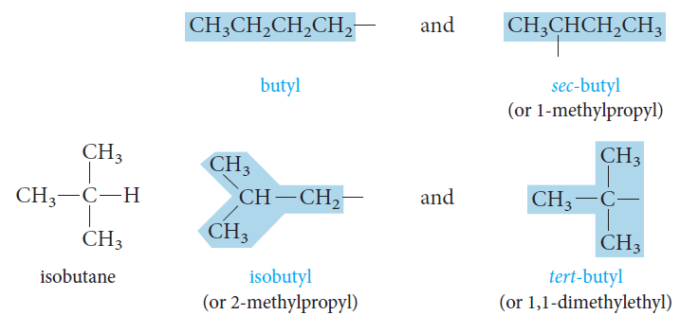
Nomenclature of Alkanes
Alkyl Group
For four-carbon alkyl group, there are four different butyl groups.
The butyl and sec-butyl groups are based on n-butane.
The isobutyl and tert-butyl groups come from isobutane.
n-butane

Slide 12
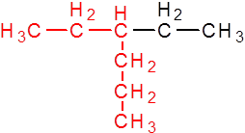
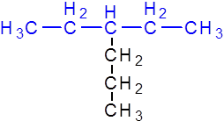
Nomenclature of Alkanes
- Most organic compounds are known by two or more names:
The older unsystematic names, (Common names).
The IUPAC names.
IUPAC: International Union of Pure & Applied Chemistry
The IUPAC Rules
1) Select the parent structure; the longest continuous chain
not
X
Ethylhexane
Propylpentane
The longest continuous chain is not necessarily straight.

Slide 13
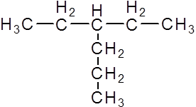
Nomenclature of Alkanes
The IUPAC Rules
2) Number the carbons in the parent chain
starting from the end which gives the lowest number for the substituent
1
6
2
3
5
4
4
not
3
5
2
6
1
X
3-
Ethyl
hexane
4-
Ethyl
hexane
To name the compound;
1) The position of the substituent on the parent carbon chain by a number.
2) The number is followed by a hyphen (-).
3) The combined name of the substituent (ethyl).
4) The parent carbon chain (hexane).
-
3
Ethyl
hexane

Slide 14
Nomenclature of Alkanes
The IUPAC Rules
3) If the same alkyl substituent occurs more than once on the parent carbon chain,
the prefixes di-, tri-, tetra-, penta-, and so on
are used to indicate two, three, four, five, and so on.
5
4
3
2
1
2,2,4-
Tri
pentane
methyl

Slide 15
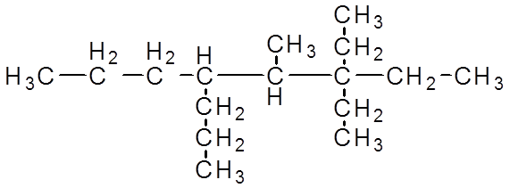
Nomenclature of Alkanes
The IUPAC Rules
4) If different alkyl substituents are attached on the parent carbon chain, they are named in order of alphabetical order.
8
7
6
5
4
3
2
1
3,3-
di
ethyl
methyl
4-
propyl
n-
5-
-
octane
methyl
-
-
3,3-
Diethyl
4
n-propyl
-
5

Slide 16
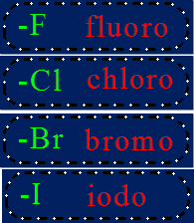
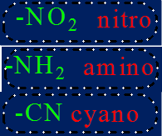
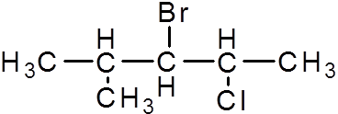
Nomenclature of Alkanes
The IUPAC Rules
5) If substituents other than alky groups are also presents on the parent carbon chain;
all substituents are named alphabetically.
2-
chloro
5
4
3
2
1
bromo
3-
4-
methyl
chloro
2-
-
pentane
4-
-
methyl
bromo
3-

Slide 17
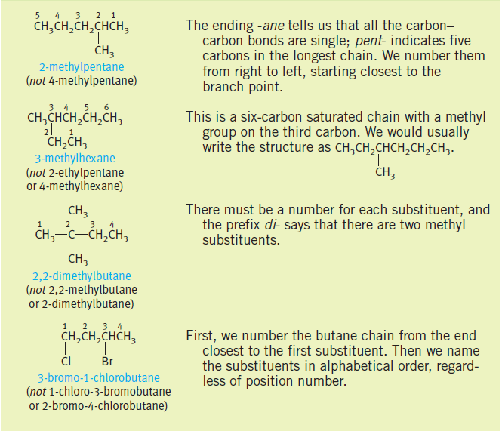
Nomenclature of Alkanes
The IUPAC Rules
Examples

Slide 18
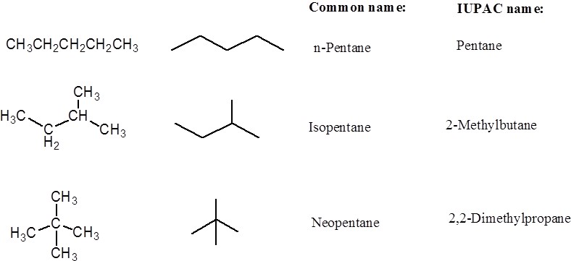
Nomenclature of Alkanes
Examples

Slide 19
Physical Properties of Alkanes
- Those properties that can be observed without the compound undergoing a chemical reaction.
- Physical State
Alkanes occur at room temperature are gases, liquids, and solids.
C1 to C4 are gases,
C5 to C17 are liquids,
C18 and larger alkanes are wax –like solids.
- Solubility
Alkanes are nonpolar compounds.
Their solubility “ Like dissolve like”
Alkanes are soluble in the nonpolar solvents;
carbon tetrachloride, CCl₄ and benzene,
Alkanes are insoluble in polar solvents like water.

Slide 20
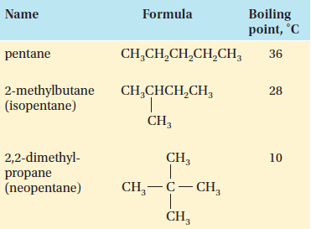
Physical Properties of Alkanes
- Boiling Points & Melting Points
Effect of Molecular Weight
The boiling points and melting points of normal hydrocarbons increase with increasing molecular weight.
As the molecules become larger, there are more forces of attraction between them, and more energy is needed.
Effect of Branching
Among isomeric alkanes, straight chain compound has the highest boiling point.
The greater the number of branches, the lower the boiling point.

Slide 21
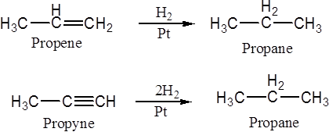
Preparation of Alkanes
1. Hydrogenation of unsaturated hydrocarbon:
2. Hydrolysis of Grignard reagent

Slide 22
Preparation of Alkanes
3. Reduction of Alkyl halides By lithium dialkyl cuprate
4. The Wurtz reaction
two alkyl halides are reacted with sodium to form a new carbon-carbon bond.
2R-X + 2Na → R-R + 2Na⁺X⁻

Slide 23
Notations for Bond Breaking and Bond Making
- A covalent bond can be broken in either two ways,
- Homolytic cleavage.
Free radicals
- Heterolytic cleavage.
Carbocation
Carboanion

Slide 24
Types of Organic Reactions
Substitution reactions
Addition reactions
Elimination reactions
Oxidation-Reduction
Rearrangement reactions

Slide 25
Reactions of Alkanes
- All of the bonds in alkanes are single, covalent, and nonpolar.
- Hence alkanes are relatively inert and they are called Paraffinic hydrocarbons. ( Latin parum, little; affinis, affinity)
- Alkanes ordinarily do not react with most common acids, bases, or oxidizing and reducing agents.
- However, alkanes do react with some reagents, such as molecular oxygen and the halogens.

Slide 26
Reactions of Alkanes
Halogenation of Alkanes
- When a mixture of an alkane and chlorine gas is stored at low temperatures in the dark, no reaction occurs.
- In sunlight or at high temperatures, however, an exothermic reaction occurs.
One or more hydrogen atoms of the alkane are replaced by chlorine atoms.
- This process is a substitution reaction,
chlorination.
bromination
- Halogenation of alkanes take place at
high temperatures or under the influence of ultraviolet light
- Flourine reacts explosively with alkanes
It is unsuitable reagent for the preparation of the alkyl fluorides.
- Iodine is too unreactive
It is not used in the halogenation of alkanes.

Slide 27
Reactions of Alkanes
Halogenation of Alkanes
- If excess halogen is present, the reaction can continue further to give polyhalogenated products.
- With longer chain alkanes, mixtures of products may be obtained even at the first step. For example, with propane,

Slide 28
Reactions of Alkanes
Halogenation of Alkanes
Mechanism of Halogenation of Alkanes
- Proceeds by a free-radical chain mechanism.
- The mechanism involves three steps;
1) Chain-initiation step;
3) Chain-termination step;
2) Chain-propagating step;

Slide 29
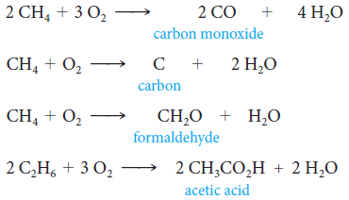
Reactions of Alkanes
Oxidation and Combustion of Alkanes
- The most important use of alkanes is as fuel. With excess oxygen, alkanes burn to form carbon dioxide and water.
- The incomplete combustion of alkanes.

Slide 30
Cycloalkanes
- Cycloalkanes are saturated hydrocarbons that have at least one ring of carbon atoms.
Nomenclature of Cycloalkanes
- Cycloalkanes are named by placing the prefix cyclo- before the alkane name that corresponds to the number of carbon atoms in the ring.
- Alkyl or halogen substituents attached to the rings are named in the usual way.
- If only one substituent is present, no number is needed to locate it.
- If there are several substituents, numbers are required.
With different substituents, the one with highest alphabetic priority is located at carbon 1.

Slide 31
Cycloalkanes
Nomenclature of Cycloalkanes
If there are more than two substituents on the ring, they are cited in alphabetical order. The substituent given the number 1 position is the one that results in a second substituent getting as low a number as possible. If two substituents have the same low number, the ring is numbered—either clockwise or counterclockwise—in the direction that gives the third substituent the lowest possible number.
For example, the correct name of the following compound is 4-ethyl-2-methyl- 1-propylcyclohexane, not 5-ethyl-1-methyl-2-propylcyclohexane: .

Slide 32
Cycloalkanes
Cis-Trans Isomerism in Cycloalkanes
Cis–trans isomerism (sometimes called geometric isomerism) is one kind of stereoisomerism.

Slide 33
Cycloalkanes
Ring Strain
- Ring Strain is a type of instability that exists when bonds in a molecule form angles that are abnormal.
- Baeyer suggested that the stability of a cycloalkane could be predicted by determining how close the bond angle of a planar cycloalkane is to the ideal tetrahedral bond angle of 109.5°.
- Strain is most commonly discussed for small rings, such as cyclopropanes and cyclobutanes.

Slide 34
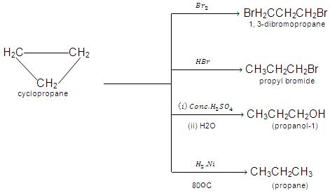
Cycloalkanes
Reactions of Cycloalkanes
- Less stable rings; ring opening due to ring strain

Slide 35
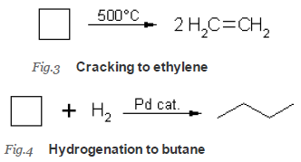
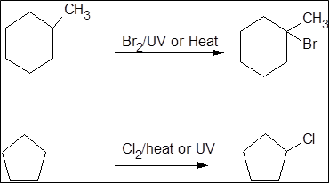
Cycloalkanes
Reactions of Cycloalkanes
- Less stable rings; ring opening due to ring strain
- More stable 5 and 6 rings

