Slide 1
Unit 1
New Challenges

Slide 2
Key vocabulary
Impression (first impressions-lasting impressions-personal impressions)
Postcard (postcard photo)
Motorcycles
Souvenir (inexpensive souvenirs-souvenir shop)
Neighborhood (nice neighborhood-bad neighborhood)
The crowds (huge crowds)
Surprises
Neat (neat writing)
Orderly (orderly place)

Slide 3
Describing a place
Place
Beautiful
Different
neat
Perfect
Orderly
safe

Slide 4
Description
Weather
Foggy
Cold
sunny
Cloudy
Rainy

Slide 5
Description
People
Friendly
Polite
Helpful
Food
Tasty
Delicious
Expensive

Slide 6
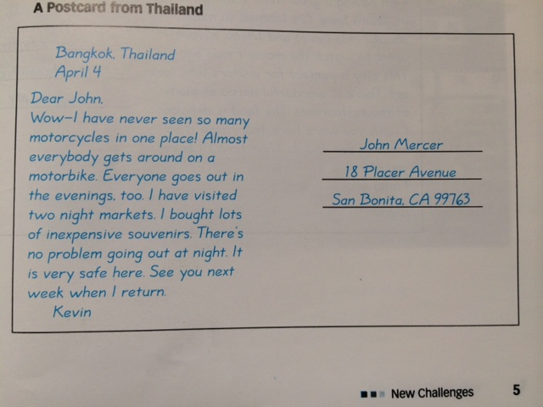

Slide 7
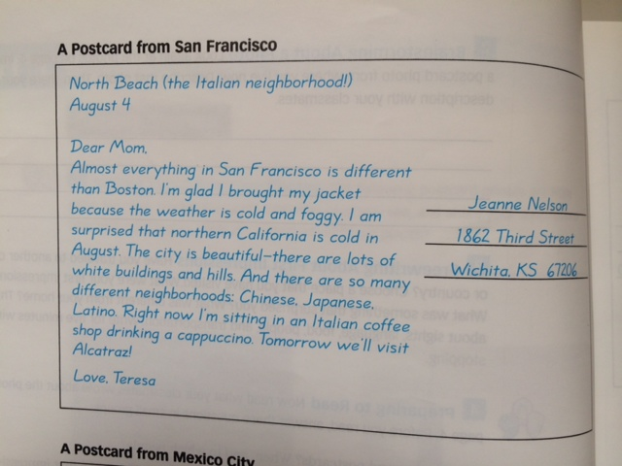

Slide 8
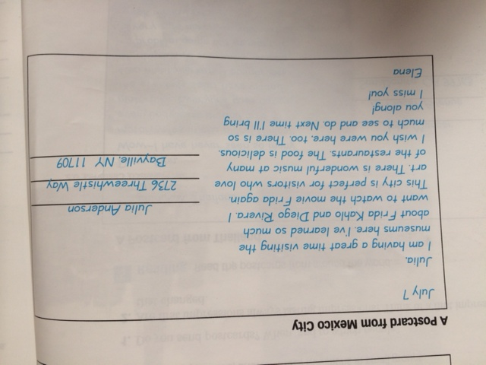

Slide 9
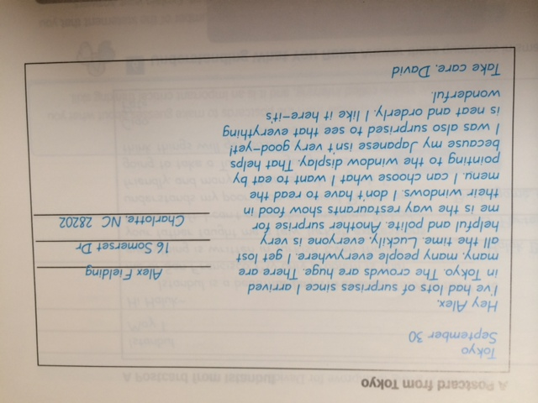

Slide 10
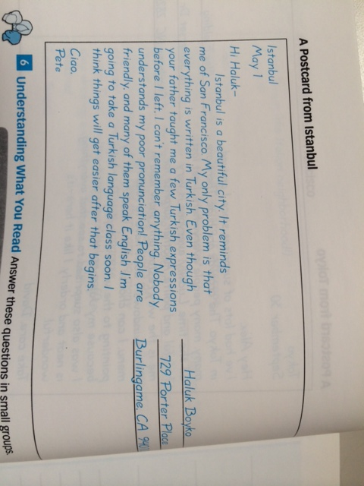

Slide 11
Questions
What does Kevin notice about Bangkok?
What are two things Teresa notices about San Francisco?
According to Elena, what kind of people would like Mexico City?
What is going to improve for David?
What’s Pete’s problem in Istanbul?

Slide 12
Homework
City or country you visited
……………………………………………………………………………
Year
……………………………………………………………………………
First impressions
……………………………………………………………………………
……………………………………………………………………………...
………………………………………………………………………………..
Difficulties
……………………………………………………………………………….
……………………………………………………………………………...
………………………………………………………………………………..

