Slide 1
Qualitative tests of Amino Acids
BCH302 [Practical]

Slide 2
Amino Acids:
Amino acids play a central role:
As building blocks of proteins.
As intermediates in metabolism, converted to specialized products.
There are 20 natural amino acids that are found within proteins.
➔All of them are L-α amino acids.

Slide 3
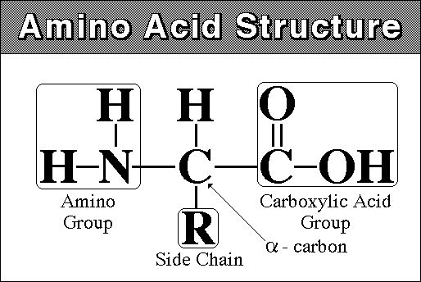
General structure of amino acids:
All amino acids found in proteins consist of:
A basic amino group ( —NH₂ )
An acidic carboxyl group ( —COOH)
A hydrogen atom ( —H)
A distinctive side chain ( —R).
Amino acids differing only in the structure
of the R-group or the side chain.
The simplest, and smallest, amino acid found in proteins is glycine for which the R-group is hydrogen (H).

Slide 4
Classification of amino acids:
Classification of amino acid depending on the R-group ionization (polarity) in water:
Non-polar.
Uncharged polar.
Charged polar amino acids :
Basic polar (positively charged).
Acidic polar (negatively charged).
Amino Acids
Non-Polar
Polar
Uncharged
Charged
Basic polar (positively charged)
Acidic polar (negatively charged)

Slide 5
Twenty standard amino acids

Slide 6
Some properties of Amino Acids:
Amphoteric Compounds.
2. Isoelectric point (pI).
3. Optical Activity.
4. Light Absorption.

Slide 7
Some properties of Amino Acids:
Amphoteric Compounds:
Amphoteric compounds is a molecule that can can act as acids (donate a proton) and bases (accept a proton).
Amphoteric properties of amino acids due to the presence of their ionizable α-amino and α-carboxylic group can act sometimes as acids and sometimes as bases depending on the pH of their media .

Slide 8
A. Presence of carboxyl group COOH that able to donate proton (H⁺) “acidic behavior”, and converted to COO⁻ :
COOH ➔ COO –
B. Presence of amino group NH₂ that able to accept proton (H⁺) “basic behavior”, and converted to NH₃⁺ :
NH₂ ➔ NH₃⁺
High pH➔ Act as acids
Low pH ➔ Act as Base

Slide 9
Some properties of Amino Acids cont’:
2. Isoelectric point (pI):
It is the pH value at which the positive charge equals the negative charge (i.e. the net charge of this molecule equals zero) ➔ Zwitter ion
It is known as a point at which the molecule does not move to either cathode or anode if it is put in electric field and its solubility is minimum so it is possible to precipitate at this point.
Each amino acid have a different pI.
pH= pI

Slide 10
Some properties of Amino Acids cont’:
3. Optical Activity :
Amino acids are able to rotate polarized light either to:
The left (Levorotatory) ➔ (-) – Amino acid
The right (Dextrorotatory) ➔ (+) – Amino acid
The ability to rotate the plane of polarized light because they have an asymmetric C atom (a carbon atom linked to 4 different groups).
Glycine is the only amino acid which lacks asymmetric C atom (has 2 H⁺ on α-C) .

Slide 11
Some properties of Amino Acids cont’:
4. Light Absorption:
The aromatic amino acids tryptophan , tyrosine , and phenylalanine absorb ultraviolet light at 280nm ,which explains the absorption of proteins at 280nm.

Slide 12
Practical part

Slide 13
Qualitative tests of amino acids
Solubility Test.
Ninhydrin test: for α-L amino acids.
Xanthoproteic test: for Aromatic amino acids.
Lead sulfite test: for of amino acids containing sulfhydral group (- SH) (Cysteine)
Sakaguchi Test: for arginine.
Millon's test: for amino acids containing hydroxy phenyl group (Tyrosine)
1
2
3
4
5
6

Slide 14
Experiment 1 : Solubility Test
Objective:
Investigate the solubility of selected amino acid in various solutions.
Principle:
Amino acids are generally soluble in water and insoluble in non-polar organic solvents such as hydrocarbons.
This is because the presence of amino and carboxyl group which enables amino acids to accept and donate protons to aqueous solution, and therefore, to act as acids and bases.

Slide 15
Experiment 1 : Solubility Test
Method:
1. Add 4ml of different solvents in 3 clean test tubes then place 1 ml of each amino acid.
2. Shake the tubes thoroughly, then leave the solution for about one minute.
3. Notice what happened to the solution .
^{4. Record your result .}
Results:
Tube | Glycine | Arginine
HCl (acid)
NaOH (base)
Chloroform (organic solvent)
^{soluble}
^{insoluble}

Slide 16
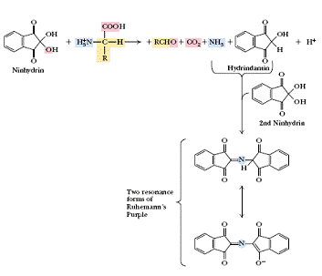
Experiment 2: Ninhydrin test
Objective:
To detect α-L-amino acids.
Principle:
1. Ninhydrin (triketohydrindene hydrate) degrades amino acids into aldehydes (on pH range 4-8), ammonia and CO₂ though a series of reactions.
➔ The net result is ninhydrin in a partially reduced from hydrindantin.
2. Ninhydrin then condenses with ammonia and hydrindantin to produce an intensely blue or purple pigment, sometimes called ruhemann's purple.

Slide 17
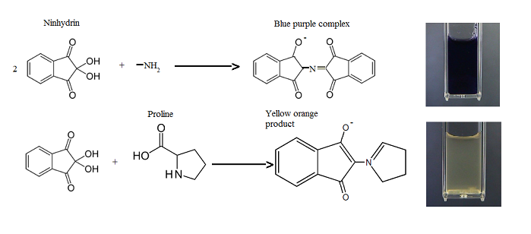
Experiment 2: Ninhydrin test
Principle cont’:
All amino acids that have a free amino group will give positive result (purple color).
While not free amino group-proline and hydroxy-proline (amino acids) will give a (yellow color) ➔ In proline the N is not available for reaction as it is locked in the ring structure, therefore no ammonia is produced, so no blue color is presented.
Note:
Many substances other than amino acids, such as amines will yield a blue color with ninhydrin.

Slide 18
Experiment 2: Ninhydrin test
Method:
1-Place 1 ml of each of the solutions in a test tube and add 1 ml of ninhydrin solution.
2- Boil the mixture over a water bath for 2 min.
3- Allow to cool and observe the blue-purple color formed.
4- Record your results.
Results:
Ninhydrin is a strong oxidizing agent, it should be handled with care.
Tube | Observation
Glycine
Tryptophan
Proline

Slide 19
Experiment 3 : Xanthoproteic test
Objective:
To differentiate between aromatic amino acids which give positive results and other amino acids.
Principle:
Concentrated nitric acid (HNO₃) react with aromatic nucleus present in the amino acid side chain [nitration reaction] ➔ giving the solution yellow color.
Amino acids tyrosine and tryptophan → contain activated benzene rings [aromatic nucleus] which are easily nitrated to yellow colored compounds.
The aromatic ring of phenylalanine dose not react with nitric acid despite it contains a benzene ring, but it is not activated, therefore it will not react.

Slide 20
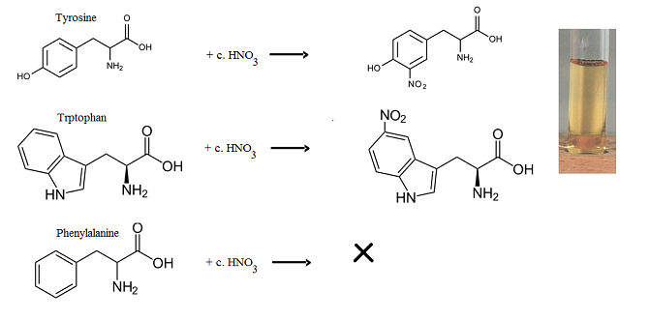
Nitration
benzene ring is not activate

Slide 21
Experiment 3 : Xanthoproteic test
Method:
1. Label four tubes (1 - 4), then add 1 ml of each amino acid solutions and phenol solution to those test tubes each alone.
2. Add 1 ml of concentrated HNO₃. then record your result
3. Now COOL THOROUGHLY under the tap and CAUTIOSLY add 5 drops of 10M
NaOH to make the solution strongly alkaline (the alkaline is added to be sure about the
nitration).
Results:
Concentrated HNO₃ is a toxic, , it should be handled with care.
Tube | Observation
 | + HNO₃ | + NaOH
Tyrosine
Tryptophan
Phenylalanine
Phenol

Slide 22
Experiment 4 : Sakaguchi Test
Objective:
Detection of amino acid containing gauanidium group ➔test for Arginine.
Principle:
In alkaline solution, arginine react with α-naphthol and sodium hypobromite /chlorite as an oxidize agent, to form red complexes as a positive result.
gauanidium group

Slide 23
Experiment 4 : Sakaguchi Test
Method:
1. Label 2 test tube and place in each one 2 ml of the amino acid solution .
2. Add to each tube 2ml of NaOH solution. Mix well
3. Add to each tube 5 drops of α-naphthol solution. Mix well
4. Add to each tube 5 drops of sodium hypobromite solution, and record your result .
Results:
Glycine
Arginine
Tube | Observation
Glycine
Arginine

Slide 24
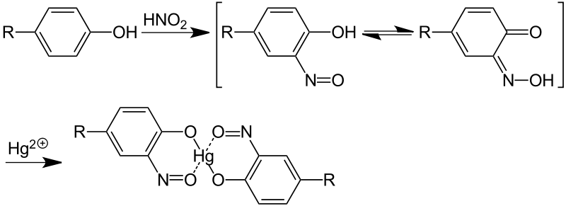
Experiment 5 : Millon's test
Objective:
This test is specific for Tyrosine ➔ because it is the only amino acid containing a phenol group.
Principle:
The phenol group of tyrosine is first nitrated by nitric acid in the test solution.
Then the nitrated tyrosine complexes mercury ions in the solution to form a brick-red solution or precipitate of nitrated tyrosine, in all cases, appearance of red color is positive test.
Note:
All phenols (compound having benzene ring and OH attached to it) give positive results in Millon’s test.

Slide 25
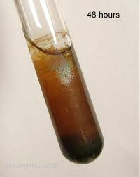
Experiment 6 : Lead Sulfite Test
Objective:
This test specific for–SH [sulfhydral group ]containing amino acid ➔ Cysteine.
Principle:
Sulphur in cysteine, is converted to sodium sulfide by boiling with 40% NaOH.
The Na₂S can be detected by the precipitation of PbS (lead sulfide) from an alkaline solution when adding lead acetate (CH₃COO)₂ Pb .
Cysteine

