Slide 1
Communication DIAGRAM

Slide 2
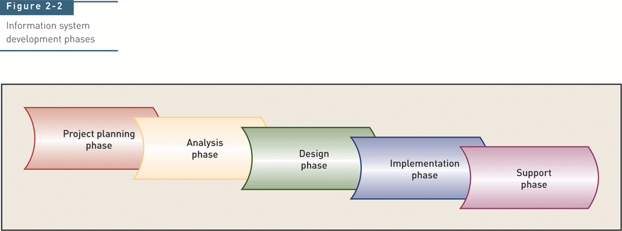
Traditional System Development Life Cycle (SDLC)

Slide 3
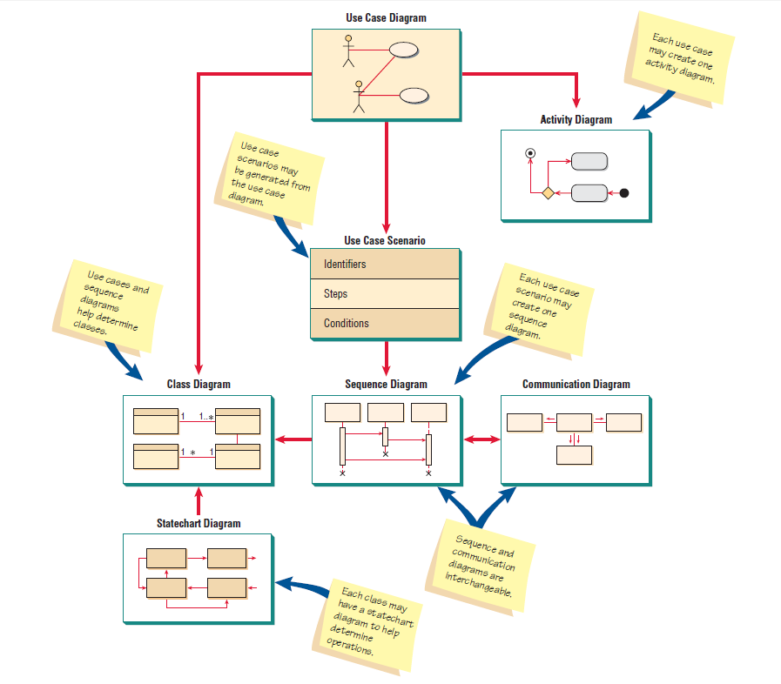

Slide 4
Introduction
Interaction Diagrams are used to model system dynamics
How do objects change state?
How do objects interact (message passing)?

Slide 5
Communication & Sequence Diagrams
An Interaction Diagram is a generalization of two specialized UML diagram types
Sequence Diagrams: Illustrate object interactions arranged in time sequence
Communication Diagrams: Illustrate object interactions organized around the objects and their links to each other

Slide 6
Sequence and communication Diagrams
Interaction diagrams
Sequence diagram
Communication diagram
Emphasize the time ordering of messages
Emphasize the organization of objects
Can be used interchangeably
Communication Diagrams explicitly show object linkages, while links are implied in Sequence Diagrams
Communication diagram introduced in UML 2.0. It original name in UML 1.x is Collaboration Diagram.

Slide 7
Common Interaction Diagram Notation

Slide 8
Communication Diagrams
Actors
Each Actor is named and has a role
One actor will be the initiator of the use case
Objects
Each object in the collaboration is named and has its class specified
Not all classes need to appear
There may be more than one object of a class
Links
Links connect objects and actors and are instances of associations
Each link corresponds to an association in the class diagram

Slide 9
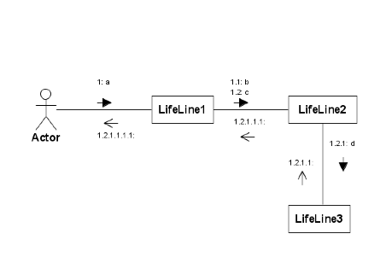
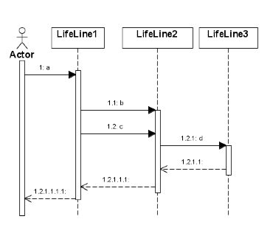
Communication vs. Sequence Diagram

Slide 10
Basic Communication Diagram Notation
Link - connection path between two objects (an instance of an association)
Message - represented with a message expression on an arrowed line between objects
Sequence Number - represents the order in which the flows are used

Slide 11
Messages
A message on a communication diagram is shown using an arrow from the message sender to the message receiver
Each message in a communication diagram has a sequence number. The top-level message is numbered 1. Messages sent during the same call have the same decimal prefix but suffixes of 1, 2, etc. according to when they occur.

Slide 12
Communication Diagrams
Communication Diagrams show relationship between objects
Sequence Diagrams focus on the time in which events occur
Communication Diagrams, formerly called Collaboration Diagrams

Slide 13
Interaction Diagram Weaknesses
Communication Diagram
Difficult to see sequence of messages
More complex notation
Sequence Diagram
Forced to extend to the right when adding new objects; consumes horizontal space

