Slide 1
Use Case Model
Use case description

Slide 2
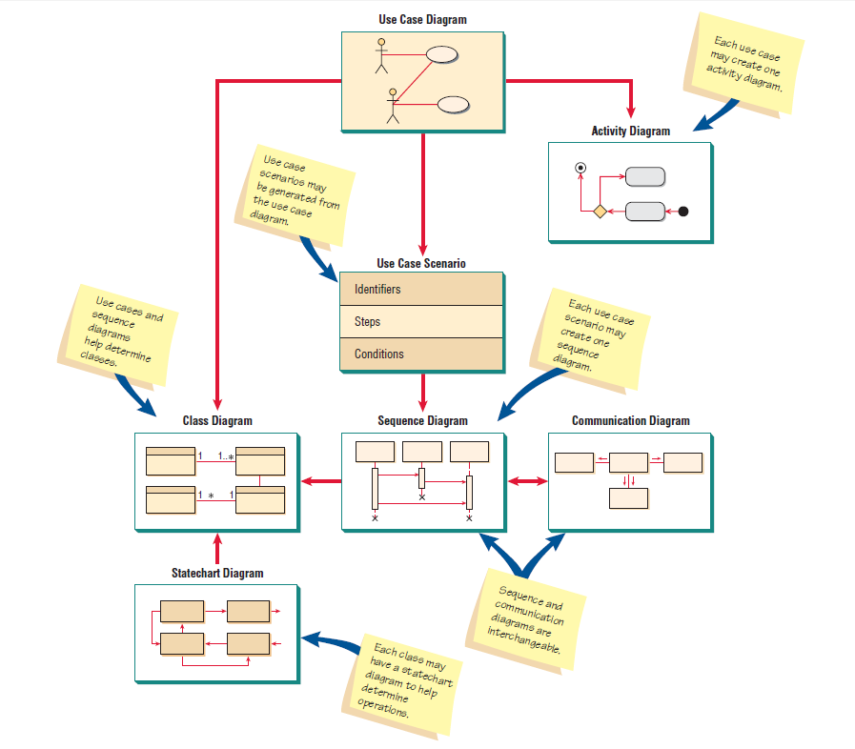

Slide 3
Relevant Requirements Artifacts
Use-Case Model
Glossary
Actors
Use Cases
...
Supplementary Specification
Use-Case Specifications
٥

Slide 4
Use Case Description
Complements Use Case Diagram
A breakdown of a single use case (e.g., sequence of steps included in the function “Look up item availability”); process logic included
In contrast to Use Case Diagram, Use Case Description captures variations of a Use Case
Example: “Create new order” can be done via phone+clerk and via Internet ordering – 2 scenarios

Slide 5
Level of Use Case Description
Three levels of details:
UC* Brief description
Summary of what system does in response to actor’s actions
UC Intermediate description
Shows steps in use case, if-then
UC Full description
Includes Brief description, expands intermediate description, shows scenarios
* UC=Use Case

Slide 6
Brief Description of Use Case
Same description that is usually captured in initial
Use Case Diagrams

Slide 7
Intermediate Use Case Description
Telephone Order Scenario for Create New Order Use Case

Slide 8
Full Use Case Description
Shows steps (“Flow of Events”) broken down to the actor and the system side – useful!

Slide 9
Use Cases Basics
A use case has four mandatory elements:
Name: Each use case has a unique name describing what is achieved by the interaction with the actor.
EX: "Turn Light On/Off" and "Print Document" are good examples.
Brief description: The purpose of the use case should be described in one or two sentences.
EX: "This use case controls the selected light bank when instructed by the actor Homeowner.“
Actor(s) List each actor that participates in the use case.
Flow of events: The heart of the use case is the event flow, usually a textual description of the interactions between the actor and the system.
The main (basic) flow of events
The alternate flows of events

Slide 10
Use Cases Basics
Optional elements in a Use case:
Pre-conditions: Must be present in order for a use case to start. Represent some system state that must be present before the use case can be used.
EX: A pre-condition of the "Print Author's Manuscript Draft" use case is that a document must be open.
Post-conditions: Describe the state of the system after a use case has run. Represent persistent data that is saved by the system as a result of executing the use case.
EX: Post-condition of “Register" use case is that the new data is
added in the profile of the student.

Slide 11
Use Cases Basics
Other stakeholders: Other key stakeholders who may be affected by the use case.
EX: A manager may use a report built by the system, and yet the manager may not personally interact with the system in any way and therefore would not appear as an actor on the system.

Slide 12
A Recommended Template:
Use Case Description
System:
Use Case name:
Primary actor: |  | Other actors:
Stakeholders:
Description:
Relationships Includes: Extends:
Input:
Pre-conditions:
Steps:
Actor | System
1. Actor does.… 3. 4. | 2. System does.…
Alternative and exceptional flows: 4.1 ….
Post-conditions:

Slide 13
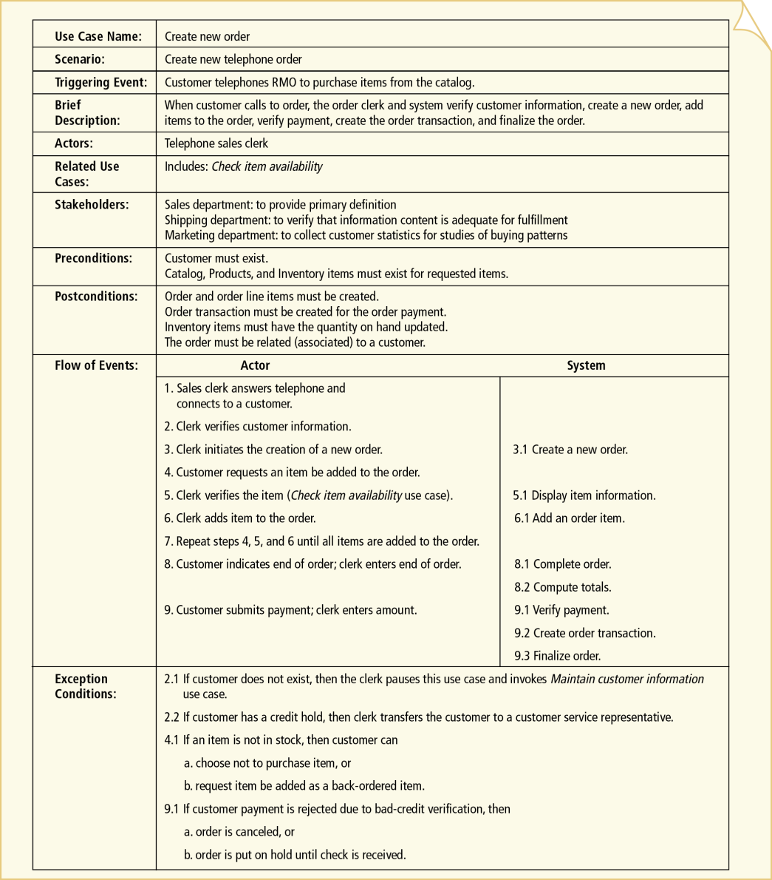
Full Use Case Description
Telephone Order Scenario for Create New Order Use Case

Slide 14
Full Use Case Description
Telephone Order Scenario for Create New Order Use Case

Slide 15
Full Use Case Description
Telephone Order Scenario for Create New Order Use Case

Slide 16
Use-Cases – Common Mistakes
Complex diagram
No system
No actor
Too many user interface details
“User types ID and password, clicks OK or hits Enter”
Very low goal details
User provides name
User provides address
User provides telephone number
…

Slide 17
Writing Use Case Descriptions
Select a use case
Write abbreviated full description (Use case name, Scenario (if any), Business Event, Actors, Flow of steps, Exception conditions)
For figuring Flow of steps,
- Keep in mind general system model: Input-Processing-Output
- Steps should be at nearly the same level of abstraction (each makes nearly same progress toward use case completion)
For figuring exception conditions, focus on if-then logic.

Slide 18
Combining Processes
Number Limit:
The diagram should have between 3 to 10 base use-case. No more than 15 use cases (base + included + extending).
Abstraction:
All use-cases should be in similar abstraction levels.
Size:
Use cases should be described in half a page or more.
Interaction:
Use-cases which are carried out as part of the same interaction.

Slide 19
More Guidelines
Factor out common usages that are required by multiple use cases
If the usage is required use <<include>>
If the base use case is complete and the usage may be optional, consider use <<extend>>
A use case diagram should:
contain only use cases at the same level of abstraction
include only actors who are required
Notes:
DELETE

Slide 20
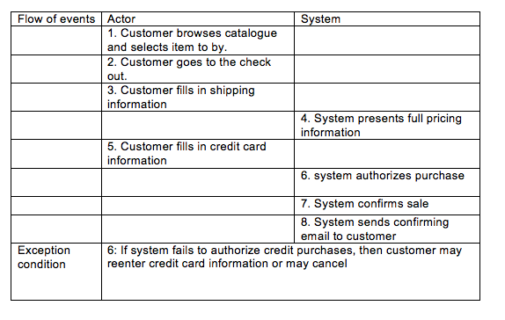
Example 1 Buy product

Slide 21
Example 2
Use Case Name: Release a Vehicle (to a Customer)
Summary:
A customer arrives to acquire the vehicle and depart for desired destination. The vehicle reservation contract is signed and the vehicle is released to the customer.
Actors: Front-Desk Clerk, Customer

Slide 22
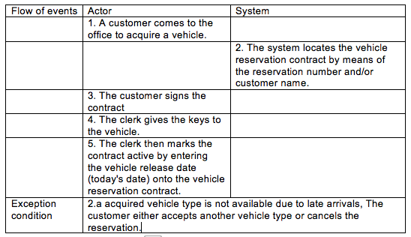
Example 2

