Slide 1
Use Case Model
Use case diagram

Slide 2
Relevant Requirements Artifacts
Use-Case Model
Glossary
Actors
Use Cases
...
Supplementary Specification
Use-Case Specifications
٥

Slide 3
What Is System Behavior?
System behavior is how a system acts and reacts.
It is the outwardly visible and testable activity of a system.
System behavior is captured in use cases.
Use cases describe the system, its environment, and the relationship between the system and its environment.
٨

Slide 4
What Are the Benefits of a Use-Case Model?
Communication
Identification
Verification
Communication
Use Case
Verification
Identification
End User
Domain Expert
Users
١٢

Slide 5
Key points
The development team, with stakeholders involvement, writes the use cases.
Compared to traditional requirement methods, use cases are relatively easy to write and easier to read.
Free of technical or implementation details.

Slide 6
Use Case Diagrams
A use case diagram depicts the interactions between the system and the external actors.

Slide 7
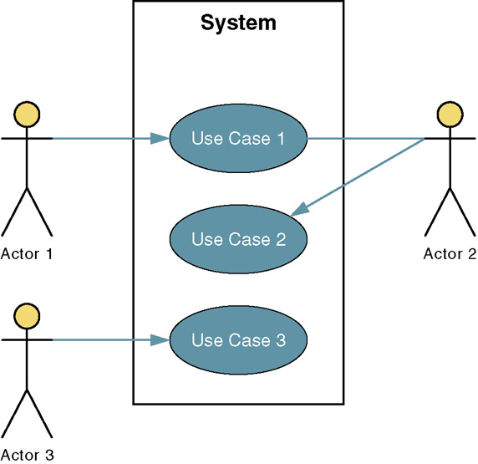
Developing use case diagram
System name
Actor is a stick figure usually an actual person using the system
System boundary
Connection line shows which actor participate in the use cases
The use case

Slide 8
Major Concepts in Use-Case Modeling
An actor represents anything that interacts with the system.
An actor might be:
a person
a company or organization,
a computer program, or a computer system
Hardware
A use case is a sequence of actions a system performs that yields an observable result of value to a particular actor.
Name each use case using Noun-Verb
Actor
UseCase
٩

Slide 9
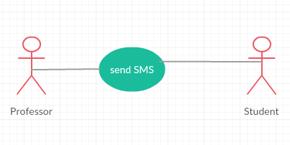
Types of actor
Primary actor initiates the use case.
Secondary actor is used to complete the use case.
E.g. the professor send SMS to the students. The professor considered as primary actor, whereas students considered as secondary actor

Slide 10
A Step-by-Step Guide to Building the Use-Case Model
Step 1: Identify and Describe the Actors
Who uses the system?
Who gets information from this system?
Who provides information to the system?
Where in the company is the system used?
Who supports and maintains the system?
What other systems use this system?

Slide 11
A Step-by-Step Guide to Building the Use-Case Model
Step 2: Identify the Use Cases and Write a Brief Description
What will the actor use the system for?
Will the actor create, store, change, remove, or read data in the system?
Will the actor need to inform the system about external events or changes?
Will the actor need to be informed about certain occurrences in the system?

Slide 12
A Step-by-Step Guide to Building the Use-Case Model
Step 3: Identify the Actor and Use-Case Relationships
Only one actor can initiate a use case
Many use cases may involve the participation of multiple actors.
Each use case is analyzed to see what actors interact with it

Slide 13
Use case diagram

Slide 14
Case Study: Course Registration Problem Statement
Review the problem statement provided in the Course Registration Requirements Document.
Course Registration Requirements Document
٦

Slide 15
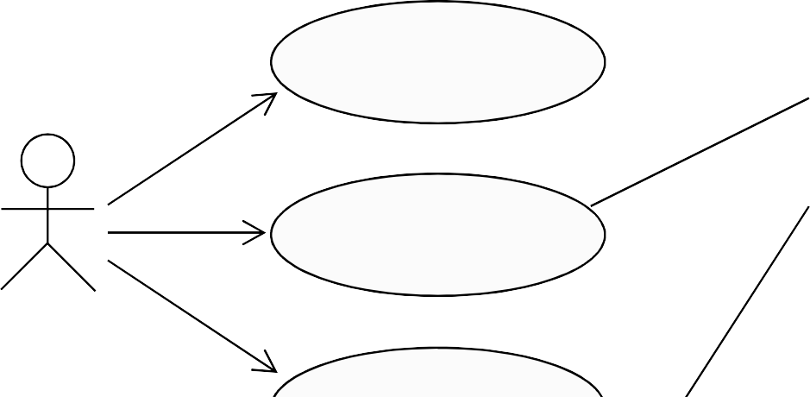
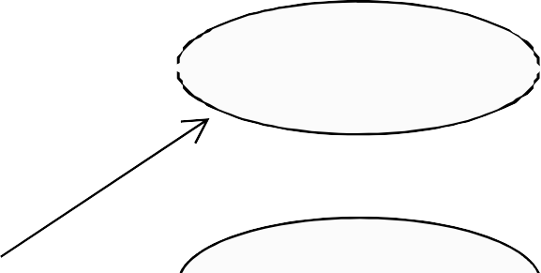
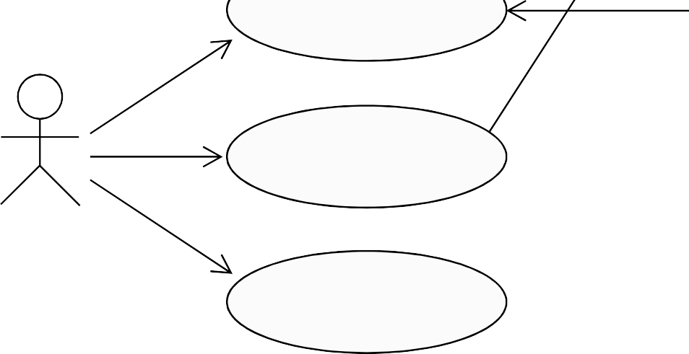
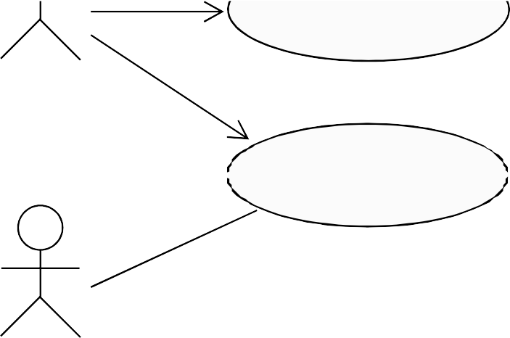
How Would You Read This Diagram?
View Report Card
Course Catalog
Maintain Professor Information
Register for Courses
Student
Login
Maintain Student Information
Registrar
Select Courses to Teach
Professor
Submit Grades
Close Registration
Billing System
١٣

Slide 16
Use-Case Flow of Events
Has one normal, basic flow
Several alternative flows
Regular variants
Odd cases
Exceptional flows for handling error situations
١٥

Slide 17
Relationships between Use Cases
Include - use cases that are included as parts of other use cases. Enable to factor common behavior.
Extend - use cases that extend the behavior of other core use cases. Enable to factor variants.

Slide 18
Includes and Extends
Includes
You have a piece of behavior that is similar across many use cases
Break this out as a separate use-case and let the other ones “include” it
Examples include
Valuation
Validate user interaction
Sanity check on sensor inputs
Check for proper authorization
Extends
A use-case is similar to another one but does a little bit more
Put the normal behavior in one use-case and the exceptional behavior somewhere else
Capture the normal behavior
Try to figure out what can go wrong in each step
Capture the exceptional cases in separate use-cases
Makes it a lot easier to understand
base
<<include>>
included
base
<<extend>>
extending

Slide 19
Examples
Include
Extend
Purchase Item
<<include>>
Verify
Credit card

