Slide 1
CT1404 Lecture 2
Requirement Engineering
1

Slide 2
Today's Lecture
Definition of a Software Requirement
Definition of Software Requirements Management
Characteristics of a Good Requirement
Characteristics for the Requirements Set
Types of Requirements (Functional, Nonfunctional, and Design Constraints)
2

Slide 3
The goal of software development is to develop quality software—on time and on budget—that meets customers' real needs.
Project Features
Project Cost
Project Time

Slide 4
Defining a Requirement
A Requirements is simply a statement of what the system must do or what characteristics it must have.

Slide 5
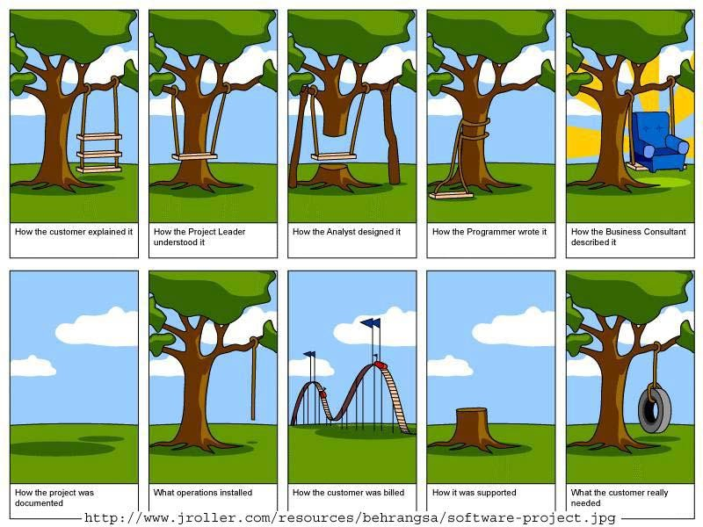
3

Slide 6
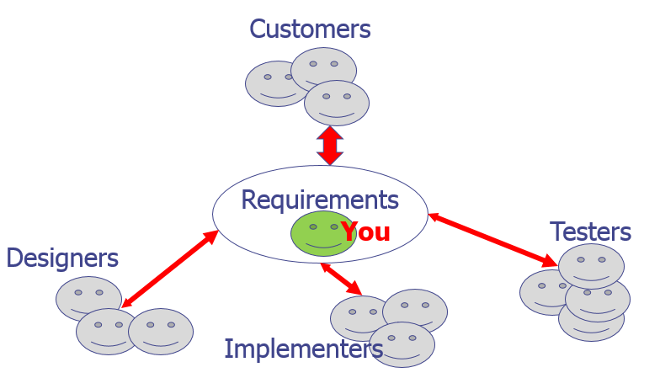
Importance of Requirements Analysis

Slide 7
Characteristics of a Good Requirement
Feasible (realistic)
Independent
Atomic
Necessary
Implementation-free (abstract)
Unambiguous
Testable (verifiable)
Concise
Correct
Understandable

Slide 8
Unambiguous
REQ: The system shall be implemented using ASP.
REQ: The system shall be implemented using Active Server Pages.
REQ: On the books screen, the user can only view one book.
REQ: On the books screen, the system shall display only one book.

Slide 9
Testable (Verifiable)
REQ: The user shall be able to search for books based on author’s name, title, etc.
REQ: The user shall be able to search for books based on author’s name or title.

Slide 10
Concise
REQ: Sometimes the user can search for books using author’s name, but sometimes he should be able to search using the book title. Yet, other times, the user can enter both.
REQ: The user shall be able to search for books based on author’s name or title.

Slide 11
Correct
REQ: Based on bank regulations, currency amounts shall be calculated and stored with accuracy of two decimal places.

Slide 12
Understandable
Requirements should be
grammatically correct
Written in a consistent style e.g. the word “shall” should be used instead of “will”, “must”, “can”, or “may”
REQ: The system shall remember customer data.
REQ: The system shall displayed order details.

Slide 13
Feasible (Realistic)
REQ: The system shall be able to understand commands given in Arabic language.

Slide 14
Independent
REQ: The administrator shall be able to enter the list of best selling books.
REQ: The system shall allow the user to view it.
REQ: He shall be able to enter books related to a given book.

Slide 15
Atomic
REQ: The system shall provide the ability to order books, browse the best-selling books, search for books, and view book information.

Slide 16
Necessary
A requirement is unnecessary if
It is not needed by any stakeholder
Or removing it will not affect the system
REQ: All requirements shall be implemented and tested.

Slide 17
Implementation-Free (Abstract)
Requirements should not contain unnecessary design and implementation information.
REQ: Customer information shall be stored in a text file.

Slide 18
Characteristics for the Set of Requirements
Consistent
Non-redundant
Complete

Slide 19
Consistent
There should be no conflict between requirements.
REQ1: Payment by PayPal shall be available.
REQ2: Only credit card payments shall be accepted.

Slide 20
Consistent
The applied terminology should be consistent
REQ1: Users shall be able to view best selling books.
REQ2: An administrator shall be able to add books to the highest-sales books.

Slide 21
Non-redundant
There should be no overlapping between requirements
REQ1: A calendar shall be available to help with entering the flight date.
REQ2: The system shall display a calendar when entering any date.

Slide 22
Complete
All applicable requirements should be specified.

Slide 23
What VERSUS How
Requirements should not contain:
Project information
Budget information
Testing information
Design information
Unless the customer really demands it
Put under design constraints to distinguish from other requirements

Slide 24
Types of Requirements (based on what they describe)
Requirements types
Functional requirements
Non-functional requirements
Design constraint

Slide 25
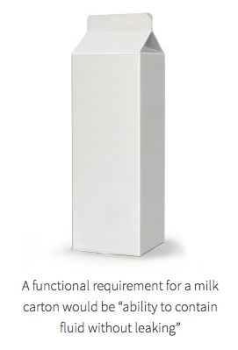
Functional Requirement
The activity that the system must perform.
It related directly to a process a system has to perform or information it need to contain.
Functional requirements flow directly into the creation of functional, structural and behavioral models.

Slide 26
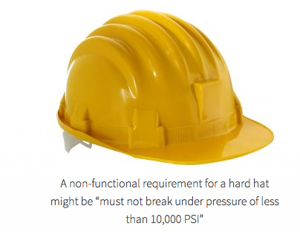
Non-functional requirement
The definition for a non-functional requirement is that it essentially specifies how the system should behave and that it is a constraint upon the systems behavior.
One could also think of non-functional requirements as quality attributes for of a system.
Simply put, the difference is that non-functional requirements describe how the system works, while functional requirements describe what the system should do.

Slide 27
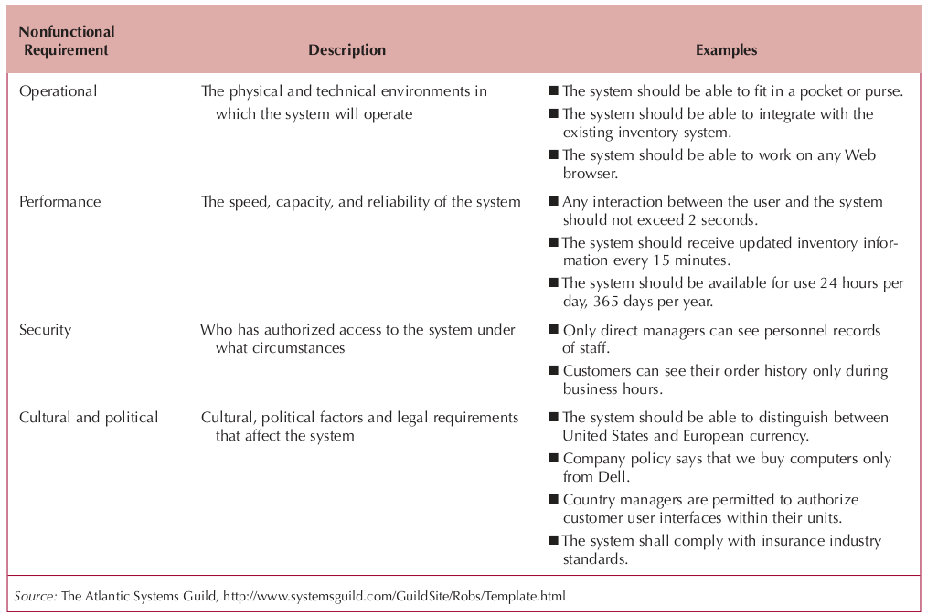

Slide 28
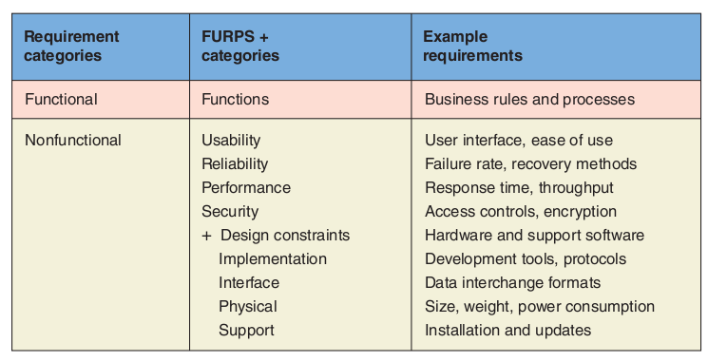
FURPS+ Framework

Slide 29
Stakeholders
People or organizations that are affected by the proposed system or have a potential influence on the requirements .
Includes:
–Client
–User
–Development team
– Sponsor
–Others involved in context of use
•Important to involve key stakeholders in requirements capture process

Slide 30
Requirements gathering techniques
• Requirements capture techniques:
– Observation
– Interview
– Questionnaires
– Scenario Walkthroughs
– Focus groups
– Prototypes.

Slide 31
Approaches to requirements capture
•
Result:
•
•
•
•
Large legalistic documents
Easy to misinterpret
Changes hard
to manage
Easy
to
miss
/
omit
requirements

Slide 32
Approaches to requirements capture
•
Modern approach
–
Model using UML
•
Use cases are used
– Use Case Diagram
to capture functional requirements
– Set of Use Case descriptions

