Slide 1
Introduction To System Analysis and Design

Slide 2
What Is An Information System?
An information system is a collection of interrelated components that collect, process and store, and provide as output the information needed to complete a business task.

Slide 3
Examples of Information Systems
Course registration system
Online order system
Online banking system

Slide 4
What Is System Analysis About?
Understanding the goals and strategies of the business.
Defining the information requirements that support those goals and strategies.
It is not about programming.

Slide 5
System Analysis vs. System Design
System Analysis:
Investigation of the problem and requirement rather than solution.
System Design:
A conceptual solution that fulfills the requirements, rather than implementation.

Slide 6
System Analyst
A business professional who uses analysis and design techniques to solve business problems using information technology.

Slide 7
The Role of a System Analyst
Business knowledge.
Business problem solver.
Help translate business requirements into IT projects.

Slide 8
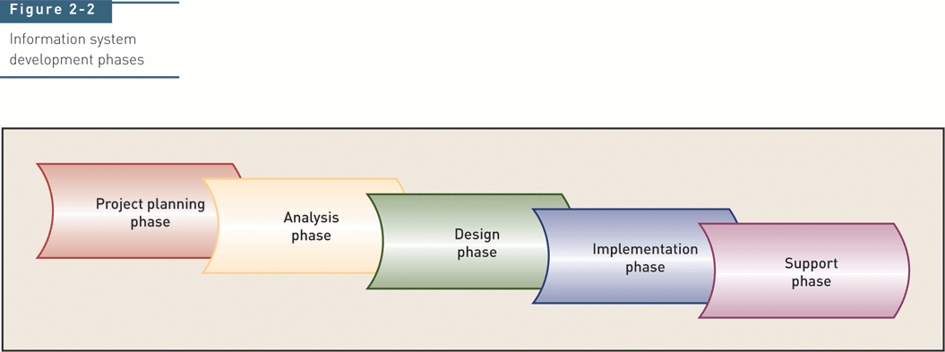
Traditional System Development Life Cycle (SDLC)

Slide 9
Traditional System Development life Cycle (SDLC)
Project planning – initiate, ensure feasibility, plan schedule, obtain approval for project
Analysis – understand business needs and processing requirements
Design – define solution system based on requirements and analysis decisions
Implementation – construct, test, train users, and install new system
Support – keep system running and improve it

Slide 10
Each of the phases include a set of steps, which rely on techniques that produce specific deliverables that provide understanding about the project.

Slide 11
To Understand the SDLC:
Each phase consists of steps that lead to specific deliverables
The system evolves through gradual refinement

Slide 12
Planning
This phase is the fundamental process of understanding why an information system should be built.
The Planning phase will also determine how the project team will go about building the information system.
The Planning phase is composed of two planning steps.

Slide 13
Planning
During project initiation, the system’s business value to the organization is identified (How will it lower costs or increase revenues?) as well as the feasibility of the project from different point of views
During project management, the project manager creates a work plan, staffs the project, and puts techniques in place to help the project team control and direct the project through the entire SDLC.

Slide 14
Analysis
The analysis phase answers the questions of who will use the system, what the system will do, and where and when it will be used.
During this phase the project team investigates any current system(s), identifies improvement opportunities, and develops a concept for the new system.
This phase has three analysis steps.

Slide 15
Analysis
Analysis strategy: This is developed to guide the projects team’s efforts. This includes an analysis of the current system.
Requirements gathering: The analysis of this information leads to the development of a concept for a new system. This concept is used to build a set of analysis models.
System proposal: The proposal is presented to the project sponsor and other key individuals who decide whether the project should continue to move forward.

Slide 16
Analysis
The system proposal is the initial deliverable that describes what business requirements the new system should meet.
The deliverable from this phase is both an analysis and a high-level initial design for the new system.

Slide 17
Design
In this phases it is decided how the system will operate, in terms of the hardware, software, and network infrastructure; the user interface, forms, and reports that will be used; and the specific programs, databases, and files that will be needed.

Slide 18
Design
Design Strategy: This clarifies whether the system will be developed by the company or outside the company.
Architecture Design: This describes the hardware, software, and network infrastructure that will be used.
Database and File Specifications: These documents define what and where the data will be stored.
Program Design: Defines what programs need to be written and what they will do.
UI Design

Slide 19
Implementation
During this phase, the system is either developed or purchased (in the case of packaged software).
This phase is usually the longest and most expensive part of the process.
The phase has three steps.

Slide 20
Implementation
System Construction: The system is built and tested to make sure it performs as designed.
Installation: Prepare to support the installed system.
Support Plan: Includes a post-implementation review.

Slide 21
Category I of the System Development Methodology: Structured Design
Structured design methodologies adopt a formal step-by-step approach to the SDLC that moves logically from one phase to the next.
This design methodology introduces the use of formal modeling or diagramming techniques to describe business processes (process models) and data (data models).

Slide 22
Category I of the System Development Methodology: Waterfall Development
With waterfall development- based methodologies, the analysts and users proceed sequentially from one phase to the next.
The two key advantages of waterfall development-based methodologies are:
- The system requirements are identified long before programming begins. - Changes to the requirements are minimized as the project proceeds.

Slide 23
Waterfall Development
The two key disadvantages of waterfall development-based methodologies are: - The design must be completely specified before programming begins.
- A long time elapses between the completion of the system proposal in the analysis phase and the delivery of the system.

Slide 24
Waterfall Development-based Methodology

Slide 25
Parallel Development
This methodology attempts to address the long time interval between the analysis phase and the delivery of the system.
Additional work:
Project division
Integration at the end.

Slide 26
A general analysis/design for the entire system is performed and then the project is divided into a series of distinct subprojects.

Slide 27
Rapid Application Development (RAD)
RAD-based methodologies adjust the SDLC phases to get some part of system developed quickly and into the hands of the users.
Most RAD-based methodologies recommend that analysts use special techniques and computer tools to speed up the analysis, design, and implementation phases, such as CASE (computer-aided software engineering) tools.

Slide 28
RAD: Phased Development
This methodology breaks the overall system into a series of versions that are developed sequentially.
The team categorizes the requirements into a series of versions, then the most important and fundamental requirements are bundled into the first version of the system.
The analysis phase then leads into design and implementation; however, only with the set of requirements identified for version 1.
As each version is completed, the team begins work on a new version.

Slide 29
Phased Development-based Methodology

Slide 30
RAD
One possible problem with RAD-based methodologies is managing user expectations.

Slide 31
RAD: Prototyping
Prototyping-based methodologies perform the analysis, design and implementation phases concurrently.
All three phases are performed repeatedly in a cycle until the system is completed.
A prototype is a smaller version of the system with a minimal amount of features.

Slide 32
Prototyping-based Methodology

Slide 33
RAD: Prototyping
Advantage: Provides a system for the users to interact with, even if it is not initially ready for use. The user can give feedback.
Disadvantages:
Manage user expectations.
Forget some important points since we are prototyping (opposite of careful design)

Slide 34
Agile Development
This category focuses on streamlining the SDLC by eliminating much of the modeling and documentation overhead and the time spent on those tasks.
Projects emphasize simple, iterative application development.
This category uses extreme programming, which is described next.

Slide 35
Extreme Programming (XP)
Extreme Programming (XP) was founded on four core values:
Communication
Simplicity
Feedback
Courage

Slide 36
Extreme Programming (XP)
Key principles of XP include:
Continuous testing
Simple coding
Close interaction with the end users to build systems very quickly

Slide 37
An Extreme Programming-based Methodology

Slide 38
Selecting the Appropriate Development Methodology
Selecting a methodology is not simple, as no one methodology is always best.
Many organizations have their own standards.
The next figure summarizes some important methodology selection criteria.

Slide 39
Selection criteria
Clarity of requirements
Familiarity with technology
System complexity
System reliability
Short time schedule
Schedule visibility
Others

Slide 40
Clarity of User Requirements
RAD methodologies of prototyping is usually more appropriate when user requirements are unclear as they provide prototypes for users to interact with early in the SDLC.

Slide 41
Familiarity with Technology
If the system is designed without some familiarity with the base technology, risks increase because the tools may not be capable of doing what is needed.

Slide 42
System Complexity
Complex systems require careful and detailed analysis and design.
Project teams who follow phased development-based methodologies tend to devote less attention to the analysis of the complete problem domain than they might if they were using other methodologies.

Slide 43
System Reliability
System reliability is usually an important factor in system development.

Slide 44
Short Time Schedules
RAD-based methodologies are well suited for projects with short time schedules as they increase speed.
Waterfall-based methodologies are the worst choice when time is essential as they do not allow for easy schedule changes.

Slide 45
Schedule Visibility
RAD-based methodologies move many of the critical design decisions earlier in the project; consequently, this helps project managers recognize and address risk factors and keep expectations high.

Slide 46
Selecting a Methodology

Slide 47
Two Approaches to System Development
Traditional (Structured) approach
Also called structured system development
Structured analysis and design technique (SADT)
Includes information engineering (IE)
Object-oriented approach
Also called OOA, OOD, and OOP
Views information system as collection of interacting objects that work together to accomplish tasks

Slide 48
Object-Oriented Approach
Completely different approach to information systems
Views information system as collection of interacting objects that work together to accomplish tasks
Objects – things in computer system that can respond to messages
Conceptually, no processes, programs, data entities, or files are defined – just objects
OO languages: Java, C++, C# .NET, VB .NET

Slide 49
Unified Modeling Language (UML)
UML (Unified Modeling Language) is a graphical language that is suit-able to express software or system requirements, architecture, and design.
UML used for both database and software modeling
UML modeling also supports multiple views of the same system.

Slide 50
UML diagrams
Can be categorized as the fallowing:
Structural diagrams:
Show the building blocks of your system—features that don’t change with time.
Ex: Class diagram
Behavioral diagrams:
Show how your system responds to requests or otherwise evolves over time.
Ex: Use case diagram
Interaction diagrams:
Is a type of behavioral diagram.
To depict the exchange of messages within a collaboration (a group of cooperating objects).
Ex: Sequence diagram & Collaboration diagram

Slide 51
UML Diagrams
Another way of categorizing UML diagram:
Static diagrams
to show the static features of the system. (no change)
Dynamic diagrams
to show how your system evolves over time.
Functional diagrams:
to show the details of behaviors and algorithms.

Slide 52
Object-oriented analysis (OOA)
Trying to figure out what the users and customers of a software effort want the System to do.
Builds a “real-world” model from requirements
client interviews, domain knowledge, real-world experience collected in use cases and other simple notations
OOA models address three aspects of the system (its objects)
class structure and relationships
sequencing of interactions and events
data transformations and computations

