Slide 1
Organic Chemistry
145 CHEM
Carbohydrates

Slide 2
Carbohydrates
The word carbohydrate can be expressed as hydrates of carbon because molecular formulas C_{n}(H₂O)_{n} of these compounds.
Example; Glucose has the molecular formula C₆H₁₂O₆, which might be written as C₆(H₂O)₆.
Carbohydrates are polyhydroxyaldehydes or polyhydroxyketones.
The chemistry of carbohydrates is mainly the combined chemistry of two functional groups: the hydroxyl group and the carbonyl group.
Carbohydrates are usually classified according to their structure as monosaccharides, disaccharides, oligosaccharides, or polysaccharides.

Slide 3

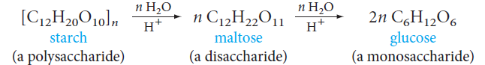
Carbohydrates
The term saccharide comes from Latin (saccharum, sugar) and refers to the sweet taste of some simple carbohydrates.
The three classes of carbohydrates are related to each other through hydrolysis.
Monosaccharides (or simple sugars) are carbohydrates that cannot be hydrolyzed to simpler compounds.

Slide 4
Carbohydrates
Disaccharides contain two monosaccharides
Example; Maltose is a disaccharide made of two glucose units.
Sucrose is made of two different monosaccharide units: glucose and fructose.
Oligosaccharides (from the Greek oligos, few) contain at least three and generally no more than a ten linked monosaccharide units. They may be called trisaccharides, tetrasaccharides, and so on, depending on the number of units, which may be the same or different.
Polysaccharides contain many monosaccharide units—sometimes hundreds or even thousands. Usually, but not always, the units are identical.
Example; starch and cellulose, contain linked units of the same monosaccharide, glucose.

Slide 5
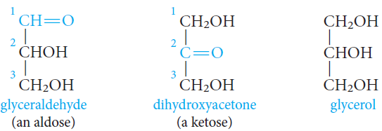
Monosaccharides
Monosaccharides are classified according to:
The number of carbon atoms present (triose, tetrose, pentose, hexose, and so on).
Whether the carbonyl group is present as an aldehyde (aldose) or as a ketone (ketose).
There are only two trioses: glyceraldehyde and dihydroxyacetone.
Glyceraldehyde is the simplest aldose, and dihydroxyacetone is the simplest ketose.
Each is related to glycerol in that each has a carbonyl group in place of one of the hydroxyl groups.

Slide 6
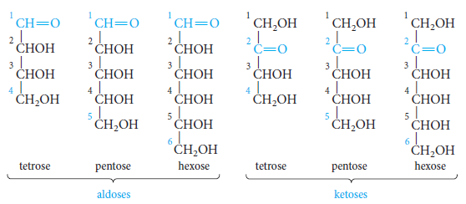
Monosaccharides
Other aldoses or ketoses can be derived from glyceraldehyde or dihydroxyacetone by adding carbon atoms, each with a hydroxyl group.
In aldoses, the chain is numbered from the aldehyde carbon.
In most ketoses, the carbonyl group is located at C-2.

Slide 7
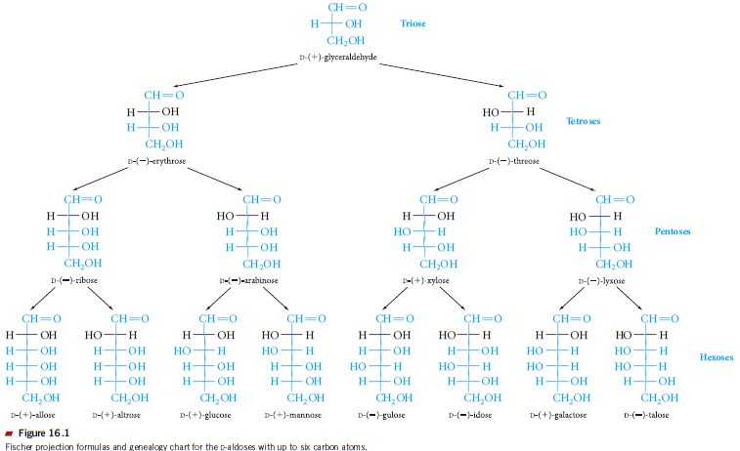
Monosaccharides

Slide 8
Plans of symmetry and chirality
A molecule or an everyday object without a plan of symmetry is not superimposable on its mirror image.
These two images have the same relation to each other that your left and right hands have when reflected in a mirror also the same relation two feet and golf clubs have to each other.
Thus this molecule or object is called chiral (Greek for hand) and these two forms are called enantiomers (non identical mirror- image forms)
Similarly, chiral carbon (stereogenic center) is any carbon doesn’t have a plan of symmetry thus it has to be connected to four different groups or atoms and can exist as a pair of two enantiomers.
Many organic compounds, including carbohydrates contain more than one chiral center.
Aldehyde cyanohydrin
chiral

Slide 9
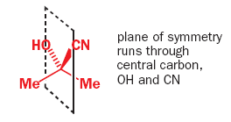
Plans of symmetry and chirality
On the other hand , a molecule (or an everyday object) does not have a stereogenic center thus it has a plan of symmetry will be superimposable on its mirror image
Thus this molecule or object is called achiral and it cannot exist as two enantiomers such as methane, acetone cycnohydrine, tennis racquets
acetone cyanohydrin
achiral
H.W.
Name the followoing carbohydrates and identify the chiral carbons (if any) in them by putting an asterisk at this carbon

Slide 10
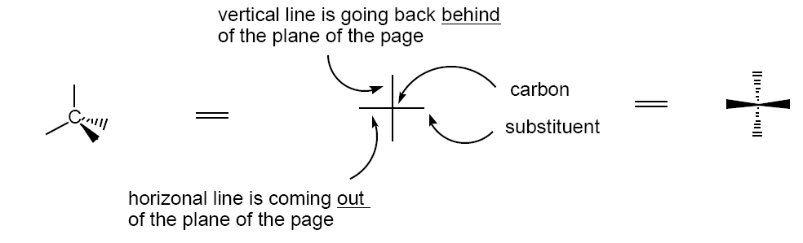
Methods of drawing monosaccharides
When a molecule has more than one chiral carbon each carbon can possibly be arranged in either right-hand or left-hand form in Fischer projection, thus if there are n chiral carbons, there are 2^{n} possible stereoisomers.
Maximum number of possible stereoisomers = 2^{n}
Fischer projection and Dand L noation
Fischer projection is a method of representing chiral molecules in two dimensions using vertical and horizontal lines.
The vertical lines represent bond pointing away from the viewer and are drawn behind the plan of the paper (shown as dashed line).
The horizontal lines represent bond coming towards the viewer and drawn project out of the plane of the paper (solid wedge)

Slide 11
Fischer projection and D and L notation
For carbohydrates the convention is to put the carbonyl group at the top for aldoses and closest to the top for ketoses, then the carbon atoms are numbered from the top to the bottom.
The simplest aldose is glyceraldehyde (aldotriose), it is the simplest chiral molecule in nature with one stereogenic centre thus it can be represented as a pair of enantiomers.
L- Glyecraldehyde
D- Glyecraldehyde
As shown in the above the isomer of glyeraldehyde with the OH group on the chiral carbon is pointing to the right is described to have D configuration (for dextro- because it rotates the plan polarized light to right (+)) while the isomer with the OH pointing to left it is assigned the L-configuration (for laevo-because it was (-)-enantiomer)

Slide 12
Fischer projection and D and L notaion
However, D and L notations are now used only to describe the configuration of certain well known naturally occurring compounds relative to glyceraldehyde molecules and regardless of optical activity for examples, the D-sugars and L-amino acids.
Thus to assign the configuration of a monosaccharide molecule that has more than one chiral centre as D or L you have to look at the chiral carbon farthest from the carbonyl group in Fischer projection and assign its configuration as D or L as described before.

Slide 13
The Cyclic Hemiacetal Structures of Monosaccharides
Monosaccharides exist mainly in cyclic, hemiacetal forms and not in the acyclic aldo- or keto-forms.
Manipulation of the Fischer projection formula of D-glucose to bring the C-5 hydroxyl group in position for cyclization to the hemiacetal form.

Slide 14
Drawing different stereoisomers
If the molecule has more than one chiral carbon thus it can be represented by different stereoisomers.
To draw an enantiomer ofa molecule you have to revert the configuration at all of the chiral centers together in Fischer projection.
While, reverting the configuration at only one stereogenic centre will result in two structures known as Epimers.
Reverting the configuration at more than one stereogenic centre at once will result in structures known as diasteroisomers.

Slide 15
Haworth projection
The carbons are arranged clockwise numerically, with C-1 at the right.
Substituents attached to the ring lie above or below the plane.
Carbons 1 through 5 are part of the ring structure, but carbon 6 (the -CH2OH group) is a substituent on the ring.
C-1 is special. C-1 is the hemiacetal carbon (it carries a hydroxyl group, and it is also connected to C-5 by an ether linkage).
C-2, C-3, and C-4 are secondary alcohol carbons.
C-6 is a primary alcohol carbon;
Hydroxyl groups on the right in the Fischer projection are down in the Haworth projection (and conversely, hydroxyl groups on the left in the Fischer projection are up in the Haworth projection).
For D-sugars, the terminal -CH2OH group is up in the Haworth projection; for L-sugars, it is down.

Slide 16
Anomeric Carbons; Mutarotation
Anomeric carbon; The hemiacetal carbon, the carbon that forms the new stereogenic center.
Anomers; Two monosaccharides that differ only in configuration at the anomeric center are (a special kind of epimers).
Anomers are called α or β, depending on the position of the hydroxyl group.
For monosaccharides in the D-series, the hydroxyl group is “down” in the α anomer and “up” in the β anomer.

Slide 17
If D-glucose is crystallized from methanol, the pure α form is obtained.
Crystallization from acetic acid gives the β form.
The α and β forms of D-glucose are diastereomers.

Slide 18
Conformations of Pyranoses; chair conformation
At the anomeric carbon (C-1), where the hydroxyl group may be axial (in the α anomer) or equatorial (in the β anomer).

Slide 19
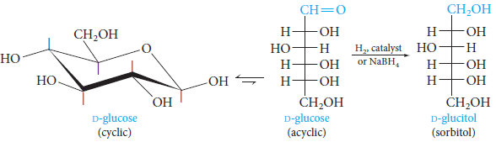
Reactions of Monosaccharides
1) Reduction of Monosaccharides
The carbonyl group of aldoses and ketoses can be reduced by various reagents to give polyols, called alditols.
Example, catalytic hydrogenation or reduction with sodium borohydride (NaBH4) converts D-glucose to D-glucitol (sorbitol).
Sorbitol is used commercially as a sweetener and sugar substitute.

Slide 20
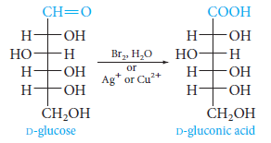
2) Oxidation of Monosaccharides
2.1. With Mild Oxidizing Agents
These aldehyde groups can be easily oxidized to acids which are called aldonic acids.
For example, D-glucose is easily oxidized to D-gluconic acid.
The oxidation of aldoses is so easy that they react with such mild oxidizing agents as Tollens’ reagent (Ag⁺ in aqueous ammonia), Fehling’s reagent (Cu²⁺ complexed with tartrate ion), or Benedict’s reagent (Cu²⁺ complexed with citrate ion).

Slide 21

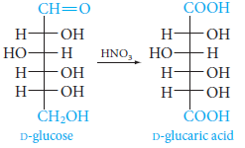
2) Oxidation of Monosaccharides
With the copper reagents, the blue solution gives a red precipitate of cuprous oxide, Cu₂O.
A carbohydrate that reacts with Ag⁺ or Cu²⁺ is called a reducing sugar
2.2. With Strong Oxidizing Agents
Stronger oxidizing agents, such as aqueous nitric acid, oxidize the aldehyde group and the primary alcohol group, producing dicarboxylic acids called aldaric acids.
For example, D-glucose gives D-glucaric acid.

Slide 22
Disaccharides
The most common oligosaccharides are disaccharides.
In a disaccharide, two monosaccharides are linked by a glycosidic bond between the anomeric carbon of one monosaccharide unit and a hydroxyl group on the other unit.

Slide 23
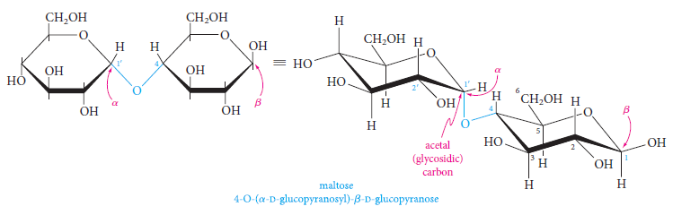
Maltose
Maltose is the disaccharide obtained by the partial hydrolysis of starch.
Further hydrolysis of maltose gives only D-glucose.
Maltose must, therefore, consist of two linked glucose units.
It turns out that the anomeric carbon of the left unit is linked to the C-4 hydroxyl group of the unit at the right as an acetal (glycoside).
The configuration at the anomeric carbon of the left unit is α.

Slide 24
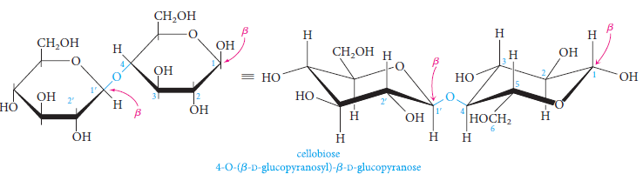
Cellibiose
Cellobiose is the disaccharide obtained by the partial hydrolysis of cellulose.
Further hydrolysis of cellobiose gives only D-glucose.
Cellobiose must therefore be an isomer of maltose.
In fact, cellobiose differs from maltose only in having the β configuration at C-1 of the left glucose unit.

Slide 25
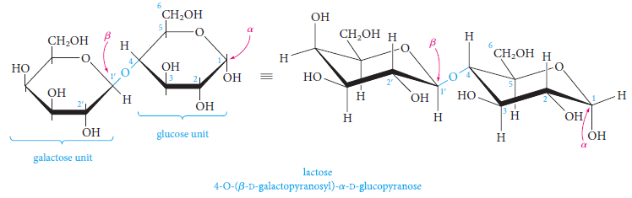
Lactose
Lactose is the major sugar in human and cow’s milk (4% to 8% lactose).
Hydrolysis of lactose gives equimolar amounts of D-galactose and D-glucose.
The anomeric carbon of the galactose unit has the β configuration at C-1 and is linked to the hydroxyl group at C-4 of the glucose unit.

Slide 26
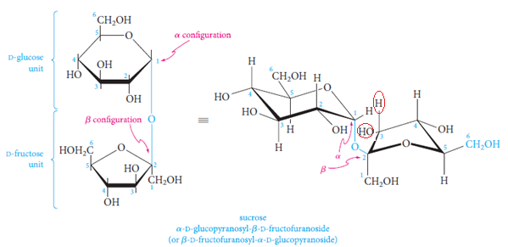
Sucrose
The most important commercial disaccharide is sucrose, ordinary table sugar.
Sucrose occurs in all photosynthetic plants, where it functions as an energy source.
It is obtained commercially from sugar cane and sugar beets, in which it constitutes 14% to 20% of the plant juices.
Sucrose is very water soluble (2 grams per milliliter at room temperature) because it is polar due to the presence of eight hydroxyl groups on its surface.
Hydrolysis of sucrose gives equimolar amounts of D-glucose and the ketose D-fructose.

Slide 27
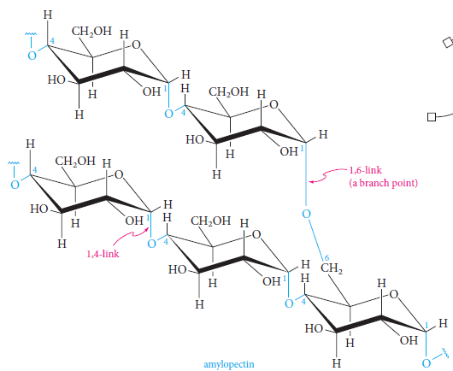
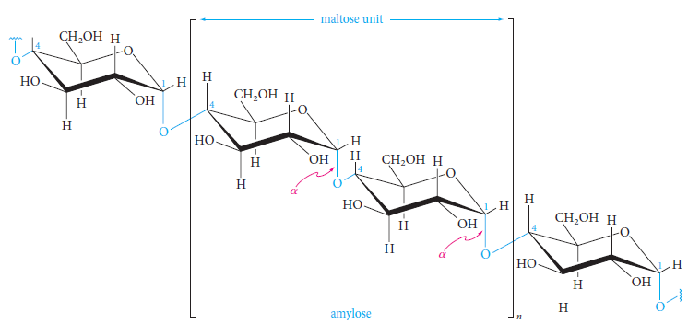
Polysaccharides
Polysaccharides contain many linked monosaccharides and vary in chain length and molecular weight.
Most polysaccharides give a single monosaccharide on complete hydrolysis.
The monosaccharide units may be linked linearly, or the chains may be branched.
Starch

Slide 28
Starch
Starch is the energy-storing carbohydrate of plants.
It is a major component of cereals, potatoes, corn, and rice.
Starch is made up of glucose units joined mainly by 1,4-α-glycosidic bonds, although the chains may have a number of branches attached through 1,6- α -glycosidic bonds.
Partial hydrolysis of starch gives maltose, and complete hydrolysis gives only D-glucose.
Starch can be separated by various techniques into two fractions: amylose and amylopectin.
In amylose, which constitutes about 20% of starch, the glucose units (50 to 300) are in a continuous chain, with 1,4 linkages.
Amylopectin is highly branched. Although each molecule may contain 300 to 5000 glucose units, chains with consecutive 1,4 links average only 25 to 30 units in length.
These chains are connected at branch points by 1,6 linkages.

Slide 29
Glycogen
Glycogen is the energy-storing carbohydrate of animals.
Like starch, it is made of 1,4- and 1,6-linked glucose units.
Glycogen has a higher molecular weight than starch (perhaps 100,000 glucose units), and its structure is even more branched than that of amylopectin, with a branch every 8 to 12 glucose units.
Glycogen is produced from glucose that is absorbed from the intestines into the blood; transported to the liver, muscles, and elsewhere; and then polymerized enzymatically.
Glycogen helps maintain the glucose balance in the body by removing and storing excess glucose from ingested food and later supplying it to the blood when various cells need it for energy.

Slide 30
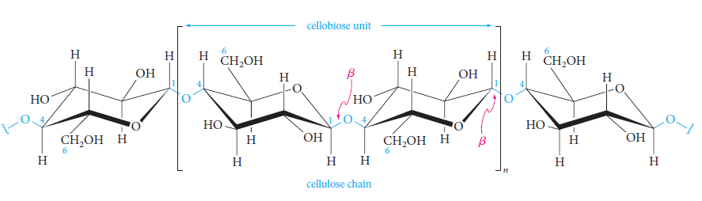
Cellulose
Cellulose is an unbranched polymer of glucose joined by 1,4-β-glycosidic bonds.
It consists of linear chains of cellobiose units.
These linear molecules, containing an average of 5000 glucose units, aggregate to give fibrils bound together by hydrogen bonds between hydroxyls on adjacent chains.
Cellulose fibers having considerable physical strength are built up from these fibrils, wound spirally in opposite directions around a central axis.
Wood, cotton, hemp, linen, straw, and corncobs are mainly cellulose.

