Slide 1
Chem. 108
Alcohols
and
Phenols
Chapter 7

Slide 2
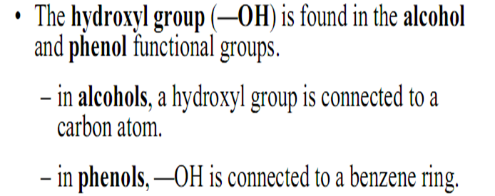
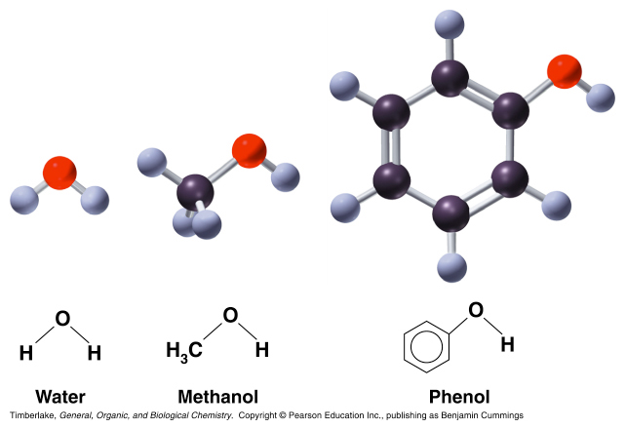
Alcohols and Phenols
The Hydroxyl group (-OH)
sp²
sp³

Slide 3
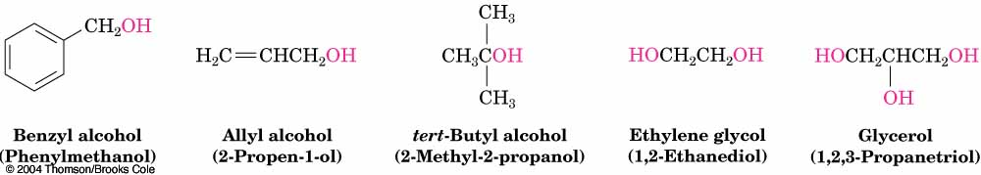
Types of Alcohols
1- Monohydroxyls: containing one hydroxyl group
2- Dihydroxyls (glycols) : containing two hydroxyl groups
3- Polyhydroxyls : containing more than two hydroxyl groups

Slide 4
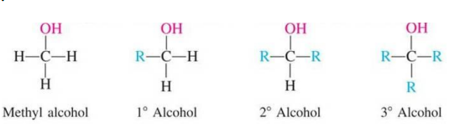
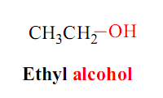
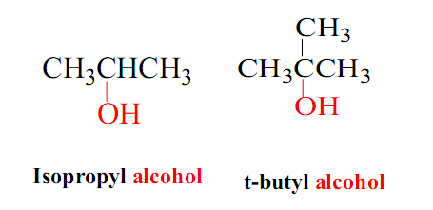
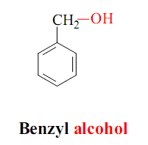
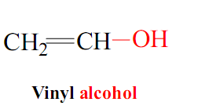
Classification of Alcohols
Carbinol Carbon
Nomenclature of Alcohols
Common Nomenclature:
Alkyl + alcohol

Slide 5
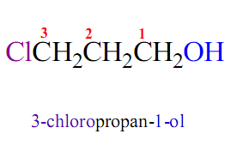
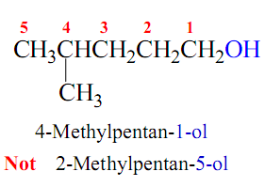
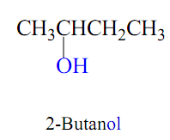
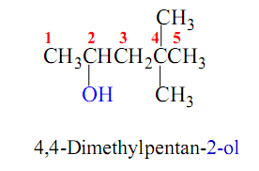
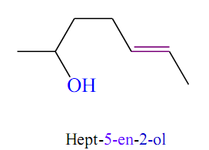
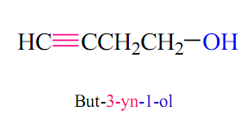
IUPAC Nomenclature:
Select the longest carbon chain containing the hydroxyl group.
derive the parent name by replacing the -e ending of the corresponding alkane with -ol.
Number the chain from the end nearer the hydroxyl group.

Slide 6
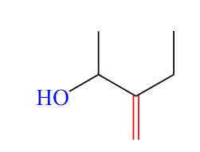
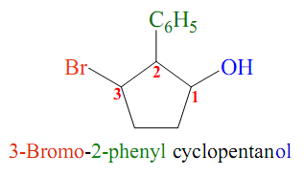
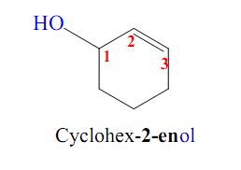

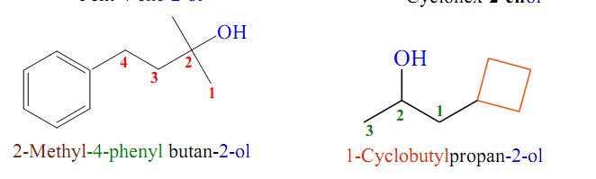

Slide 7
If more than one hydroxyl group, use suffixes
-diol, -triol, etc.
IUPAC name:
Common name:
1,2-Ethanediol
Ethylene glycol
1,2-Propanediol
Propylene glycol
1,3-Propanediol
Trimethylene glycol
1,2,3-propanetriol
Glycerol

Slide 8
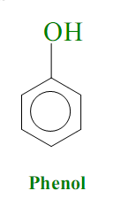
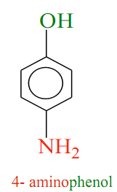
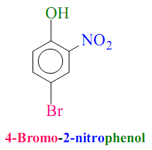
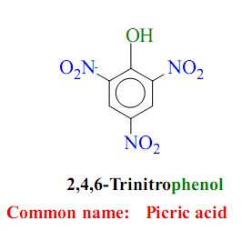
Nomenclature of Phenols
The ortho, meta, para system is used in common names.
While the numbering system is employed in IUPAC names
and in this case numbering of the ring begins at the hydroxyl
substituted carbon and proceeds in the direction of the next
substituted carbon that processes the lower number.

Slide 9
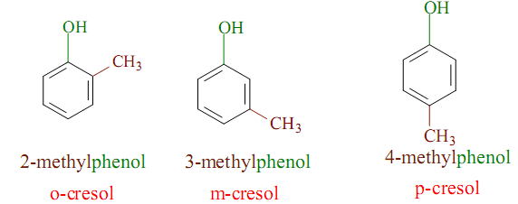
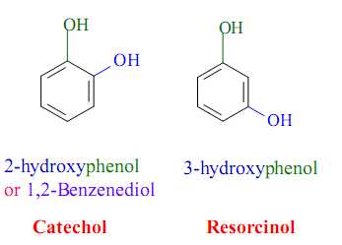
Some phenols have common names as shown in the following examples:

Slide 10
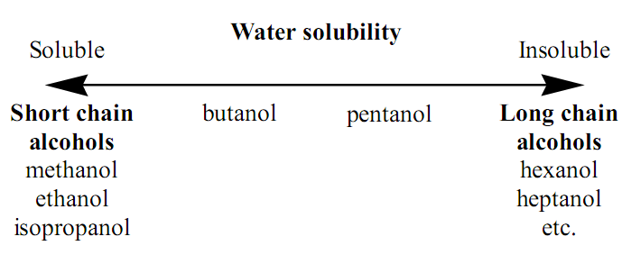
Physical Properties of Alcohols and Phenols
Smaller straight chain alcohols are usually liquids.
Phenols are crystalline solids or liquids.
Solubility of alcohols:

Slide 11
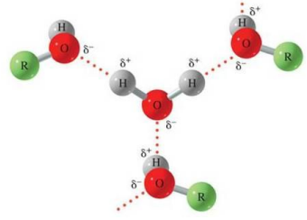
The solubility of lower alcohols is due to existence of hydrogen bonds between water and polar -OH group of alcohol molecules.
The solubility increases with branching of chain.
The number of hydroxyl groups increases the solubility.
Phenols are moderately soluble in water but readily soluble in organic solvents.

Slide 12
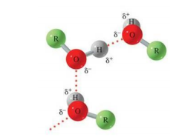
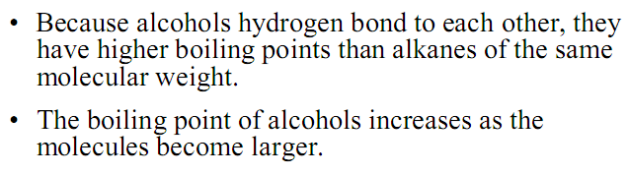
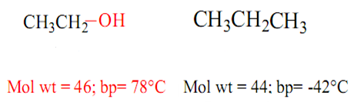
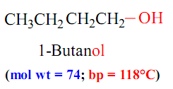
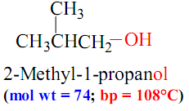
Boiling points of alcohols:
Ethanol
n-propane
The boiling point decreases with increase in branching in alkyl group.

Slide 13
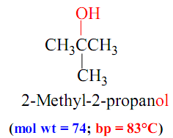
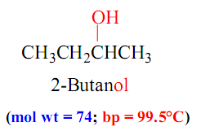
The boiling point increases with increase of number of hydroxyl groups.
Boiling points of 1° alcohol > 2° alcohol > 3° alcohol

Slide 14
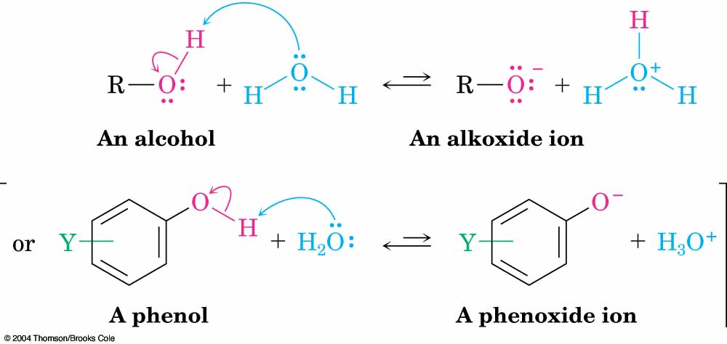
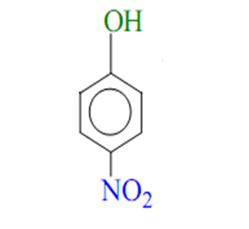
Acidities of Alcohols and Phenols:
Alcohols and Phenols have weak acidic properties.
Introduction of the electro-withdrawing groups, such as NO₂ or CN the ring increases the acidity of phenols dramatically.
>

Slide 15
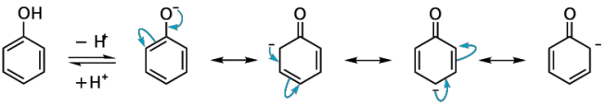
Phenols are a stronger acids than Alcohols.
Because the negative charge in oxygen is dispersed by resonance through the benzene ring.

Slide 16
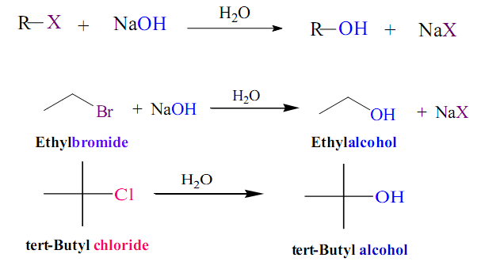
Preparation of Alcohols
1- Hydrolysis of Alkyl halide:
Examples:

Slide 17
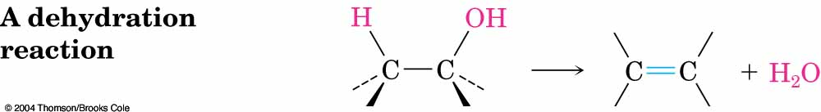
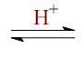
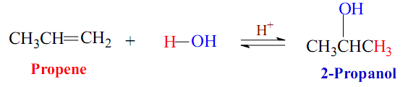
2- Hydration of Alkenes:
A- Markovnikov’s Rule
Addition of water to a double bond in the presence of
an acid catalysts.
₊
Example:

Slide 18
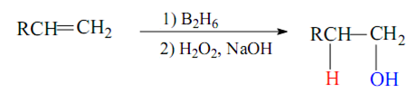
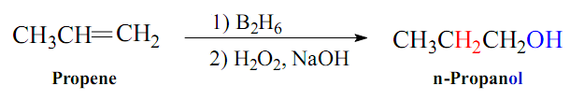
B- anti-Markovnikov’s Rule
Addition of diborane B₂H₆ , followed by oxidation with alkaline hydrogen peroxide H₂O₂,NaOH.
Example:

Slide 19
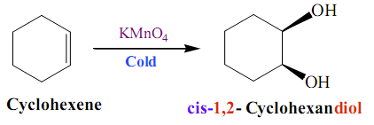
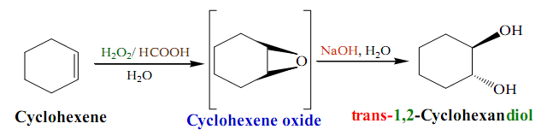
3- Oxidation of Alkenes to Vicinal Diols:
Oxidation of Alkenes with cold Potassium permanganate KMnO₄ or Osmium tetroxide OsO₄ provides occurs with syn addition and provides cis vicinal diols.
Oxidation of Alkenes with Peroxy acid HCOOOH provides occurs with anti addition and provides trans vicinal diols

Slide 20
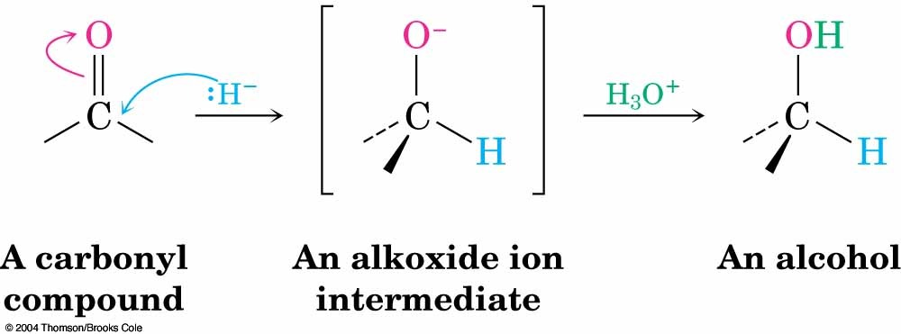
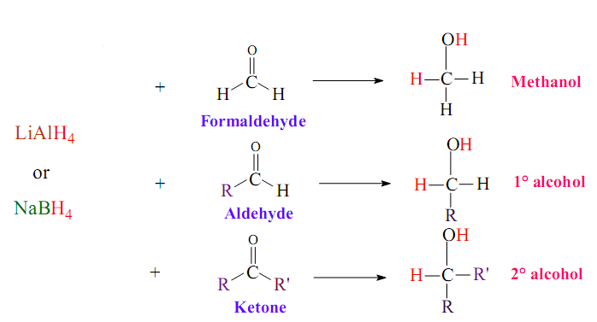
4- Reduction of Aldehydes, Ketones, Acids and Esters:
A- Reduction of Aldehydes and Ketones
Reduction by hydride reagents, Lithium aluminium hydride LiAlH₄
or Sodium boro hydride NaBH₄
1) LiAlH₄ / dry ether or NaBH₄
2) H₃O⁺
1) LiAlH₄ / dry ether or NaBH₄
2) H₃O⁺
1) LiAlH₄ / dry ether or NaBH₄
2) H₃O⁺

Slide 21
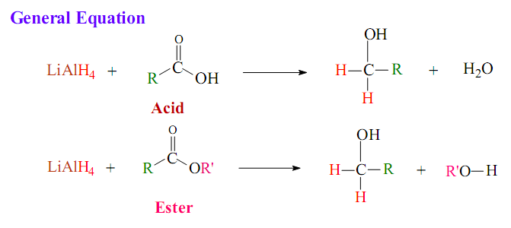
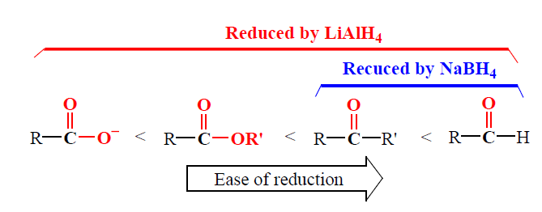
B- Reduction of Acids and Esters
Carboxylic acids and esters are reduced to give primary alcohols.
LiAlH₄ is used because NaBH₄ is not effective.
1) LiAlH₄ / dry ether
2) H₃O⁺
1) LiAlH₄ / dry ether
2) H₃O⁺

Slide 22
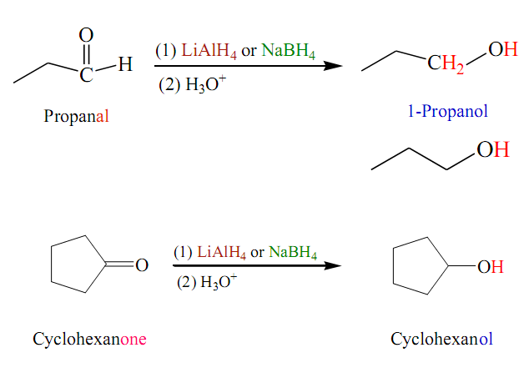
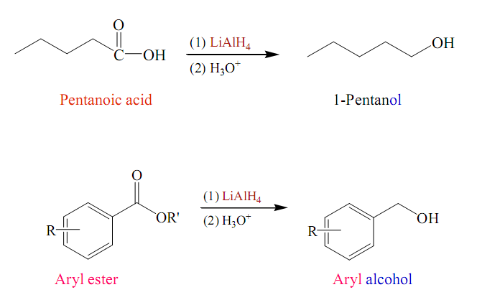
Examples:
1) LiAlH₄ / dry ether or NaBH₄
2) H₃O⁺
1) LiAlH₄ / dry ether or NaBH₄
2) H₃O⁺
1) LiAlH₄ / dry ether
2) H₃O⁺

Slide 23

5- From Grignard reagent:

Slide 24



Slide 25


Preparation of Phenols
A- Industrial process from readily available cumene (isopropylbenzen)

Slide 26


B- In the laboratory:
1- From Chlorobenzene
2- Alkali fusion of sulfonates

Slide 27

3- Hydrolysis of Diazonium salts
H₃O⁺

Slide 28

Reactions of Alcohols and Phenols
Alcohols undergo two kinds of reactions
Phenols undergo two kinds of reactions

Slide 29




A- Reactions involving oxygen-hydrogen bond breaking
1- Salt Formation
Alcohols
2 RO
Sodium alkoxide
Phenols
Sodium phenoxide

Slide 30


2- Reaction of Alcohols with Carboxylic acids: Ester Formation
Example:

Slide 31



B- Reactions involving carbon-oxgen bond breaking
1- Dehydrations of Alcohols: Formation of Alkenes
Examples:

Slide 32



2- Dehydrations of Alcohols: Ethers Formation
140 ⁰C
Example:
140 ⁰C

Slide 33


3- Replacement of the OH group by Halide: Alkyl Halides Formation

Slide 34

C- Oxidation of Alcohols to Carbonyl Compounds
Oxidation of alcohols gives different products depending on the class of alcohols that is oxidized and on the kind of oxidizing agent that is used.
Oxidizing agent:
Very strong: KMnO₄ / H⁺ / Δ
Strong: KMnO₄ / OH⁻ or H₂CrO₄ or K₂Cr₂O₄ / H⁺
Mild: CrO₃ / pyridine or Cu / 300 °C
.

Slide 35

[O]
Mild or strong oxidizing
[O]
+
very strong oxidizing
Examples:
[O]
No reaction
Mild or strong oxidizing
t-butyl alcohol
KMnO₄/ H⁺ / Δ
+
HCOOH
Acetone
Formic acid

Slide 36

H₂CrO₇

Slide 37

D- Reaction of Aromatic ring of Phenols
1- Halogenation
HBr
No reaction

Slide 38

2- Nitration
At high temperature
At low temperature
3- Sulphonation

Slide 39
Homework
1- Name the following compounds.
2- What is the correct IUPAC name.
    2-Methyl-2-penten-4-ol
    4-Chloro-5-phenyl-5-heptanol
    4-Bromocylohexanol

Slide 40
3- Complete the following reactions.

