Slide 1
Chem. 108
Unsaturated Hydrocarbons:
Alkenes
Chapter 3

Slide 2
Alkenes or Olefines
C_{n}H_{2n}
Crabon-carbon double bond
Nomenclature of Alkenes
Common names:
CH₂=CH- vinyl group
CH₂=CHCH₂- allyl group
ane
ylene
IUPAC rules:
Determine the parent name by selecting the longest chain that contains the double bond and change the ending of the name of the alkane of identical length from -ane to -ene.
Number the chain so as to include both carbon atoms of the double bond, and begin numbering at the end of the chain nearer the double bond. Designate the location of the double bond by using the number of the first atom of the double bond as a prefix.

Slide 3
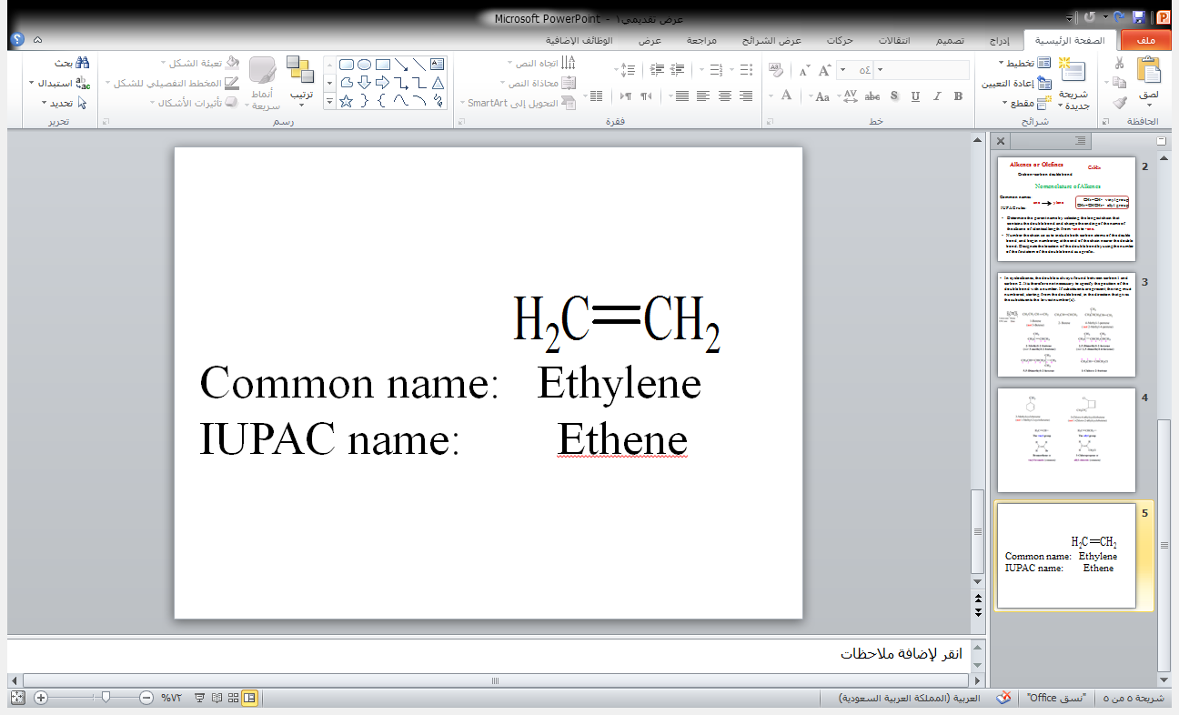
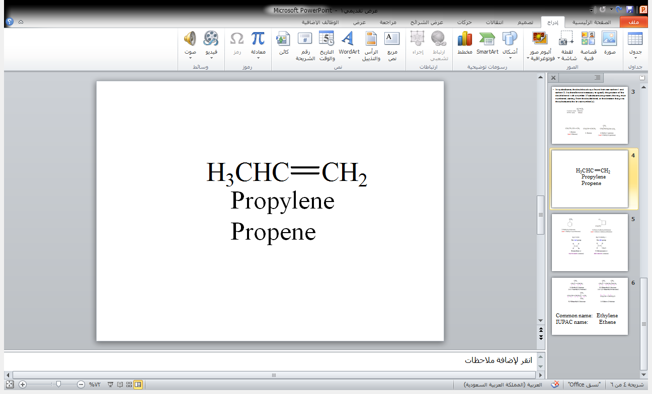
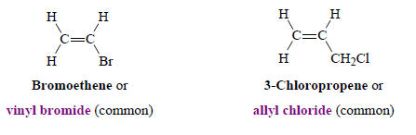
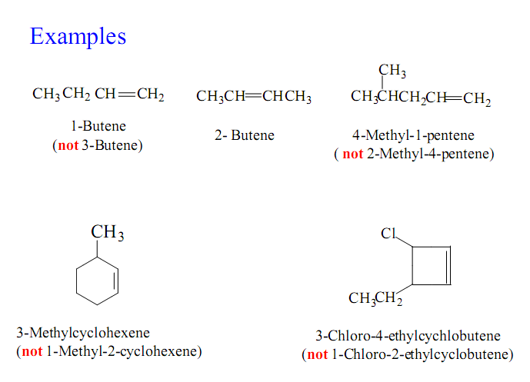
In cycloalkenes, the double is always found between carbon 1 and carbon 2. It is therefore not necessary to specify the position of the double bond with a number. If substituents are present, the ring must numbered, starting from the double bond, in the direction that gives the substituents the lowest number(s).
Examples

Slide 4
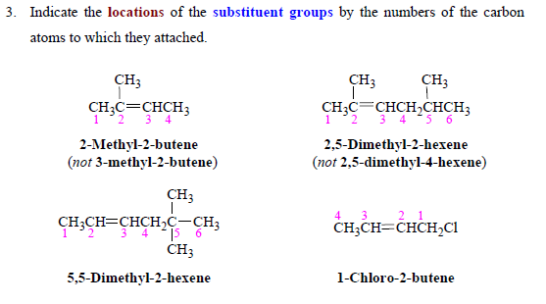

Slide 5
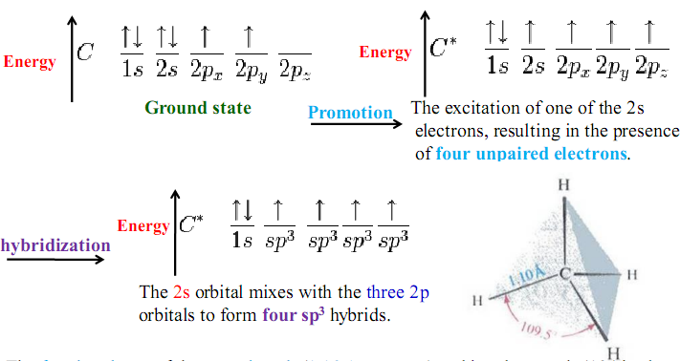
Hybridization in Alkanes:

Slide 6
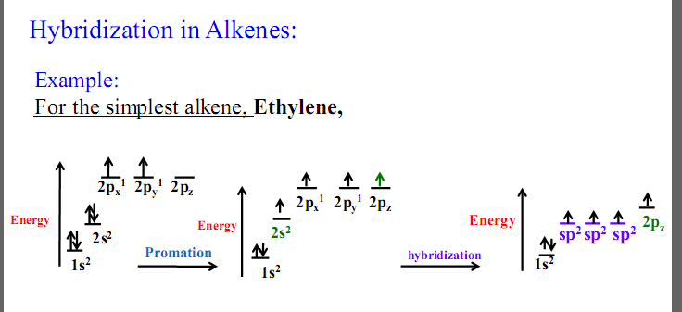
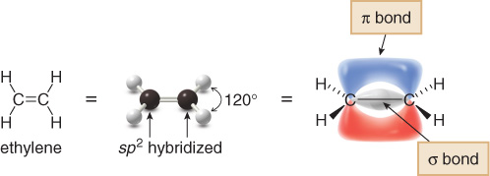
Hybridization in Alkenes:
1.34A°

Slide 7
Geometric Isomerism in Alkene
Cis-Trans Isomerism
cis (identical or analogous substituents on same side)
trans (identical or analogous substituents on opposite sides)

Slide 8
If either vinyl carbon is bonded to two equivalent groups, then no geometric isomerism exists.
CH₃CH=CHCH₃ CH₃CH₂CH=CH₂
yes no
CH₃
(CH₃)₂C=CHCH₃ CH₃CH=CCH₂CH₃
no yes

Slide 9
Examples:
H₃C
CH₃
H₃C
H
C
C
C
C
H
H
H
CH₃
cis-2-Butene
trans-2-Butene
Cl
Cl
Cl
H
C
C
C
C
H
H
H
Cl
cis-1,2-dichloroethene
trans-1,2-dichloroethene

Slide 10
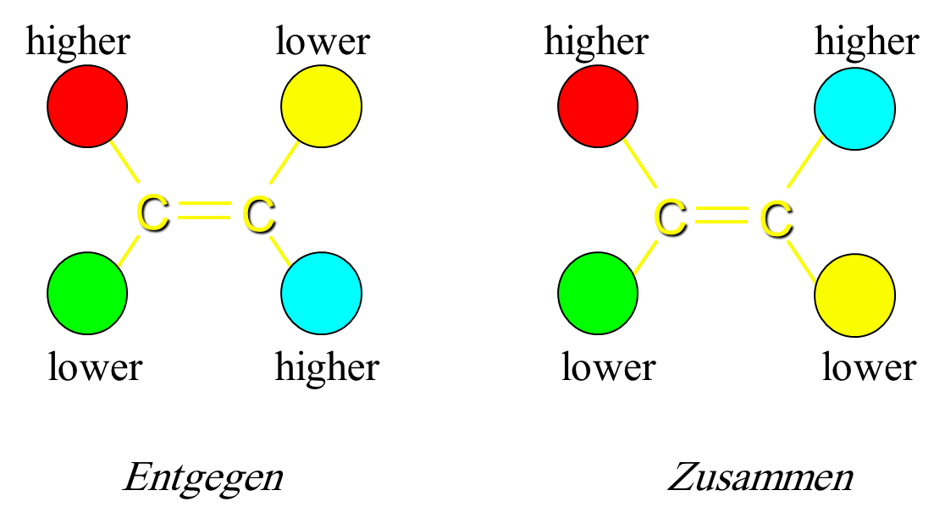
The E-Z System
E : Entgegen
higher ranked substituents on opposite sides
Z : Zusammen
higher ranked substituents on same side

Slide 11
Examples:
*
*
Z-3-methyl-2-pentene
*
E-1-bromo-1-chloropropene
*

Slide 12
Physical properties of alkenes
A Physical States and Solubilities
C₁-C₄
gases
C₅-C₁₈
liquids
More than C₁₈
solids
Alkenes are nonpolar compounds. Thus alkenes are soluble in
the nonpolar solvents such as carbon tetrachloride (CCl₄) and
benzene (C₆H₆), but they are insoluble in polar solvents such as water.

Slide 13
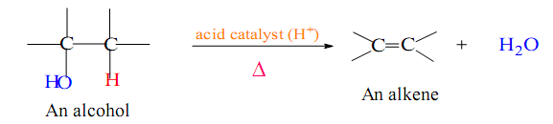
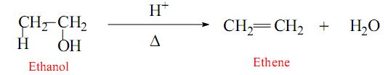
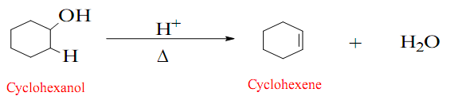
Preparation of alkenes
Alkenes can be prepared from alcohols and alkyl halides by elimination reactions.
1- Dehydration of Alcohols
Examples:

Slide 14
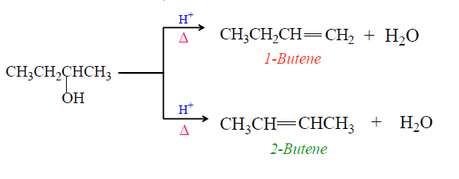
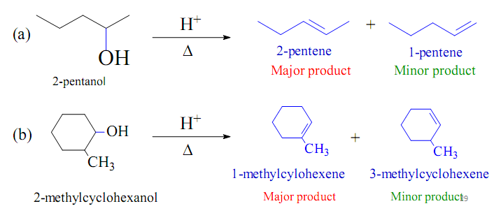
Which alkene Predominates?
How do you which one is major product?
Saytzeff’s Rule:
Hydrogen is preferably removed from the carbon with least no. of hydrogen since the alkene formed is more highly branched and is energetically more stable.
Examples:

Slide 15
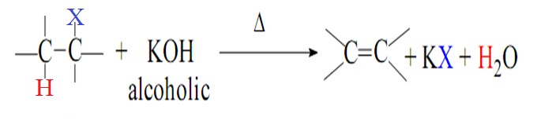
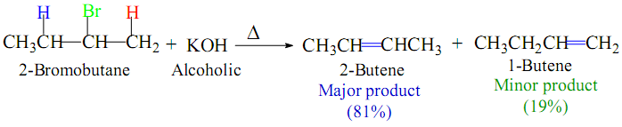
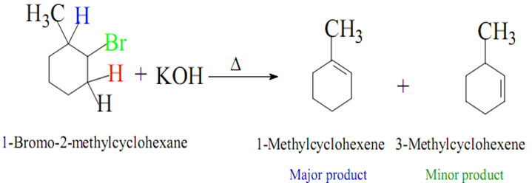
2- Dehydrohaloganation of Alkyl halides
In similar way to that in the dehydration of alcohol, Saytzeff’s rule again applies; that is, the alkene with the most alkyl substitution on the double-bonded carbons predominates.
Examples:

Slide 16
Saytzeff orientation:
Ease of formation of alkenes:
R₂C=CR₂ > R₂C=CHR > R₂C=CH₂, RCH=CHR > RCH=CH₂ > CH₂=CH₂
Stability of alkenes:
R₂C=CR₂ > R₂C=CHR > R₂C=CH₂, RCH=CHR > RCH=CH₂ > CH₂=CH₂

Slide 17
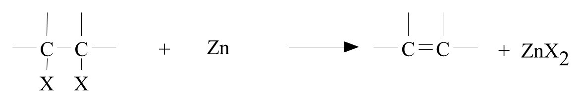
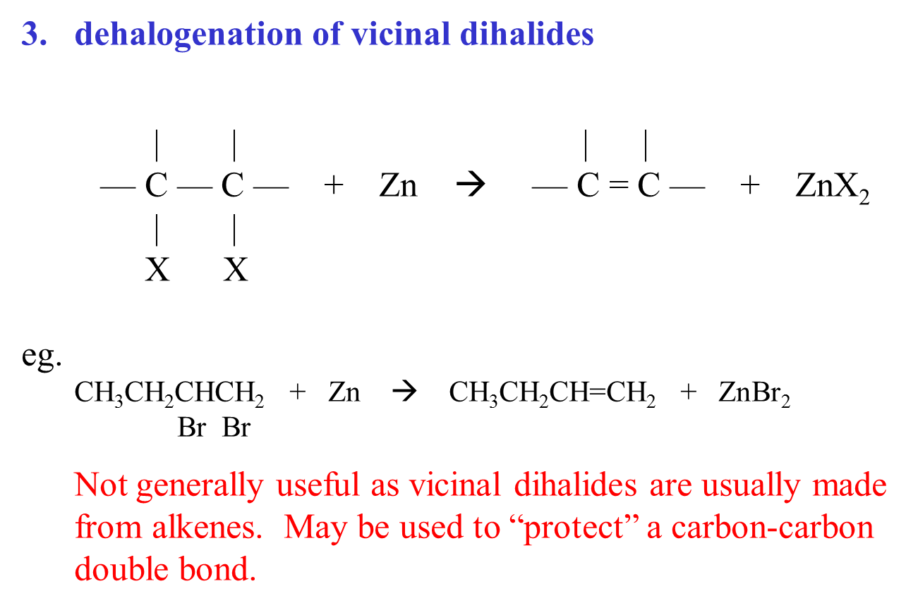
3- Dehaloganation of vicinal dihalides
alcohol
Example:
CH₃OH

Slide 18
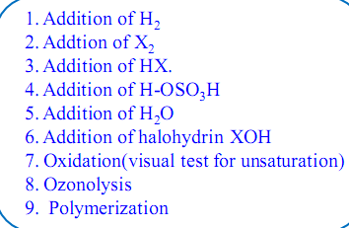
Reaction of alkenes
1- Addition reactions on the carbon-carbon double bond.
2- Substitution reactions on the saturated alkyl chain.
Addition reactions
Substitution reactions
1- Halogenation at High temperature

Slide 19
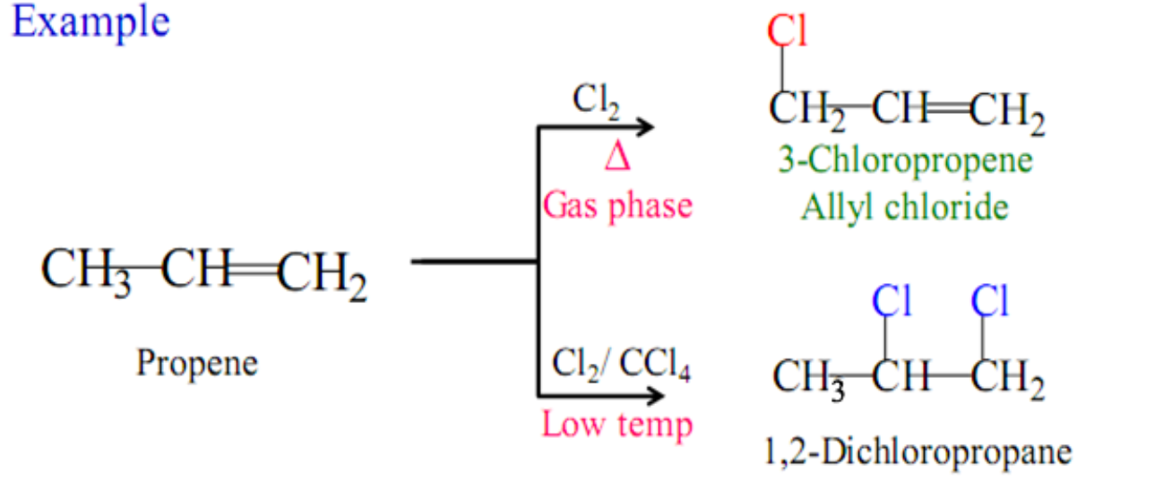
Substitution reactions
Halogenation at High temperature
Addition reaction:
low temperature
Absence of light
Substitution reaction:
High temperature
or Ultraviolet light

Slide 20
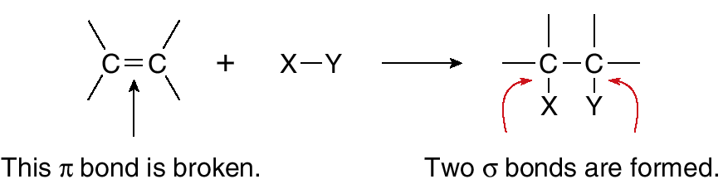
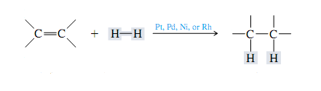
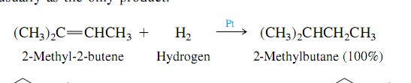
Addition reactions
1- Addition of Hydrogen: Catalytic Hydrogenation
Example:

Slide 21
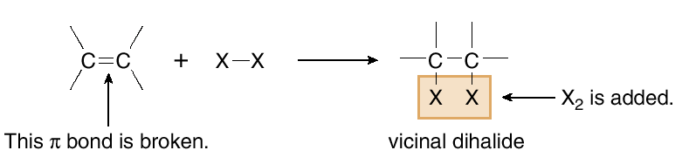
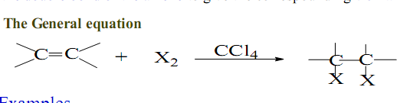
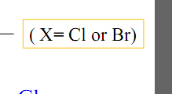
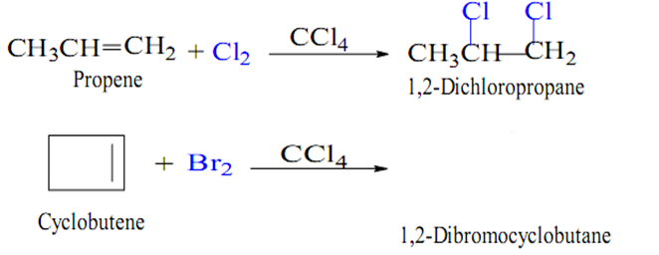
2- Addition of Halogens: Halogenation
Examples:

Slide 22
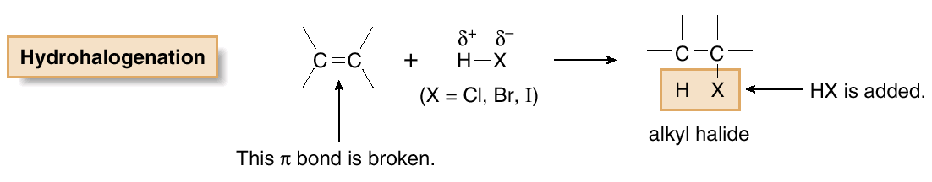
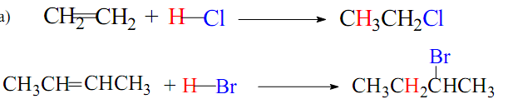
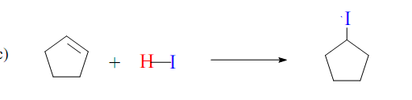
3- Addition of Hydrogen Halides: Hydrohalogenation
Examples:

Slide 23
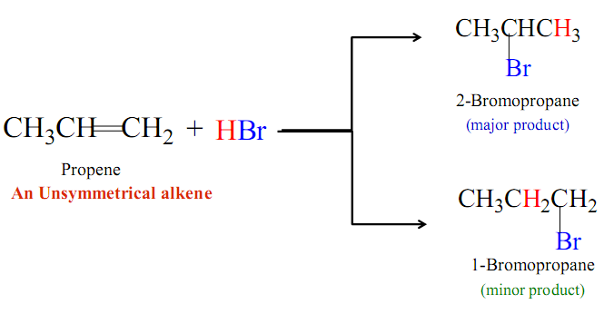
Markovnikov’s Rule
With unsymmetrical alkene
In the addition of an acid to an alkene the hydrogen will go to the vinyl carbon that already has the greater number of hydrogens.

Slide 24
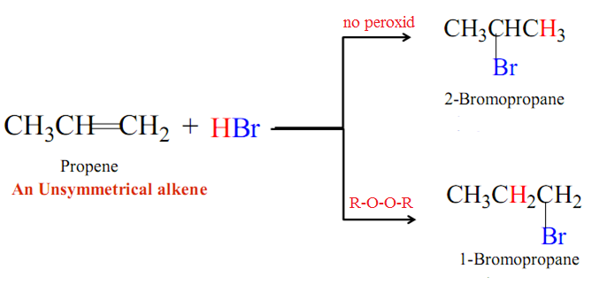
Anti Markovnikov’s Rule
In the addition of an acid to an alkene the hydrogen will go to the vinyl carbon that already has the lowest number of hydrogens.

Slide 25
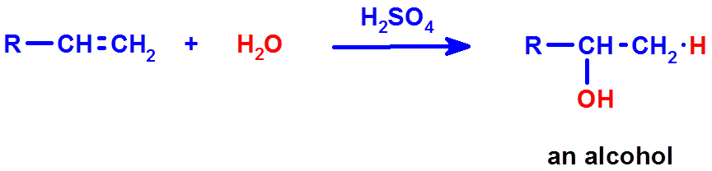
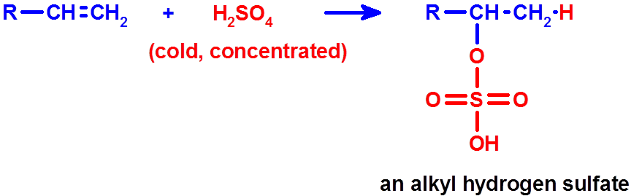
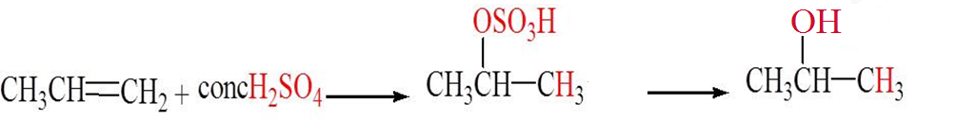
4- Addition of Sulfuric acid
heat
(H-OSO₃H)
Addition of Sulfuric acid to alkenes also follows Markovnikov’s rule,
as the example
H₂O
heat
Propene
Isopropyl hydrogen sulfate
2-Propanol

Slide 26
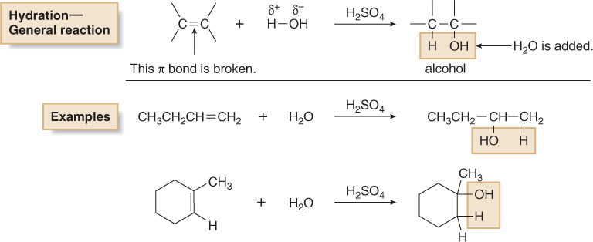
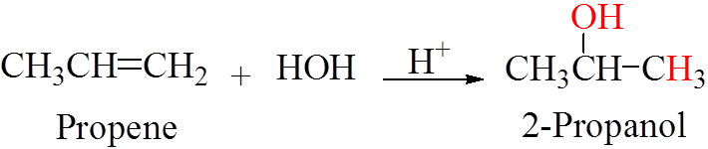
5- Addition of Water : Hydration
Addition of HOH across the double bond is in accordance with Markovnikov’s rule, as the example

Slide 27
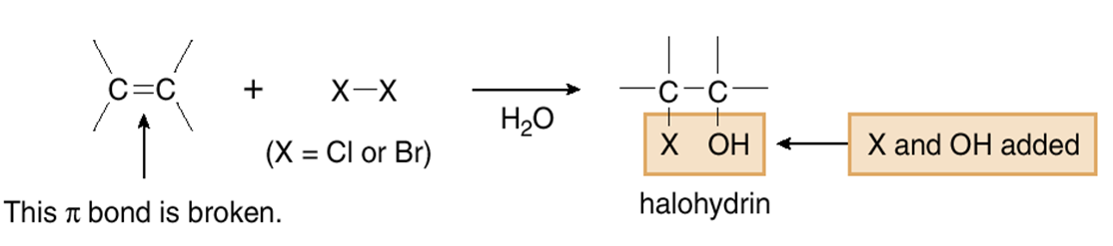
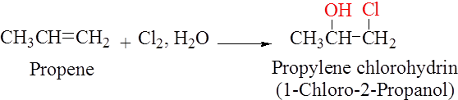
6- Addition of HOX : Halohydrin Formation
The addition of the chloronium ion, Cl⁺ or bromonium ion, Br⁺ and
the hydroxide ion, OH⁻, follows the Markovnikov’s rule, as the example.

Slide 28
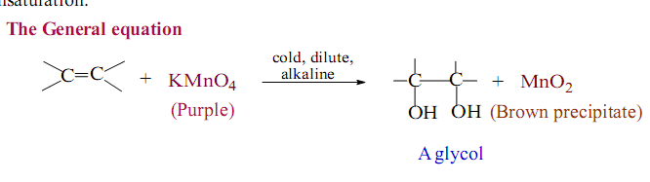
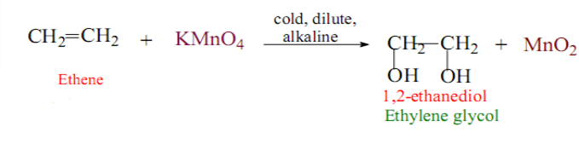
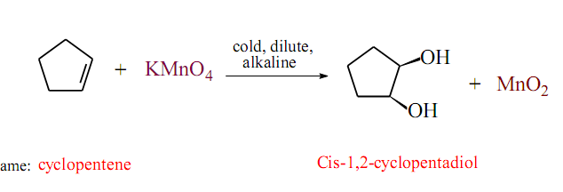
7- Oxidation of alkenes
1) Oxidation of alkenes with Permanganate (Baeyer test)
Examples:
syn hydroxylation

Slide 29
2) Oxidation of alkenes with peroxy acid
anti hydroxylation
Examples:
2,3-butanediol
trans-1,2-cyclohexanediol

Slide 30
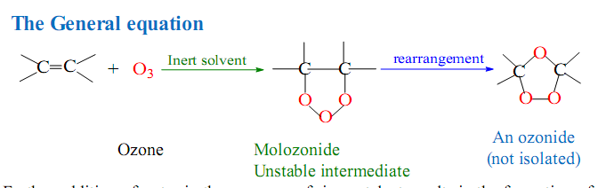
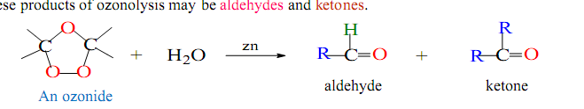
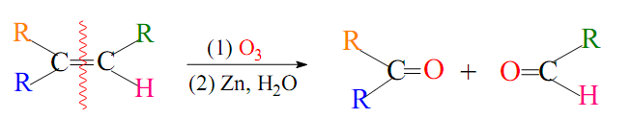
8- Ozonolysis
Oxidation of alkenes by ozone O₃
The ozonolysis reaction can be summarized by the following equation:

Slide 31
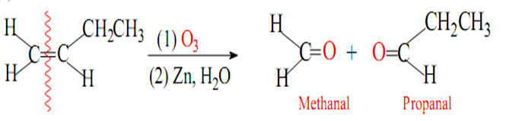
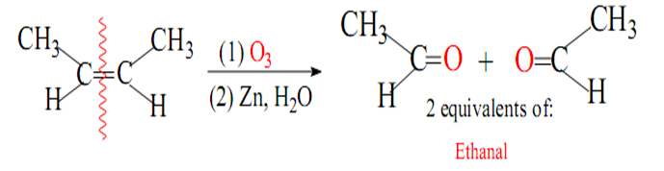
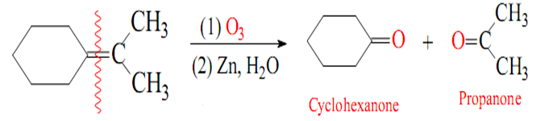
Examples:

Slide 32

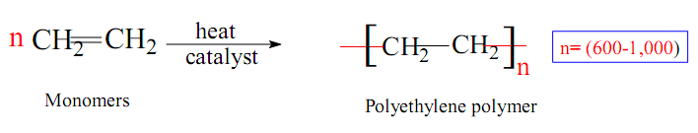


9- Polymerization
A)
B)

Slide 33
Homework
1- Which of the following compounds can exist as cis-trans isomers?
Draw the structures of the geometric isomers.
CH₂=CHCH₂CH₂CH₃
CH₃CH₂CH=CHCH₂CH₃
2- Draw the structures of the following compounds.
a) trans-4-Octene
b) cis-1,2-Dichloropropene
3- Name the following compounds using the E,Z .
4- Write the structure of the major product expected on reaction of
  1-butene with H₂SO₄
  2-methylpropene with aqueous bromine
  1-methylcyclopentene with water
  The ozonolysis of 2-methyl-2-pentene

