Slide 1
Chem. 108
Amines
Chapter 10

Slide 2
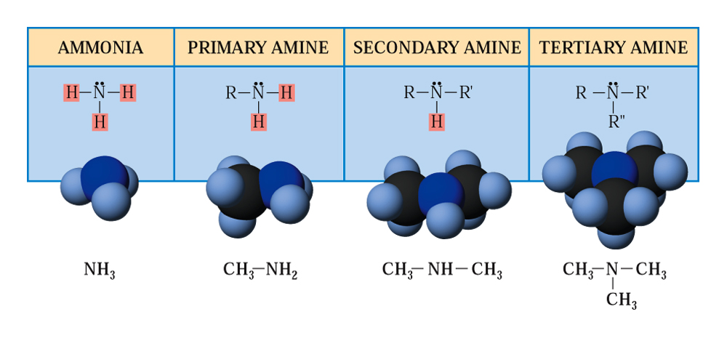
Amines are organic nitrogen compounds, formed by replacing one or more hydrogen atoms of ammonia (NH₃) with alkyl or aryl groups.
Amines are classified as 1°, 2°, or 3° based on the number of alkyl groups bonded to the nitrogen atom.

Slide 3
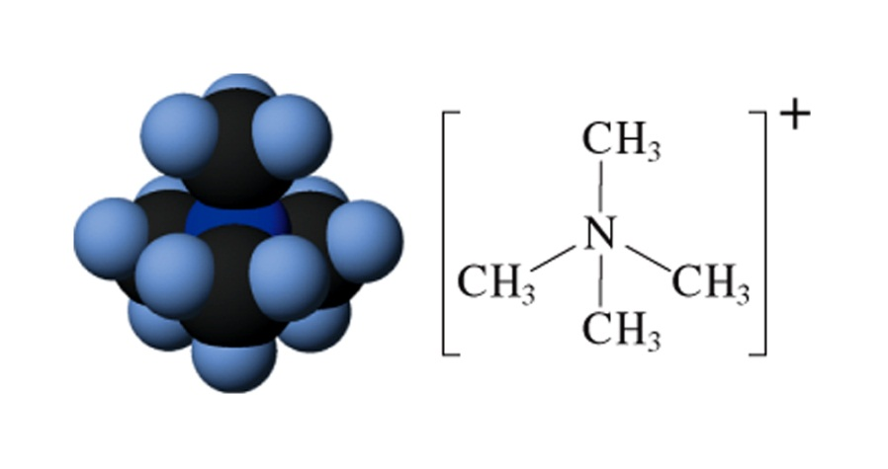
When a fourth group bonds to the nitrogen through this lone pair, the product is a quaternary ammonium ion, which has a positive charge and forms ionic compounds with anions.
Amines are stronger bases and better nucleophiles than other neutral organic compounds.

Slide 4
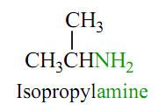
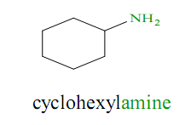
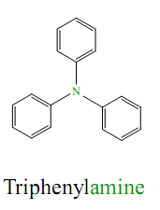
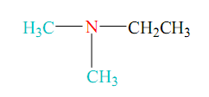
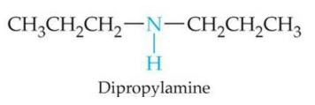
Nomenclature of Amines
Common Name
Name the alkyl group bonded to the nitrogen atom and add the word amine, forming a single word (alkylamine).
Secondary and Tertiary amines having identical alkyl groups are named using the prefix di- or tri- with the name of the primary amine (Dialkylamine or Trialkyamine)
Ethyldimethylamine

Slide 5
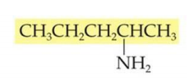
IUPAC System
If the compound does not contain a functional group except amino group, In this system find the longest chain and give it a suitable name and the amino group is considered as substituent, and its position on the chain is indicated by the lowest possible number.
Substituents attached to the nitrogen are indicated by using “N-” as the location number.
Aminomethane
1-Aminopropane
2-Aminopentane
N-Ethyl-1-aminopropane
N,N-Dimethyl-1-aminopropane

Slide 6
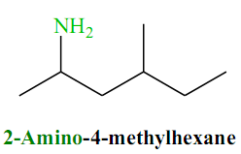
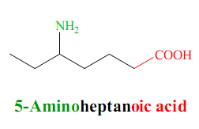
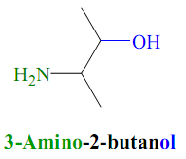
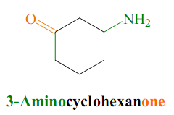
N-Ethyl,N-methyl-1-aminopropane
Nomenclature of multifunctional compounds

Slide 7
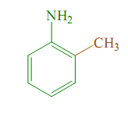
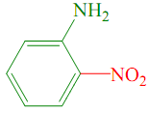
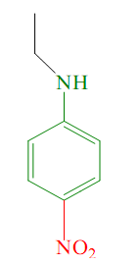
Aromatic amines are named as derivatives of aniline. Substituents attached to the nitrogen are indicated by using “N-” as the location number.
Aniline
2-Methylaniline
2-Nitroaniline
4-Chloro-N-ethyl,N-methylaniline
N-Ethyl-4-nitroaniline

Slide 8
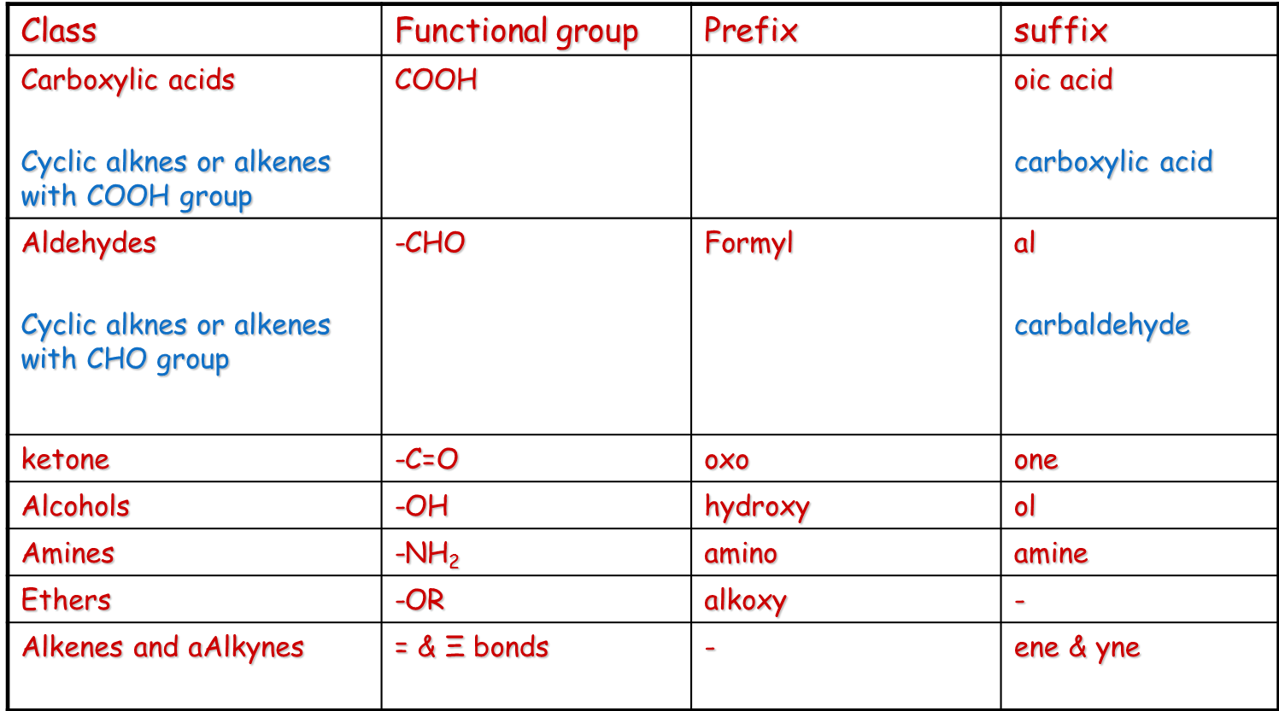
Precedence Order of Functional Groups

Slide 9
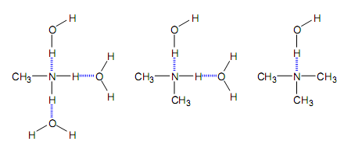
Physical properties of Amines
1. Solubility in water
1°, 2°, and 3° amines with small alkyl groups are very soluble in
water due to hydrogen bonding with the solvent.
Solubility decreases as the molecules get heavier.
Aromatic amines are insoluble in water.

Slide 10
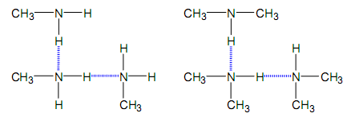
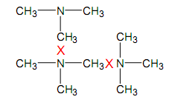
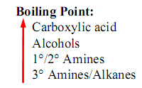
2. Boiling point
1° and 2° amines can hydrogen bond to each other:
3° amines cannot hydrogen bond to each other:

Slide 11
Basicity of Amines
Amines are basic because they possess a pair of unshared
electrons, which they can share with other atoms.
Groups that donate or supply electrons will increase the basicity of amines while groups that decrease the electron density around the nitrogen decrease the basicity of the molecule.
Aromatic amines are less basic strength than aliphatic amines.

Slide 12
Preparation of Amines
1- Reduction of N-containing compounds
(nitro compounds, nitriles, amides, and oximes)
H₂ / Pt
Nitro compounds
or
1) Sn / HCl / 2) NaOH
or
LiALH₄ / dry ether / 2) H₂O
1) Sn / HCl
2) NaOH
Nitrile

Slide 13
Oxime
Amides

Slide 14
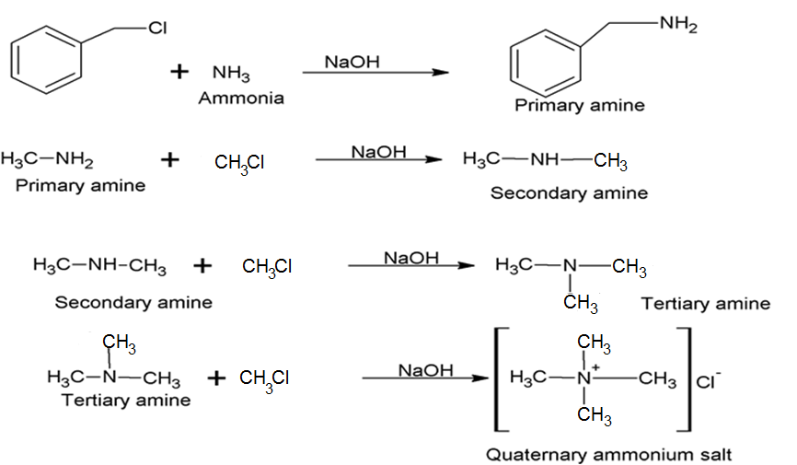
2- Alkylation Of Ammonia
Alkylammonium salt
Tetramethylammonium chloride

Slide 15
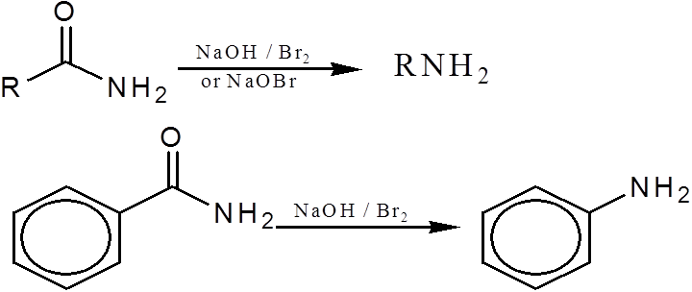
3- Hoffman Degradation Of Amides
By the action of Sodium hypobromite NaOBr
It will reduce 1 carbon atom in this reaction

Slide 16
Reactions Of Amines
Reaction of Amines with Nitrous Acid
Nitrous acid reacts with 1° alkylamines and arylamines to form diazonium salts. This reaction is called diazotization.
2° Alkylamines and aryl amines react with nitrous acid to form N-nitrosamines.

Slide 17
3° Alkylamines react with nitrous acid to form
Water -soluuble ammoium salts.
3° aryl amines react with nitrous acid to form
p-nitroso aromatic compounds

Slide 18
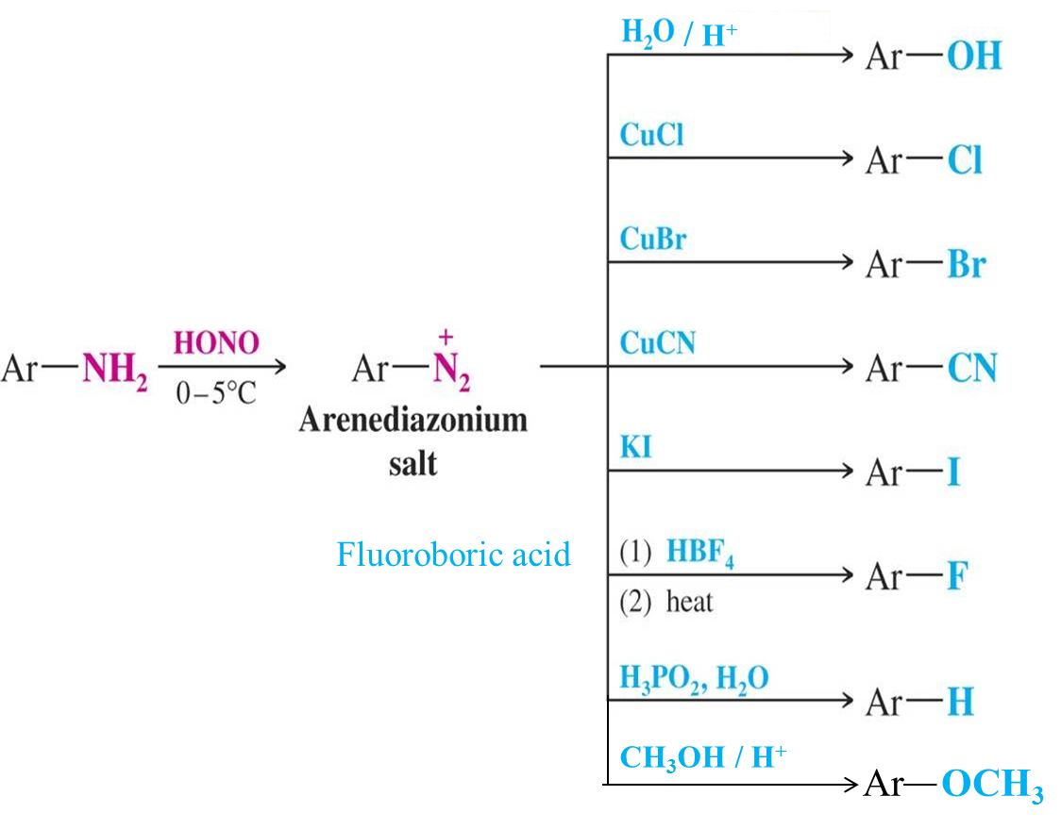
Fluoroboric acid

Slide 19
Halogenation

