Slide 1
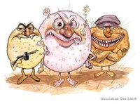
Factors affecting bacterial growth

Slide 2
Factors affecting bacterial growth are:
Oxygen requirement.
Osmotic pressure (salt tolerance).
PH.
Temperature requirement.

Slide 3
Oxygen requirement
Bacteria are divided according to Oxygen requirement:
Strict aerobes: grow only in presence of oxygen.
Strict anaerobes: grow only in absence of oxygen.
Facultative anaerobes: grow in presence or absence of oxygen.
Microaerophilic organisms: grow in small amount of oxygen.
Notes:
Strict aerobe ex pseudomonas, strict anaerobe ex bacteroides, facultative ex E.coli, microaerophilic ex: campylobacter

Slide 4
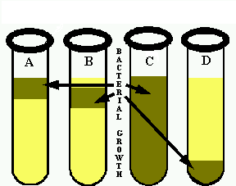
Oxygen requirement
O2 conc.
High
Low
Notes:
A: strict aerobe, B :microaerophilic, C:Facultative anaerobe, D: microaerophilic

Slide 5
In our bodies
The aerobic places: skin, eye, mouth, throat, nose.
The anaerobic places: deep in tissue, large intestine.
The micro aerobic: upper part of stomach.

Slide 6
How to achieve anaerobic condition:
GasPak Anaerobic Technique
This system uses a Gas generator kit, which contains chemicals to consume the oxygen present in the jar upon the addition of water. It should be in sealed jar.
Chemial+H2O-----> H2 + CO2
A Palladium catalyst in the lid of the jar is to increase the reaction between H2 and O2 to form H2O.
Incubate at 37°C, for 24- 48 hrs.

Slide 7
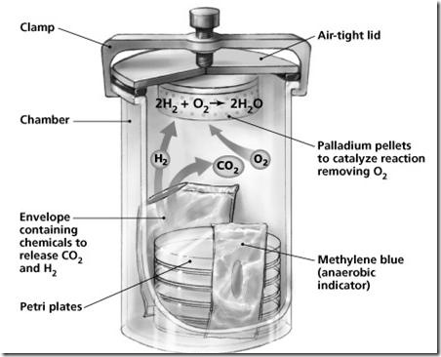
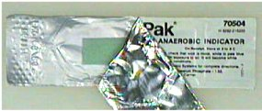

Slide 8
Anaerobic indicators
1- Chemical indicator:
Use anaerobic indicator strip: Methylene blue, It is a yellow strip and it turns green or blue in the presence of O2.
2- Biological indicator:
Strict aerobic bacteria, if it didn’t grow that means anaerobic condition.
Or :
Strict anaerobe bacteria, if it grows that’s mean anaerobic condition.

Slide 9
Salt Tolerance
The effect to which salt concentration causes changes in bacterial growth depends on the osmotic balance required for such growth.
Some bacteria require a high level of salt to grow, whereas other bacteria would be killed in high levels of salt.

Slide 10
Low salt conc.= 1% NaCl (1 g of NaCl in 100 g of NA).
Moderate salt conc.= 5% NaCl (5 g of NaCl in 100 g of NA).
High salt conc./ halophilic= 9% NaCl (9 g of NaCl in 100 g of NA).
Notes:
Low salt tolerant ex strep B, Moderate salt tolerant ex E.coli, High salt tolerant ex staph

Slide 11
PH
Most bacteria grow between pH 6.5 - pH 7.5 (neutral pH) especially pathogenic and food spoilage bacteria.
Optimum pH range is usually quite narrow so that small changes in the pH can have large effects on the growth rate of the organism.

Slide 12
Acidophilic microbes :very few can grow below pH 4.0 ( yeast and molds have much greater tolerance to acidic pH).
Alkalophilic microbes: very few can grow above pH 8.0

Slide 13
Temperature
Psychrophiles : cold loving microbes.
(-10˚C - 20˚C)
Mesophiles : moderate temp. loving microbes
20˚C - 45˚C (most pathogens)
Thermophiles : heat loving microbes
45˚C - 100˚C

Slide 14
Student work and report
Sbculture both E.coli and bacteroides on 2 BA, and incubate one plate in aerobic and the other in anaerobic condition.
Subculture strep group B, Ecoli, and staph on NA(1% Nacl, 5% Nacl,9% Nacl)
O2
E.coli /Bacteroides
No O2
E.coli/ Bacteroides

