Slide 1
Course - 222
Descriptive Histology
Introduction

Slide 2
PRACTICAL TIME TABLE | FINAL MARKS 25%
DRAWING BOOK | 5 MARKS
QUIZ | 5 MARKS
FINAL PRACTICAL EXAMINATION | 15 MARKS
TOTAL | 25%

Slide 3
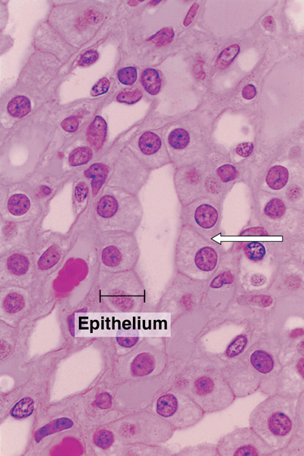
HISTOLOGY
It is the microscopic study of normal human cells and tissues.
Types of Microscopes:
1-Light microscopes (LM) (colored)-student microscope, use the day light or electric light as a source of illuminations. 2-Electron Microscopes (EM)
Hematoxyline and Eosin (H&E) is a routine stain.
Hematoxyline is an basic stain so it stains the acidic components of the cell, as DNA & RNA (nucleus ) gives dark blue.
Eosin is an acidic stain so it stains the basic components of the cell
(cytoplasm) gives pink.

Slide 4
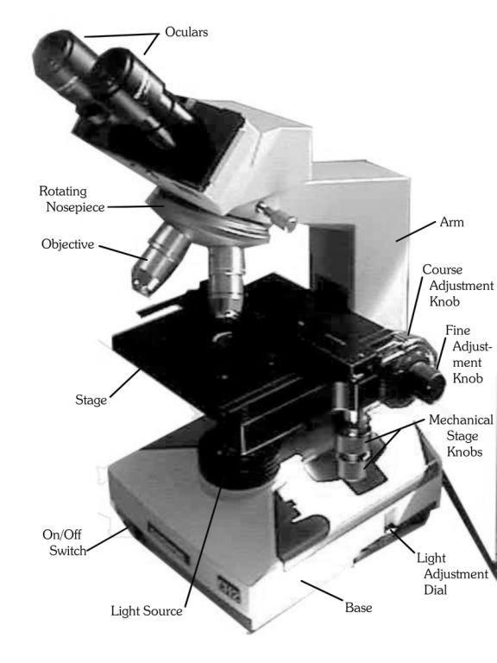
A light microscope showing its main components

Slide 5
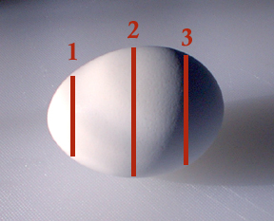
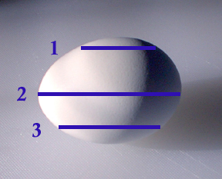
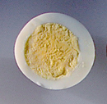
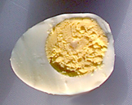
Cross section / longitudinal section
Cross (transverse) section (T.S)
longitudinal section (L.S)

