Slide 1
Different methods for insect collection and preservation
Presented by: hessa al-obaid

Slide 2
Goals of sample collection
As a hobby.
Measure biodiversity.
Detect changes in water quality.
Acquire material for biological, physiological, ecological and molecular studies.
Because of the incredible diversity of insects, we must select an appropriate tool and an appropriate way for collection.

Slide 3
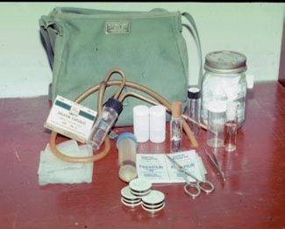
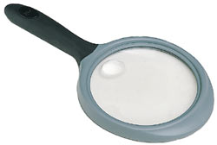
Equipment and Collecting Methods
Equipment or appropriate tool
Forceps, Vials containing alcohol or other preservatives
Killing jars, Small boxes for storing specimens after their removal from killing jars.
aspirators.
Notebook
A strong knife, hand lens
A small, fine brush for picking up minute specimens.

Slide 4
Method or appropriate way:
1-picking up insects by hand
This method is simple and sometimes effective, with large terrestrial insects, Such as cockroaches where they are picked by hand and put it in a bottle.

Slide 5
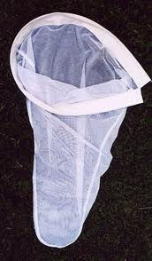
2-Collecting Nets
Collecting nets come in three basic forms:
Aerial nets is designed especially for collecting butterflies and other flying insects. Both the bag and handle are relatively lightweight
Aquatic nets are used for gathering insects from water.

Slide 6
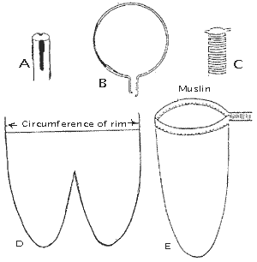
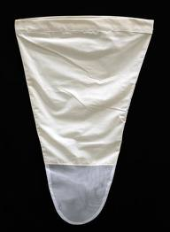
Sweeping Nets: Made of thick fabric
used in the compilation of most types of insects on crops such as wheat and clover ring, potatoes, herbs and grasses.

Slide 7
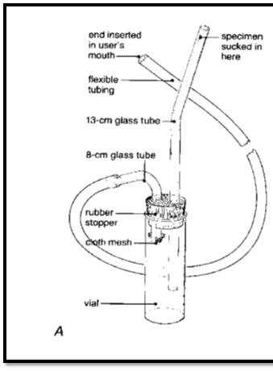
3- aspirator
is effective device for collecting small insects. The following materials are

Slide 8
4-Beating Sheets
Beating sheet should be made of durable fabric, preferably white, attached to a frame about 1 m.
Place it under a tree and sharply beat the branches or foliage with a club or stick.
Specimens will fall onto the sheet and may be removed from the light-colored material by hand or with forceps, a moistened brush, or an aspirator.
useful in collecting beetles, true bugs, and larval Lepidoptera.

Slide 9
5-Sifters
In In this way use kind of Sifters or Berlese funnel
to collect insects that live in ground litter, rotting wood, fungi, shore.
The size of the mesh depends on the size of the specimens sought.
To use the sifter, place the material to be sifted into the container and shake it gently over a white pan or piece of white fabric. As the insects and mites fall onto the fabric, they may be collected with forceps, a brush, or aspirator

Slide 10
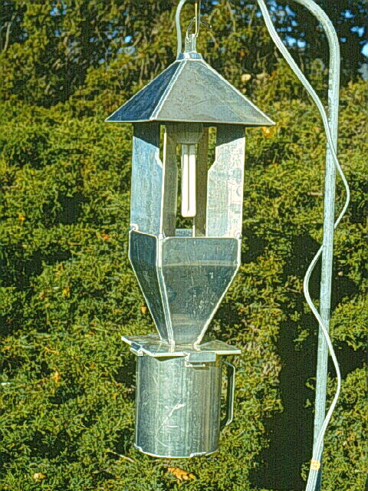
6- Traps
light traps
With light traps, advantage is taken of the attraction of many insects to a light source which increasingly active at night

Slide 11
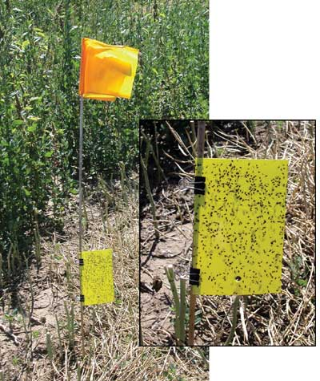
Sticky traps
using in the collection of insects active at night and day, a cylinder or a glass tube coated with an adhesive, and placed on the pillar to the desired height then, stud and identify the insects stuck

Slide 12
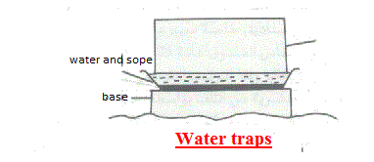
Water traps
using to collect many kinds of insects such as flies, which is a time painted from the inside in yellow or white to attract insects to it.

Slide 13
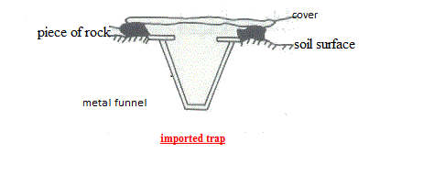
Imported traps
This method is used in the compilation of terrestrial insects such as ants. This traps are composed of glass container or plastics with a wide mouth jar and drown in a hole under the surface of the soil

Slide 14
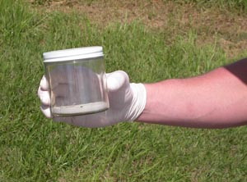
killing insect
After collecting living insects, put in jars.
These bottles have different sizes and tight lid, chemicals are added to kill insects.
The most important chemicals used to kill insects Cianorsodium or potassium, chloroform and ethyl acetate.

Slide 15
Preservation insect
Dry preservation:
used with insect have a hard outer cover to dry in good condition. Then kept Samples in special boxes made ​​of wood with tightly closed.
labeled.
Avoid placing specimens collected at different times or places in the same container The process of pinning the insect immediately after killing and before the dry stick a pin vertically in the chest area, so that leaves about 4 / 1 pin along the top body

Slide 16
Liquid Preservation
used to save the insects that are difficult to maintain dry, or the insect collected by light traps in large numbers.
Save by microscopic slides
used in the maintenance of very small insects which are placed in a liquid then carry on slides Such as fleas, aphid
Most species have soft bodies
save some parts of the body such as insect legs, antennae, wings and mouth parts

Slide 17
temporarily stored
placing specimens with the wings folded together dorsally (upper sides together) in folded triangles or in small rectangular envelopes of glassine paper, which are the translucent envelopes familiar to stamp collectors.
Lepidoptera temporaily stored in paper and glassine

