Slide 1
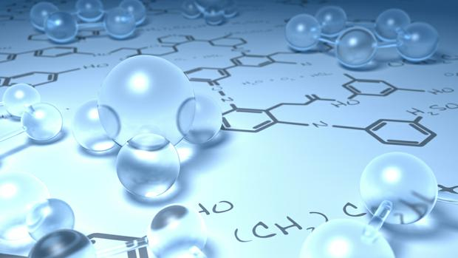
By
Dr. Mohamed El-Newehy
Chemistry Department, College of Science, King Saud University
http://fac.ksu.edu.sa/melnewehy

Slide 2
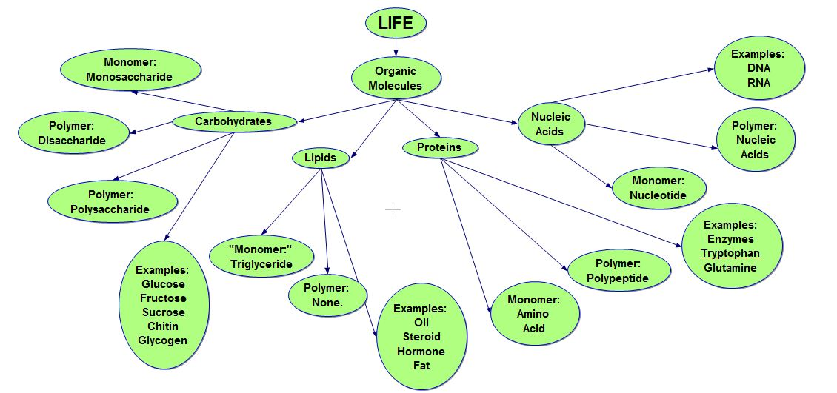
What Is Organic Chemistry?
The term organic suggests that this branch of chemistry has something to do with organisms, or living things.
Originally, organic chemistry did deal only with substances obtained from living matter.
- In particular, most compounds in living matter are made up of the same few elements: carbon, hydrogen, oxygen, nitrogen, and sometimes sulfur, phosphorus, and a few others.

Slide 3
What Is Organic Chemistry?
Carbon is virtually always present.

Organic chemistry is the chemistry of carbon compounds.
This definition broadens the scope of the subject to include not only compounds from nature but also synthetic compounds — compounds invented by organic chemists and prepared in their laboratories.
Examples:
The clothes, the petroleum products, the paper, rubber, wood, plastics, paint, cosmetics, insecticides, and drugs.

Slide 4
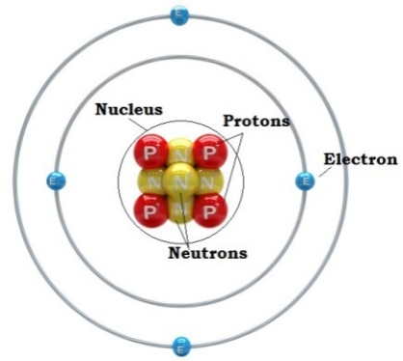
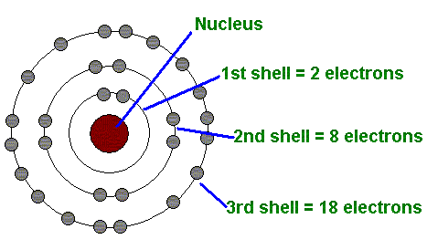
Atomic Structure
Atoms consist of three main particles: neutrons (have no charge), protons (positively charged) and electrons (negatively charged).
Neutrons and protons are found in the nucleus.
Electrons are distributed around the nucleus in successive shells (principal energy levels).
- The atomic number of an element is equal to the number of protons in its nucleus (and to the number of electrons around the nucleus in a neutral atom).
- The atomic weight is approximately equal to the sum of the number of protons and the number of neutrons in the nucleus
- The energy levels are designated by capital letters (K, L, M, N, ..).
- The maximum capacity of a shell = 2n² electrons.
n = number of the energy level.

Slide 5
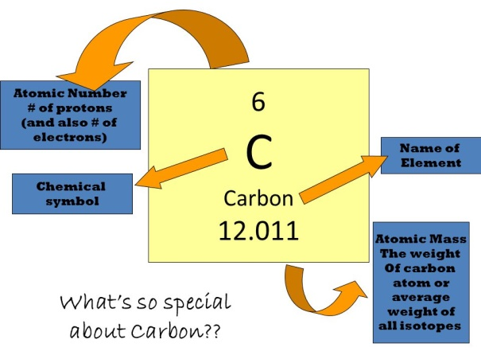
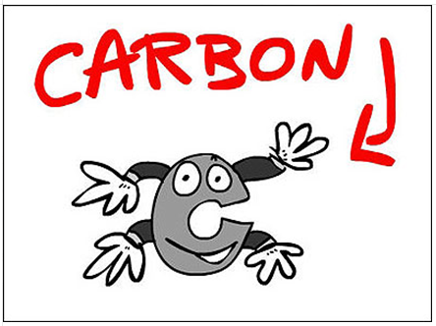
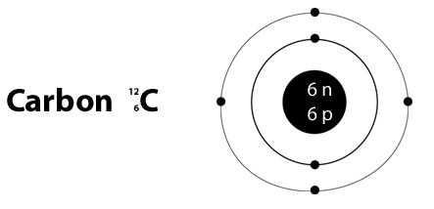
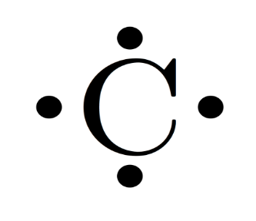
Atomic Structure
- For example, the element carbon (atomic number 6)
- Electron-dot structures
The symbol of the element represents the core of the atom and the valance electrons are shown as dots around the symbol.
Valance Electrons are those electrons located in the outermost energy level (the valance shell).

Slide 6
Types of Chemical Bonding
- In 1916 G.N. Lewis pointed out that:
The noble gases were stable elements and he ascribed their lack of reactivity to their having their valence shells filled with electrons.
2 electrons in case of helium.
8 electrons for the other noble gases.
- According to Lewis,
in interacting with one another atoms can achieve a greater degree of stability
by rearrangement of the valence electrons to acquire the outer-shell structure of the closest noble gas in the periodic table.
- Types of Chemical Bonding
A) Ionic Bonding
B) Covalent Bonding

Slide 7
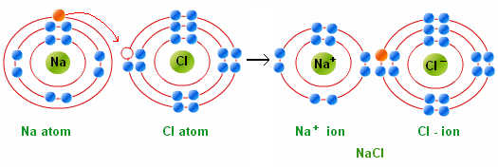
Types of Chemical Bonding
A) Ionic Bonding
Ionic bonds are formed by the transfer of one or more valence electrons from one atom to another.
- The atom that gives up electrons becomes positively charged, a cation.
- The atom that receives electrons becomes negatively charged, an anion.
Ionic Bond is the electrostatic force of attraction between oppositely charged ions.
- The majority of ionic compounds are inorganic substances.

Slide 8
Types of Chemical Bonding
B) Covalent Bonding
A covalent bond involves the mutual sharing of one or more electron pairs between atoms.
- Elements that are neither strongly electronegative nor strongly electropositive, or that have similar electronegativities, tend to form bonds by sharing electron pairs rather than completely transferring electrons.
- When the two atoms are identical or have equal electronegativities, the electron pairs are shared equally

Slide 9
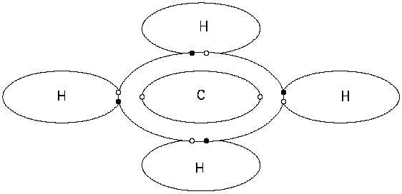
Types of Chemical Bonding
B) Covalent Bonding
For example, carbon combines with four hydrogen atoms (each of which supplies one valence electron) by sharing four electron pairs.
The substance formed is known as methane.
A polar covalent bond
A bond, in which an electron pair is shared unequally.
The more electronegative atom assumes a partial negative charge and the less electronegative atom assumes a partial positive charge.

Slide 10
Atomic Orbitals
- An atomic orbital represents a specific region in space in which an electron is most likely to be found.
- Atomic orbitals are designated in the order in which they are filled by the letters s, p, d, and f.
- Examples:
K shell has only one 1s orbital.
L shell has one 2s and three 2p (2p_{x}, 2p_{y} and 2p_{z}).
- An s orbital is spherically shaped electron cloud with the atom’s nucleus and its center.
- A p orbital is a dumbbell-shaped electron cloud with the nucleus between the two lobes.

Slide 11
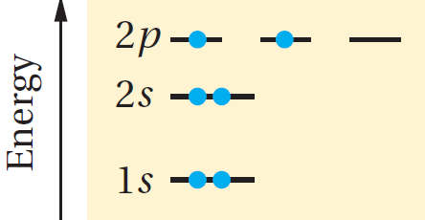
Atomic Orbitals
- An energy level diagram of atomic orbitals.
- The electronic configuration of carbon (atomic number 6) can be represented as
1s²2s²sp¹_{x}2p¹_{y} or 1s²2s²2p²

Slide 12
Molecular Orbitals
- A covalent bond consists of the overlap between two atomic orbitals to form a molecular orbital.
- Example: Molecular orbital of H₂

Slide 13
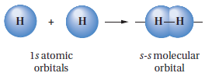
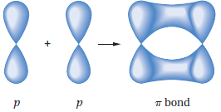
Sigma and pi Bonds
- Sigma bonds (σ bonds) can be formed from
The overlap of two s atomic orbitals.
The overlap of two an s atomic orbital with a p atomic orbital.
The end-on overlap of two p atomic orbitals.
- pi bonds (π bonds) can be formed from
The side-side overlap between two p atomic orbitals.

Slide 14
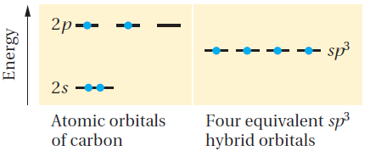
Hybridization
Carbon sp³ Hybrid Orbitals
- The electronic configuration of the isolated or ground-state carbon
1s²2s²2p_{x}¹2p_{y}¹
Equivalent to
- Mix or combine the four atomic orbitals of the valence shell to form four identical hybrid orbitals, each containing one valence electron. In this model, the hybrid orbitals are called sp³ hybrid orbitals because each one has one part s character and three parts p character
- Each sp³ orbital has the same energy: less than that of the 2p orbitals but greater than that of the 2s orbital.

Slide 15
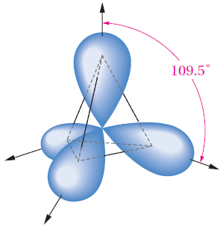
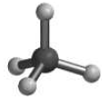
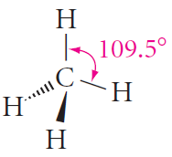
Hybridization
Carbon sp³ Hybrid Orbitals
- The angle between any two of the four bonds formed from sp3 orbitals is approximately 109.5°.
- Regular tetrahedron
- The tetrahedron is a pyramid-like structure with the carbon atom at the center and the four attached atoms located at a corner.

Slide 16
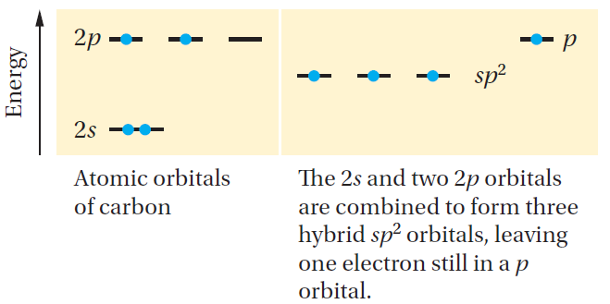
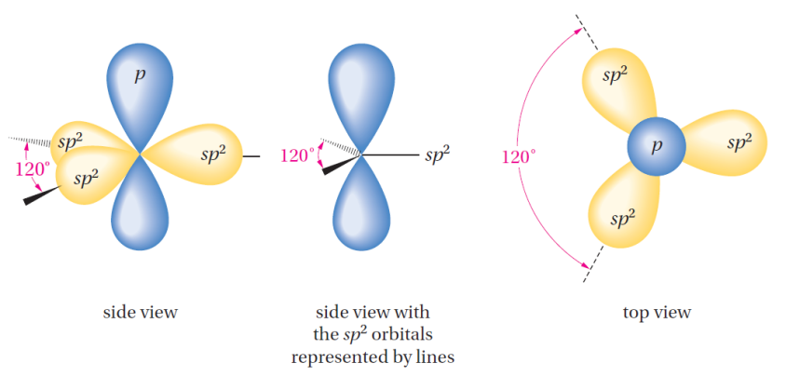
Hybridization
Carbon sp² Hybrid Orbitals
- Combine only three of the orbitals, to make three equivalent sp²-hybridized orbitals (called sp² because they are formed by combining one s and two p orbitals)
- Three valence electrons are placed in the three sp² orbitals. The fourth valence electron is placed in the remaining 2p orbital, whose axis is perpendicular to the plane formed by the three sp² hybrid orbitals
- The angle between them is 120°.
- A trigonal carbon

Slide 17
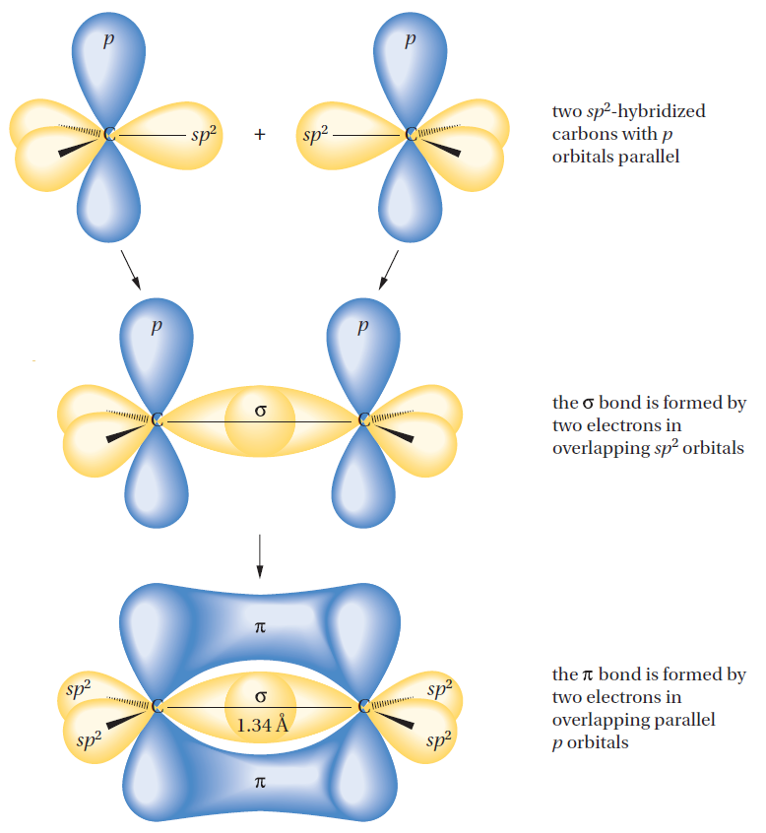
Hybridization
Carbon sp² Hybrid Orbitals
Schematic formation of a carbon–carbon double bond. Two sp2 carbons form a sigma (s) bond (end-on overlap of two sp2 orbitals) and a pi (p) bond (lateral overlap of two properly aligned p orbitals).

Slide 18
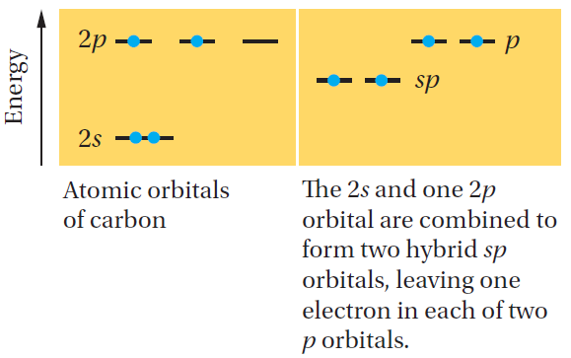
Hybridization
Carbon sp Hybrid Orbitals
- The carbon atom of an acetylene is connected to only two other atoms. Therefore, we combine the 2s orbital with only one 2p orbital to make two sp-hybrid orbitals
- The angle between the two hybrid orbitals is 180°
- Linear

Slide 19
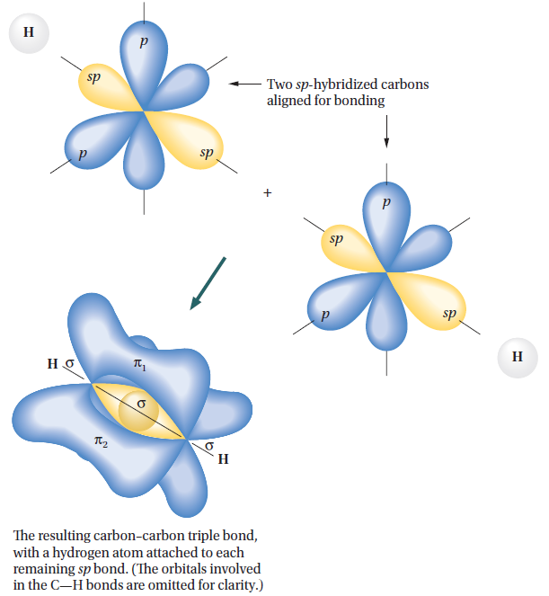
Hybridization
Carbon sp Hybrid Orbitals
A triple bond consists of the end-on overlap of two sp-hybrid orbitals to form a σ bond and the lateral overlap of two sets of parallel-oriented p orbitals to form two mutually perpendicular π bonds.

Slide 20
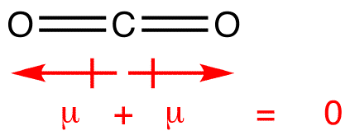
Bond Polarity and Dipole moment (µ)
- A polar bond is a covalent bond between two atoms where the electrons forming the bond are unequally distributed.
- A nonpolar bond is a covalent bond between two atoms where the electrons forming the bond are equally distributed.
- A dipole moment ​is a measurement of the separation of two oppositely charged.
- Dipole moments are a vector quantity.
- The magnitude is equal to the charge multiplied by the distance between the charges and the direction is from negative charge to positive charge.

Slide 21
Inductive Effect
- An inductive effect is an electronic effect due to the polarization of σ bonds within a molecule or ion.
- This is typically due to an electronegativity difference between the atoms at either end of the bond.
- This is the electron-withdrawing inductive effect, also known as the -I effect
- This is electron releasing character and is indicated by the +I effect

Slide 22
Acid-Base Concept
In the Brønsted–Lowry definitions (1923),
An acid is a species that donates a proton, and a base is a species that accepts a proton (or any compound possessing a lone pair).
- Example:
Hydrogen chloride (HCl) meets the Brønsted–Lowry definition of an acid because it donates a proton to water.
Water meets the definition of a base because it accepts a proton from HCl.
In the reverse reaction, H₃O⁺ is an acid because it donates a proton to Cl⁻, and Cl⁻ is a base because it accepts a proton from H₃O⁺.
- When a compound loses a proton, the resulting species is called its conjugate base.
Thus, Cl⁻ is the conjugate base of HCl, and H₂O is the conjugate base of H₃O⁺
Thus, HCl is the conjugate acid of Cl⁻ and H₃O⁺ is the conjugate acid of H₂O
- Acidity is a measure of the tendency of a compound to give up a proton.
- Basicity is a measure of a compound’s affinity for a proton.

Slide 23
Acid-Base Concept
In 1923, G. N. Lewis offered new definitions for the terms “acid” and “base.”
He defined an acid as a species that accepts a share in an electron pair.
a base as a species that donates a share in an electron pair.
- Lewis acid such as aluminum chloride (AlCl₃) boron trifluoride (BF₃) and borane (BH₃).
The term “acid” is used to mean a proton-donating acid, and the term “Lewis acid” is used to refer to non-proton-donating acids such as AlCl₃ or BF₃.
- All bases are Lewis bases because they have a pair of electrons that they can share, either with an atom such as aluminum or boron or with a proton.

Slide 24
Functional Groups
It is a reactive portion of an organic molecule, an atom, or a group of atoms that confers on the whole molecule its characteristic properties.
Class | General formula | Functional group | Specific
Alkane | RH | C – C (single bond) | H₃C – CH₃
Alkene | R – CH = CH₂ | C = C (double bond) | H₂C = CH₂
Alkyne |  | (triple bond)
Alkyl halide | RX | X (X = F, Cl, Br, I) | H₃C - Cl
Alcohol | R – OH | OH | H₃C - OH
Ether | R – O –R’ | - C- O – C - | H₃C – O – CH₃
Aldehyde
Ketone
Carboxylic acid
Ester
Amine | R – NH₂ |  | H₃C – NH₂

Slide 25
