Slide 1
Fundamentals of Organic Chemistry
CHEM 109
For Students of Health Colleges
Credit hrs.: (2+1)
King Saud University
College of Science, Chemistry Department
Syllabus

Slide 2
Syllabus
Introduction
Types of chemical bonds: (Ionic and covalent bonds) - Atomic and molecular orbital: (sigma and pi bond) - Hybridization (sp³, sp², sp) - Inductive effect, polarization, and Stability of carbocation's - Classification of organic compounds and functional groups - Types of chemical reactions: (Substitution (Free radical - electrophilic - nucleophilic), Elimination, Oxidation and reduction reactions).
Lectures (2)
Aliphatic Hydrocarbons
Classes of hydrocarbons: (saturated and unsaturated) – Nomenclature: (IUPAC and common names) – Isomerism: (Structural and Geometrical) - Physical properties of aliphatic hydrocarbons - Preparation of saturated hydrocarbons (Alkanes): (Hydrogenation of unsaturated hydrocarbons - Hydrolysis of alkyl Grignard reagent - Reaction of lithium dialkyl cuprates with alkyl halides) - Reactions of saturated hydrocarbons: (Halogenations) - Preparation of Unsaturated hydrocarbons: (Alkenes and Alkynes): (Elimination reactions (Dehydration, dehydrohalogenation and dehalogenation reactions) and Saytzeff rule) - Reactions of Unsaturated hydrocarbons: (Electrophilic addition reactions (Markovnikov's rule), hydrogenation, halogenation, hydrohalogenation, and hydration - Oxidation reactions - Acidity of alkynes).
Lectures (4)

Slide 3
Syllabus
Aromatic compounds
Aromaticity: structure and bonding requirements and Hückel's rule - Nomenclature of aromatic compounds - Electrophilic aromatic substitution reactions: (Alkylation, acylation, halogenations, nitration and sulfonation) - Effects of substituents on electrophilic aromatic substitution reactions - Side-chain reactions: (Oxidation of alkylbenzenes).
Lectures (2)
Alcohols, Phenols and Ethers
Structure, classifications and nomenclature - Physical properties - Preparation of alcohols and phenols: (Hydration of alkenes - Nucleophilic substitution reaction of alkyl halides - Reduction of aldehydes, ketones and acids - Addition of Grignard compounds to aldehydes and ketones) - Preparation of Phenols: (Benzene sulfonic acids) - Preparation of ethers (Williamson synthesis) - Reactions of Alcohols, Phenols and Ethers: (Salt formation of alcohols and phenols (Acidity of phenols and Reaction of Alcohols with Sodium metal) - Reactions of Alcohols and Ethers with Hydrogen halides - Conversion of Alcohols to alkyl halides - Oxidation of alcohols - Electrophilic substitution reactions of phenols) - Alcohols with More Than One Hydroxyl Group; glycols.
Lectures (4)
1st Midterm Exam

Slide 4
Syllabus
Aldehydes and Ketones
Structure and Nomenclature - Physical properties - Preparation of aldehydes and ketones: (Hydration of alkynes - Ozonolysis of alkynes - Friedel-Crafts acylation - Oxidation of alcohols) - Reactions of aldehydes and ketones: (Nucleophilic addition reaction (addition of hydrogen cyanide, Reduction, Grignard addition, addition of Alcohol (hemiacetal and acetal Formation), addition of ammonia and amine derivatives).
Lectures (3)
Carbohydrates
Definitions and Classification (monosaccharides, disaccharides and polysaccharides) – Monosaccharides: (Nomenclature - Structure (Optical isomerism, cyclic structure, Fischer Projection, Haworth Formulas)) - Reactions of Monosaccharides: (Reduction and oxidation of monosaccharides) – Disaccharides: (Maltose, Cellobiose, Sucrose and Lactose) – Polysaccharides: (Cellulose and Starch)
Lectures (4)
Carboxylic acids and Their Derivatives
Structure and Nomenclature - Physical properties - Acidity of Carboxylic acids - Preparation: (Hydrolysis of nitrile - Carbonation of Grignard reagents) - Reactions of carboxylic acids: (Salt Formation - Ester, amide, anhydride, and acid chloride formation).
Lectures (3)

Slide 5
Syllabus
Amines
Structure of amines - Nomenclature of amines - Physical properties of amines - Basicity of amines - Preparation of amines: (Reduction of nitro compounds, nitriles and amides - Alkylation of ammonia) - Reactions of amines: (Sulfa drugs - Diazonium salts (Formation and Replacement reactions)
Lectures (2)
2nd Midterm Exam
Amino Acids, Peptides, and Proteins
- Sources, classification and Structure - The acid–base Properties of Amino Acids - Reactions of amino acids: (The Ninhydrin Reaction, Peptides - Sanger reaction - Formation of an amide linkage (The peptide bond: Proteins)) - Structure of proteins.
Lectures (4)
Nucleic Acids
Chemical Structure: (General structure (Nucleoside, Nucleotide and Nucleic acids) - DNA; structure - RNA; structure and types).
Lectures (2)
Final Exam

Slide 6
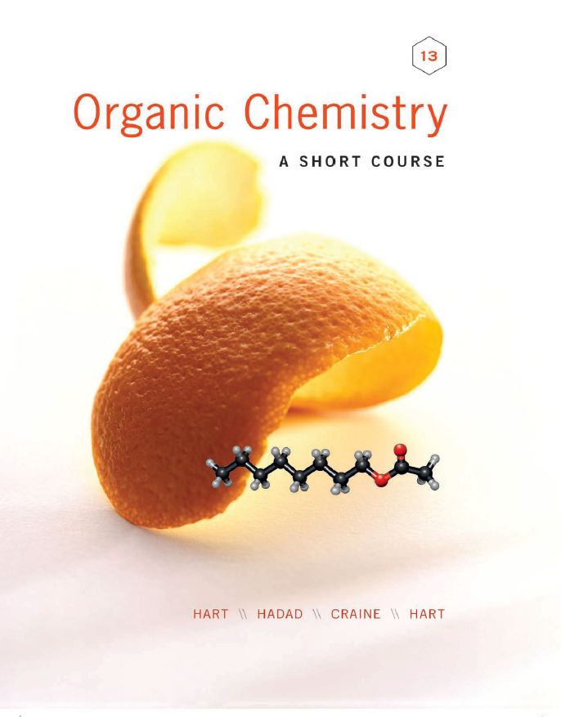
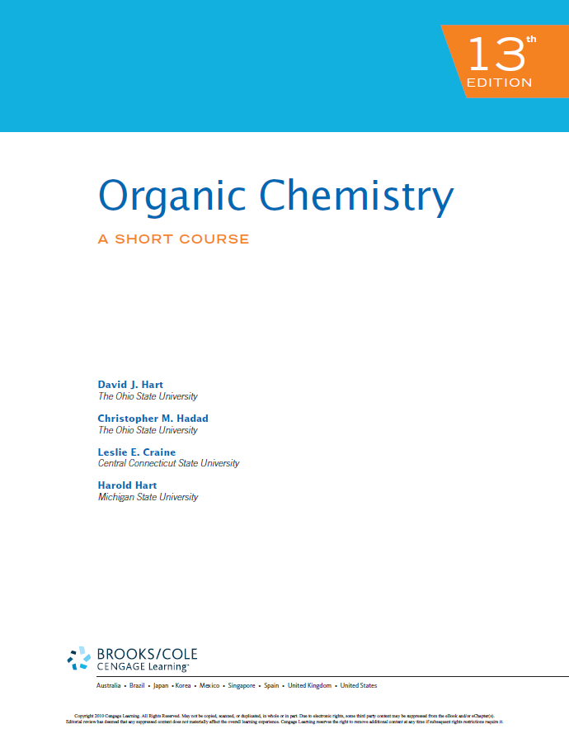
References
Organic chemistry: A short course by I Harold Hart, David J. Hart and Leslie E. Craine, Houghton Mifflin Company, USA, 2012.
Elements of Organic Chemistry (second edition) is written by Isaak Zimmerman and Henry Zimmerman and published by Macmillan Publishing Co., Inc. New York in 1983.
أسس الكيمياء العضوية - أ.د./ سالم بن سليم الذياب - الناشر: مؤسسة نافثة

Slide 7
ضوابط الاختبار البديل

