Slide 1
Gene therapy

Slide 2
Gene therapy
Gene therapy is a novel treatment method which employs genes or short oligonucleotide sequences as therapeutic molecules, instead of conventional drug compounds. This technique is widely used to treat those defective genes which contribute to disease development.
Gene therapy involves the introduction of one or more foreign genes into an organism to treat hereditary or acquired genetic defects. In gene therapy, DNA encoding a therapeutic protein is packaged within a "vector", which transports the DNA inside cells within the body.

Slide 3
Types of gene therapy
1- Somatic gene therapy:
In somatic gene therapy, the somatic cells of a patient are targeted for foreign gene transfer. In this case the effects caused by the foreign gene is restricted to the individual patient only, and not inherited by the patient's offspring or later generations.
2- Germ line gene therapy:
The functional genes are inserted in the germ cells for example: sperm or eggs. Targeting of germ cells makes the therapy heritable.

Slide 4
Gene therapy approches
1- Classical Gene Therapy:
It involves therapeutic gene delivery and their optimum expression once inside the target cell. The foreign genes carry out following functions.
Produce a product (protein) that the patient lacks.
Produces toxin so that diseased cell is killed.
Activate cells of the immune system to help in killing of diseased cells.
2- non-Classical Gene Therapy
It involves the inhibition of expression of genes associated with the pathogenesis, or to correct a genetic defect and restore the normal gene expression.

Slide 5
Methods of gene therapy
There are mainly two approaches for the transfer of genes in gene therapy:
Transfer of genes into patient cells outside the body (ex vivo gene therapy).
Transfer of genes directly to cells inside the body (in vivo).

Slide 6
Ex vivo gene therapy
Genes are transferred to the cells grown in culture, transformed cells are selected, multiplied and then introduced into the patient.
The use of autologous cells avoids immune system rejection of the introduced cells.
The cells are sourced initially from the patient to be treated and grown in culture before being reintroduced into the same individual.
This approach can be applied to the tissues like hematopoietic cells and skin cells which can be removed from the body, genetically corrected outside the body and reintroduced into the patient body where they become engrafted and survive for a long period of time

Slide 7
In Vivo Gene Therapy
In vivo method of gene transfer involves the transfer of cloned genes directly into the tissues of the patient.
This is done in case of tissues whose individual cells cannot be cultured in vitro in sufficient numbers (like brain cells) and/or where re-implantation of the cultured cells in the patient is not efficient.
Liposomes and certain viral vectors are employed for this purpose because of lack of any other mode of selection.
In case of viral vectors such type of cultured cells were often used which have been infected with the recombinant retrovirus in vitro to produce modified viral vectors regularly. These cultured cells will be called as vector-producing cells (VPCs)). The VPCs transfer the gene to surrounding disease cells.
The efficiency of gene transfer and expression determines the success of this approach, because of the lack of any way for selection and amplification of cells which take up and express the foreign gene.

Slide 8
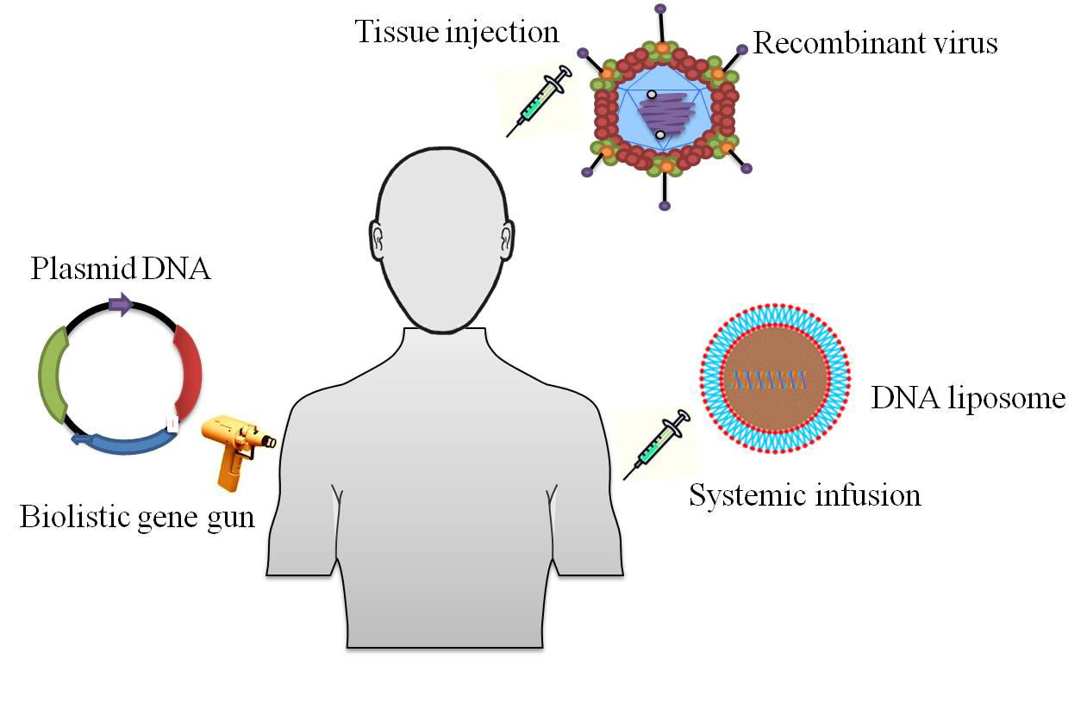
The transgene can also be transferred by viral or non-viral vectors. The recombinant viruses are designed to carry the transgene with tissue specific promoter.
Alternatively, DNA containing the transgene may be injected along with liposome in the patients.
The plasmid DNA is also targeted with the help of mechanical means such as gene gun

Slide 9
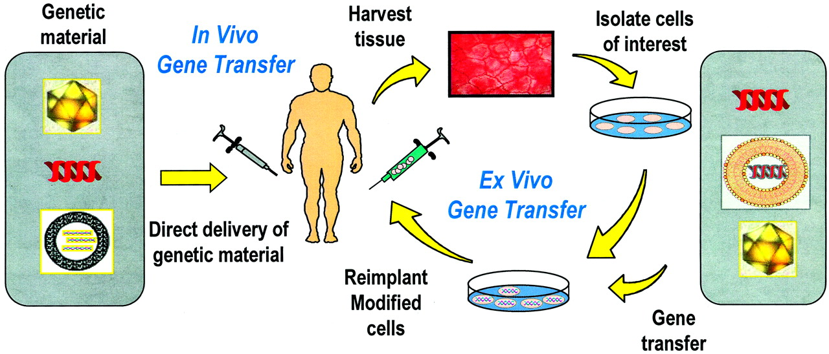
Ex vivo and in vivo gene transfer strategies.
Catherine M. Hoff, and Ty R. Shockley JASN 2002;13:S117-S124
©2002 by American Society of Nephrology
Notes:
Ex vivo and in vivo gene transfer strategies. In ex vivo gene transfer, the cells of interest are removed from the patient and established in cell culture. They are genetically modified by an appropriate gene delivery agent (e.g., naked DNA, liposomes, recombinant viruses) and then infused back into the patient. In in vivo gene transfer, the genetic material is delivered directly to the patient and genetic modification takes place in situ.

Slide 10
Vector for gene therapy
Viral vectors
Non-viral vectors

Slide 11
Viral vectors
Retroviruses, adenoviruses and adeno-associated viruses (AAV) some commonly used viral vectors whereas some less commonly used viral vectors are derived from the Herpes simplex virus (HSV-1).

Slide 12
Adenoviral vectors
Adenoviruses are large linear double-stranded DNA viruses that are commonly used for preparing gene transfer vectors.
the adenoviruses enter cells by receptor-mediated endocytosis. A primary cellular receptor binds to viral fiber then the virus interacts with secondary receptors which are responsible for its internalization. the viral genome is transcribed in the nucleus, mRNA is translated in the cytoplasm.

Slide 13
Retroviral Vectors
Retroviruses are RNA viruses which possess a reverse transcriptase activity, enabling them to synthesize a complementary DNA.
Following infection (transduction), retroviruses deliver a nucleoprotein complex (pre-integration complex) into the cytoplasm of infected cells. The viral RNA genome is reverse transcribed first and then integrates into a single site of the chromosome.

Slide 14
Non- viral vectors
It involves chemical and physical methods such as direct injection of naked plasmid DNA (particle bombardment), receptor-mediated endocytosis and gene transfer through liposomes, polymers, nanoparticles etc.

Slide 15
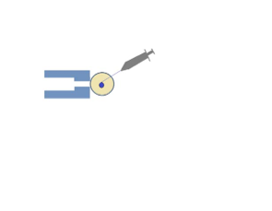
Direct injection/particle bombardment
Injection of naked DNA is the simplest non-viral transfer method. Although clinical trials of this method have been successful, gene expression is much lower with it than with other methods. In addition to tests performed with plasmids, experiments have also been performed with naked PCR products. The cellular uptake of naked DNA is generally inefficient. Researchers have, therefore, focused on improving the efficiency of DNA uptake, which has led to the development of new methods, including the gene gun (bombardment).
Gene gun (bombardment):
the DNA is coated with gold particles and then placed inside a device which provides the required force to enter the cell.
Host cell
Microinjection needle containing foreign DN
Holding pipette
nucleus

Slide 16
Liposomes Mediated
Liposomes are spherical vesicles which are made up of synthetic lipid bilayers which imitate the structure of biological membranes. DNA to be transferred is packaged into the liposome in vitro and transferred to to the targeted tissue. The lipid coating helps the DNA to survives in vivo and enters into the cell by endocytosis.

Slide 17
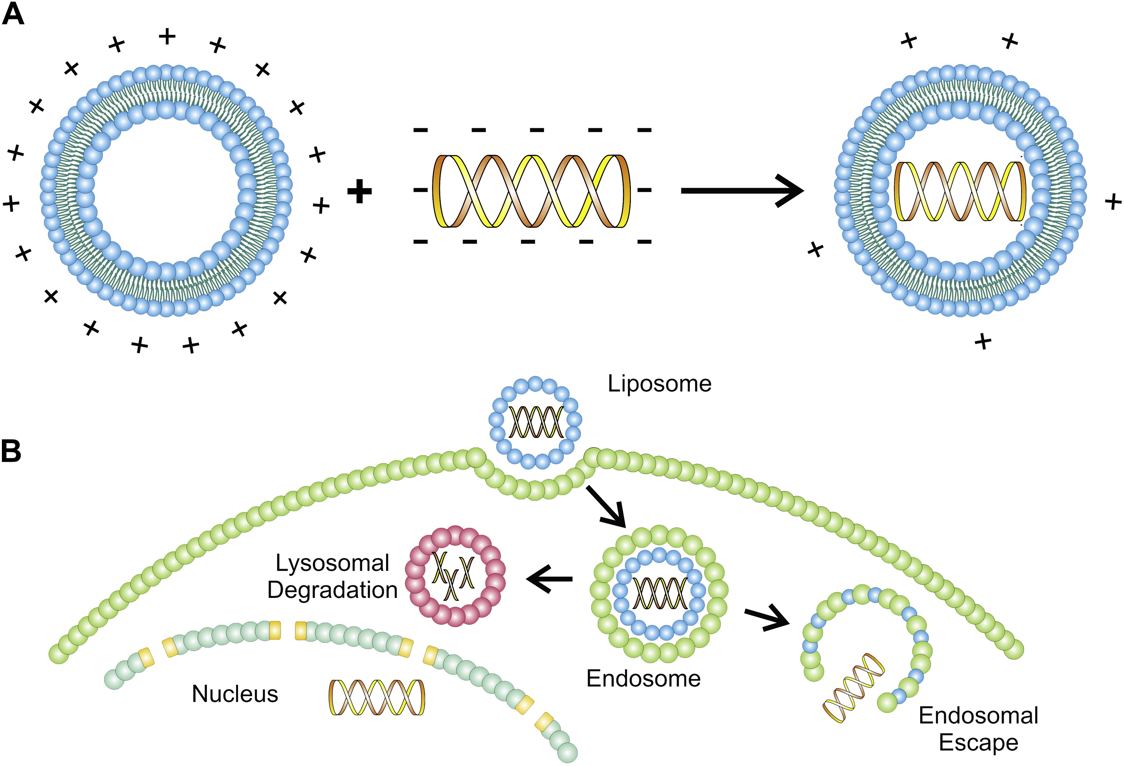
Liposome-mediated transfection and endocytosis. A. Cationic lipids can form micelles that fuse with DNA molecules to form liposomes. B. These liposomes can be internalized by endocytosis, after which the DNA can be released into the cytosol or degraded in lysosomes.

Slide 18
Advantages of Gene Therapy
Gene therapy can cure genetic diseases by addition of gene or by removal of gene or by replacing a mutated gene with corrected gene.
Gene therapy can be used for cancer treatment to kill the cancerous cells.
Gene expression can be controlled.
Therapeutic protein is continuously produced inside the body which also reduces the cost of treatment in long term.

Slide 19
Disadvantages of Gene Therapy
Stimulation of immune response: The gene injected by a virus may cause immune responses due to the presence of the virus inside the body.
Generation of genetic disorders due to the presence of multigene: The genetic material transferred may not necessarily enter the target cell; even if it does, it may not be placed at an appropriate place in the genome .

Slide 20
Applications of gene therapy
Parkinson’s disease, Alzeheimer’s disease and Cystic fibrosis.
Presentation

